Slide 1
Prolong screen time effect among school going children in Bangladesh during Covid-19 pandemic school-closure
Presented by:
Dr. Tanita Noor
ID No. 2131365
Department of Public Health
School of Pharmacy and Public Health
Independent University, Bangladesh (IUB)

Slide 2
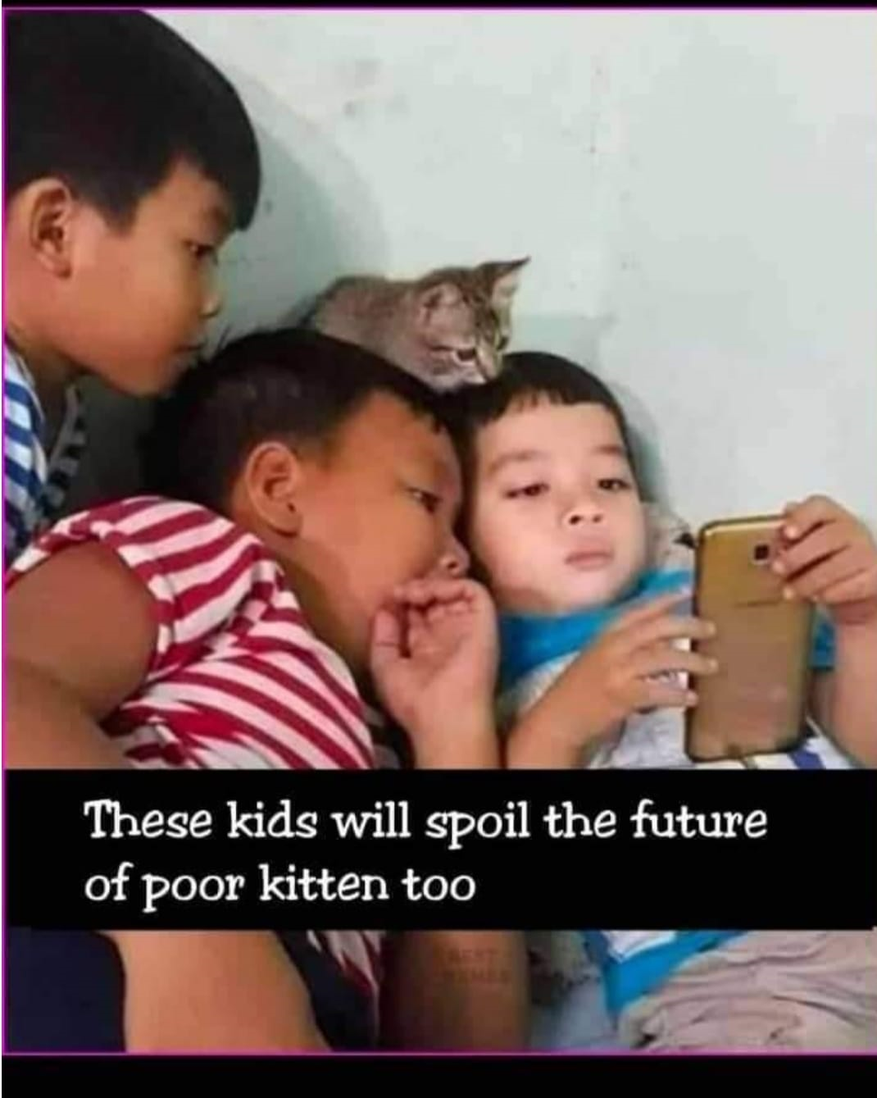
Contents
Background
Research Question
Objectives
Methodology
Results
Conclusion
Limitation
Recommendation

Slide 3
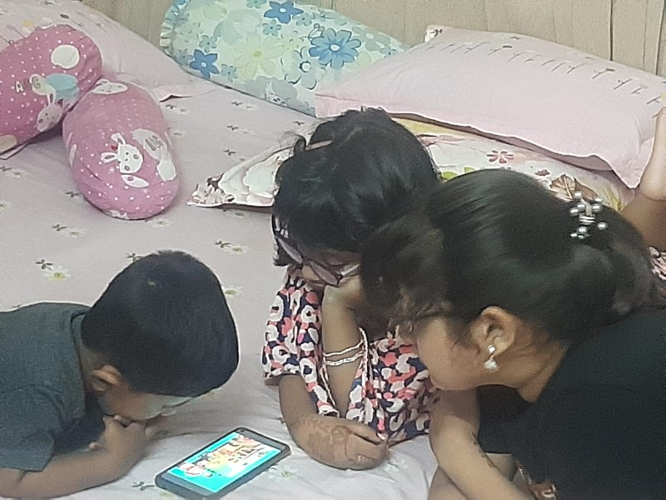
Background
To maintain social distancing government from different countries took measures like lockdown
This placed unprecedented control on the school going children
Started spending more time with device
This increased screen time can lead to several health hazards like digital eye strain, Sleep disorder, weight gain, social disorder

Slide 4
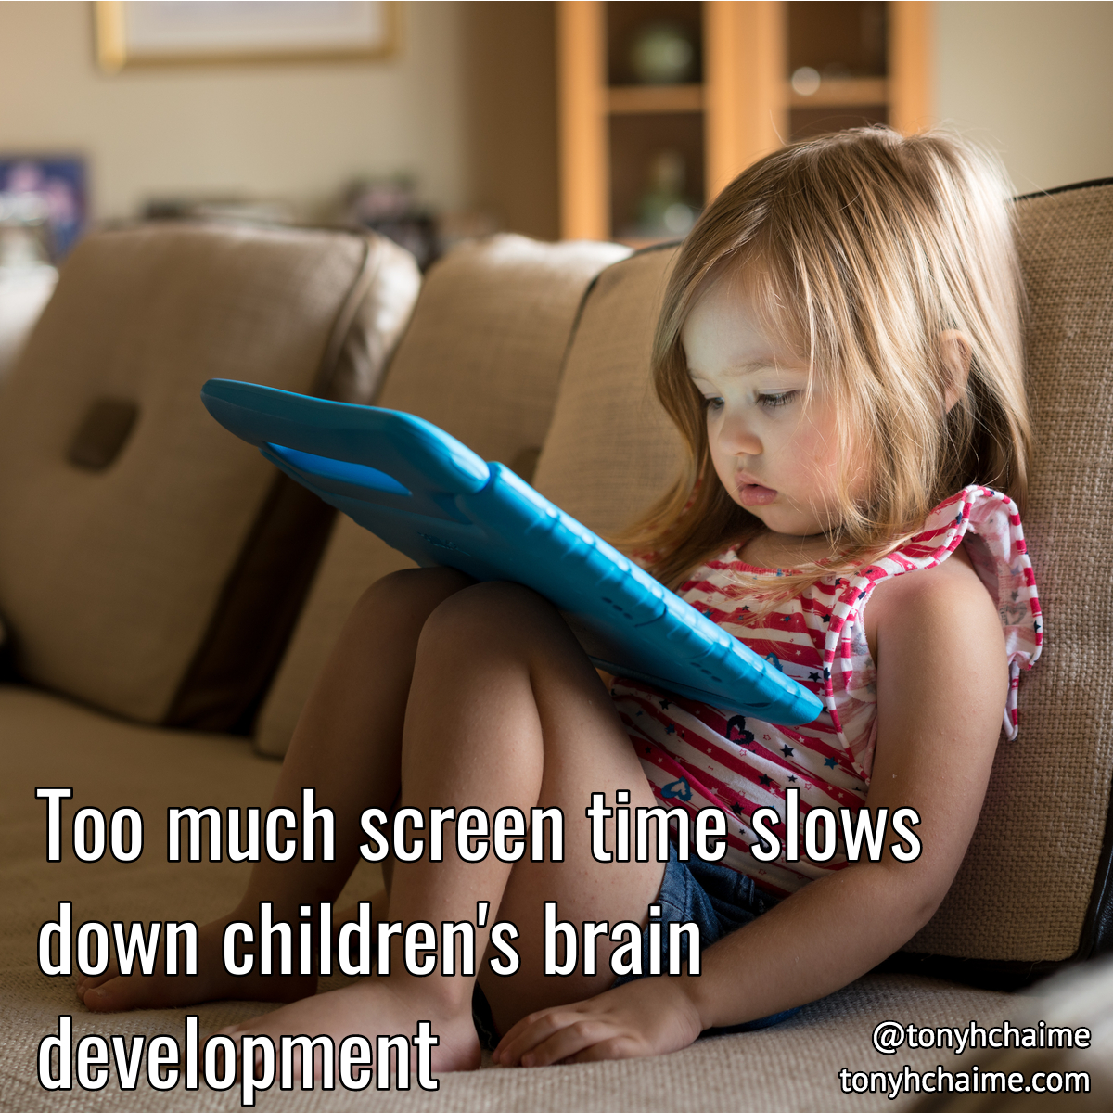
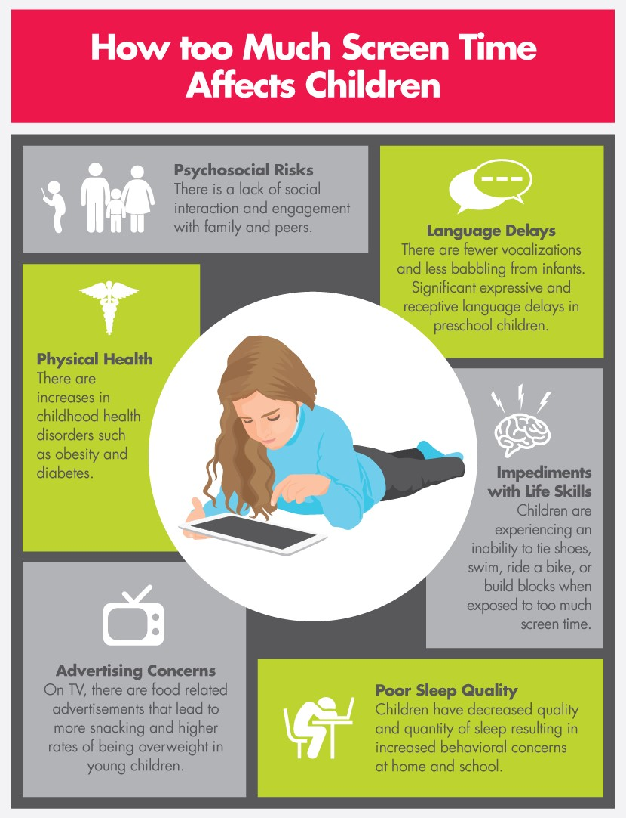
Background
Electronic gadgets used widely even before lockdown.
Little consideration given to the developmental risk they pose.
Studies shows majority of children are not participating in adequate physical activity.

Slide 5
What are the effects of prolong digital screen exposure on school going children during pandemic school closure time?
Research Question

Slide 6
Objectives
To explore the effect of prolong screen time on physical and mental health of school going children during pandemic.
General Objective
Specific Objectives
To identify the possible health hazards of digital screen exposure going children.
To understand parents’ awareness regarding the health and developmental hazard
To explore preventive measures parents are taking to minimize the screen time

Slide 7
Study design: mixed method
Study site: English and Bangla medium school of Dhaka and Chattogram city.
Study Period: December 22 to May 23
Target Population: Parents, Guardians, Teacher of school going children( aged 5-15 years).
Data Collection Tools
Pretest and training done
Sample size:
Quantitative Sample: 59
Qualitative Sample: Twenty Six Focus Group Discussion, Twelve IDI and Two KII.
Sampling Technique

Slide 8
Data Collection:
Quantitative Data : Survey questionnaire prepared and participants interviewed
Qualitative Data: Focus Group Discussion, IDI and KII done.
Data Analysis :
Quantitative: Descriptive analysis
Qualitative: Thematic analysis
Ethical Consideration: Took ethical clearance from the institute and verbal consent taken from the participant

Slide 9
Results

Slide 10
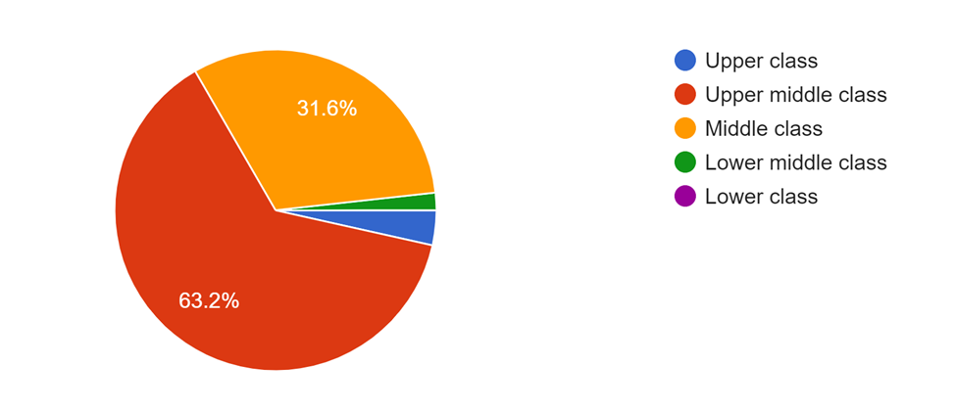
Socio Demographic Status of Parents
Age
Gender
Education
Employment History
Occupational Status
Occupational Status

Slide 11
Screen Time
Using device for Entertainment
 | During Covid | Post Covid
Smartphone+internet | 78.9% | 66.7%
Tablet+internet | 29.8% | 28.1%
Smart Tv+ internet | 64.9% | 61.4%
Desktop+internet | 3.5% | 0%
Laptop+internet | 40.4% | 33.3%
Gaming console+internet | 8.8% | 1.8%
Using device for Education
 | During Covid | Post Covid
Smartphone+internet | 76.3% | 69.5%
Tablet+internet | 35.6% | 27.1%
SmartTV+intrnet | 30.5% | 25.4%
Desktop+internet | 5.1% | 0(0%)
Laptop+internet | 49.2% | 30.5%
Gaming console + internet | 1.7% | 1.7%

Slide 12
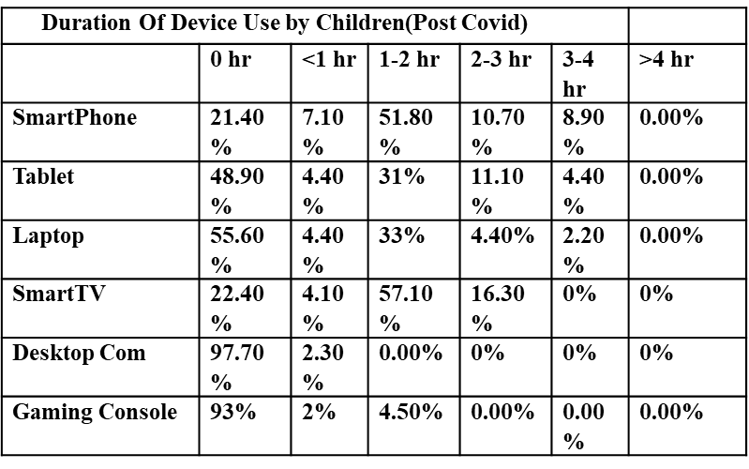
Duration Of Device use by Children

Slide 13
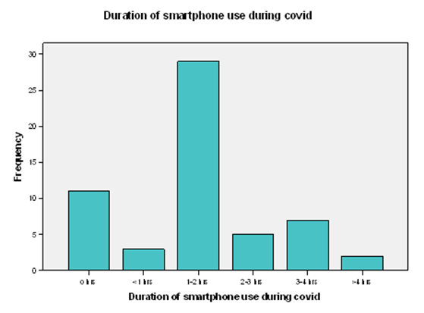
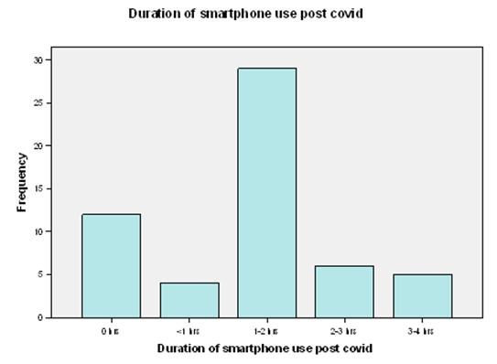
Frequency of using devices and viewing distance by children
Smartphone was used by 81% children almost everyday during lockdown.
Most of them used more than 1 hour.
Reduced to 77% post covid.

Slide 14
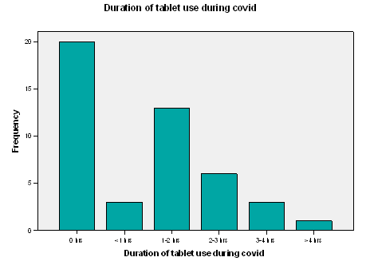
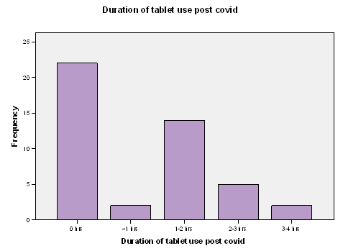
Frequency of using devices and viewing distance by children
Tablet were used by 57% children almost everyday during lockdown.
Reduced to 43% post covid.
Most of them used Tablet more than 1 hour.

Slide 15
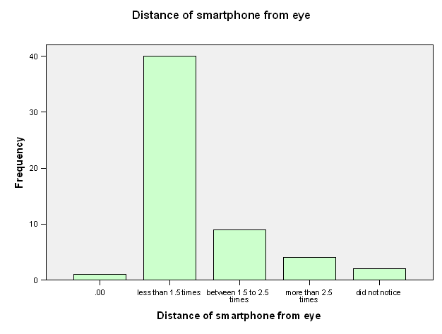
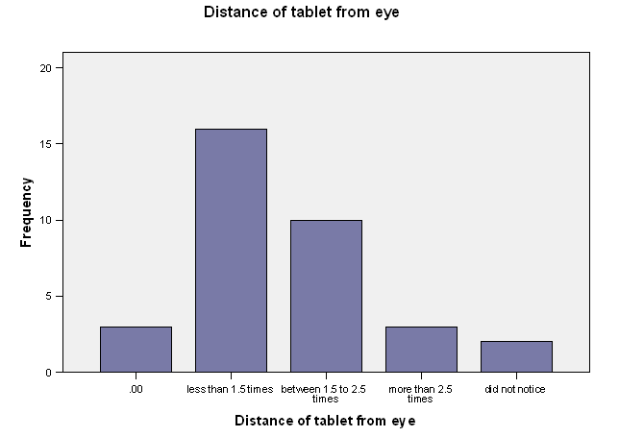
Frequency of using devices and viewing distance by children
Children watching Tablet and Smartphone from very near viewing distance.
For Tablet among the users 47% used it from near viewing distance.
For Smartphone it is 71.4%.
This will expose them to the blue light emitted from the device.

Slide 16
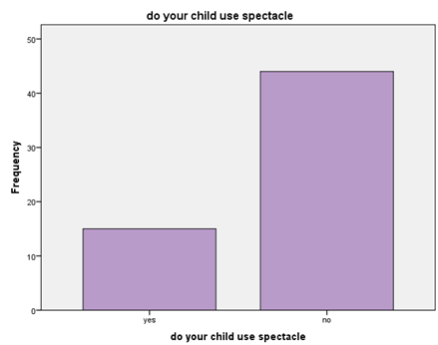
Spectacle Use
Total 15 children were using spectacle among the respondents.

Slide 17
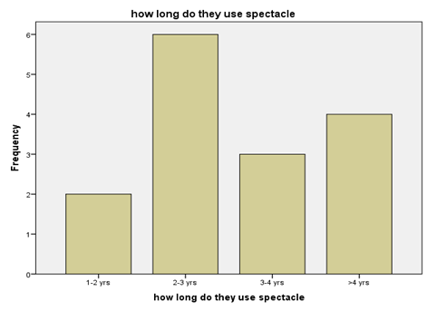
Spectacle Use
 | Use Spectacle | Spectacle power has changed
Yes | 15 | 13(86%)
No | 44 | 2(14%)
Interestingly most of them started using spectacle for 2-3 years.
Among the 15 users 13 have to change their power post covid.

Slide 18
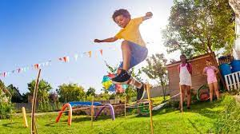
Outdoor Activity
 | Everyday outdoor activity
 | During Covid | Post Covid
0-1 hr | 42(71.2%) | 5(8.5%)
1-2 hr | 12(20.3%) | 14(23.7%)
2-3 hrs | 4(6.8%) | 21(35.6%)
3-4 hrs | 0(0%) | 1(1.7%)
more than 4 hrs | 1(1.7%) | 18(30.5%)
 | Weekend outing
 | During Covid | Post Covid
0-1 hr | 43(72.9%) | 3(5.1%)
1-2 hrs | 11(18.6%) | 10(16.9%)
2-3 hrs | 4(6.8%) | 20(33.9%)
3-4 hrs | 1(1.75%) | 9(15.5%)
more than 4 hrs | 0(0%) | 17(28.6%)
Outdoor activity of the children drastically reduced during covid.
71.2% responded their outdoor activity was almost 0,which was only 5% post covid.

Slide 19
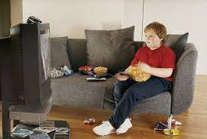
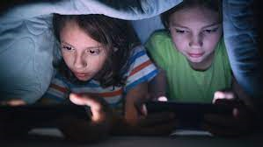
Health Impacts from Parents Perspective
Impact on Physical Health
Eyesight | 81.80%
Obesity | 58%
Backpain | 31.90%
Tiredness | 4.40%
did not notice | 16.30%
Impact on mental Health
Development | 63.30%
language delay | 32.70%
mood swing | 69.20%
stress and depression | 47.10%
sleep disorder | 69.20%
Others | 8.80%
did not notice | 13.20%

Slide 20
Parents Observation
Observation
1.Does your child have nervous breakdown? | 30.50%
2.Does your child have sleeping disorder? | 28.80%
3.Does your child face developmental disorder? | 18.60%
4.Does your child become irritable when ask to stop playing video game? | 66.10%
5.Does you notice your child pupil dilated during device use? | 20.30%
6.Does your child have a hard time making eye contact? | 24.60%
7.Do you ever feel your child is not so happy as he/she should be? | 44.10%
8.Does your child have trouble making friends? | 25.40%
9.Do you worry that your child interest has narrowed recently? | 47.50%
10.Do you feel that his/her thrust for knowledge has been dampened? | 39%
11.Do your child develop any physical problem due to screen addiction? | 27.10%
12.Do your child seem unmotivated? | 40.70%

Slide 21
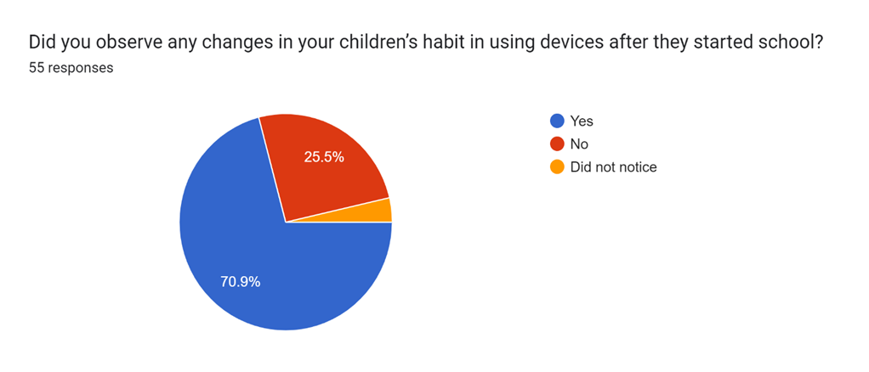
Parents Observation
Post Covid Observation

Slide 22
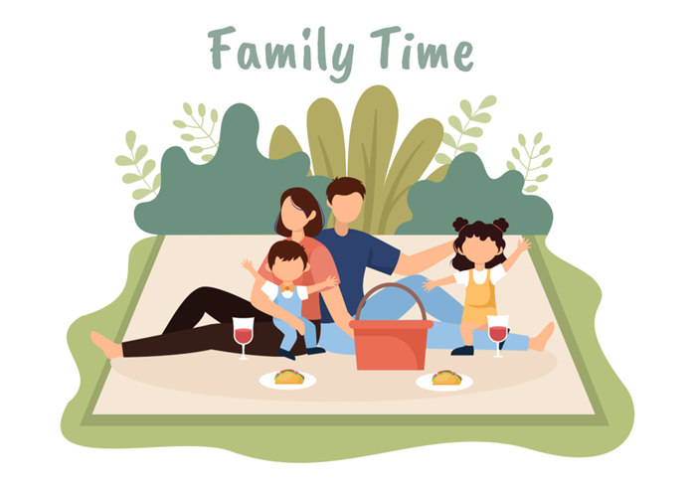
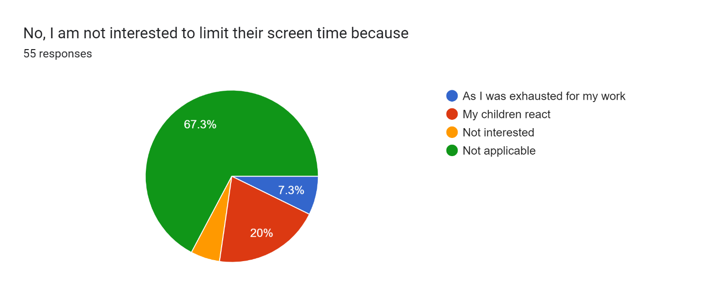
Precautionary measures taken by parents
Types of Precautionary Measure | Respondents
Play a part as a role model | 44.80%
Restrict child playing video game | 44.80%
Encourage physical activity | 74.10%
Encourage reading books | 70.70%
Schedule family activity | 51.70%
Disallowing device during meal time | 41.40%
Make them justify their use | 39.70%

Slide 23
Conclusion
Screen exposure causes enormous physical and mental health hazards among young school going children
Analysis showed children were suffering several health issues due to increased screentime during lockdown
Most of the parents complaints about eye strain during using device
Other problems like sleep disorder, tiredness, irritability and weight gain also observed
Parents of school going children are inadequately aware regarding the consequences of too much screen-time
Results indicate that there is a willingness to take measures by the parents

Slide 24
Recommendation
Proper guidelines and precautionary measures should help parent to take steps to reduce screen time for children
Timely implementation of precautionary measures should be ensured
Parents being the only player regulating screen time restrictions must be aware of all the consequences of prolonged screen exposure
School should take several steps like regular health checkup including eye check up and should engage the children in different outdoor activities
Further research and strong awareness measures is required to protect our future generation

Slide 25
Limitation
Simple descriptive study
Time constraints
Relatively small sample size

Slide 26
Thank you 2131365@iub.edu.bd

