Slide 1
Welcome to our session

Slide 2
Factors associated with failure of early initiation of breast feeding among the female workers at the readymade garments in Gazipur, Bangladesh
Dr.Tasnim Tamanna
ID:2131257
Independent University of Bangladesh

Slide 3
Introduction
Early initiation of breast feeding (EIBF)
Without taking any other foods or liquids or even water, initiation of breast feeding within the first hour of life.
Exclusive breast feeding (EBF)
Children should exclusively breast feed for the first
6 months of life to fulfill the maximum growth and
development of health both physically and mentally.
-world health Organization (WHO)

Slide 4
Continue
Breast feeding is an natural essential first food for the child health and their survival which is known as the first immunization source of the baby .
This first breast milk is known as colostrum which looks thicker and more yellow than mature milk.
It contains full of protein and nutrient dense like carotenoids, vitamin A, Zinc, minerals, magnesium etc .
In spite of having all benefits, Globally the rates of EIBF are low.

Slide 5
Only 47% of new-borns were breastfed within 1 h of birth [UNICEF 2022].
According to UNICEF report 2018,
- In Asia, EIBF ranged from 32 to 40% ,
- 40% in Central Africa,
- 65% in Southern Africa, 62% in Kenya,
- 66% in Uganda and 80% in Rwanda
According to Bangladesh Demographic and
Health Surveys (BDHS) (2017-2018),
EIBF rate is 60.8%.

Slide 6
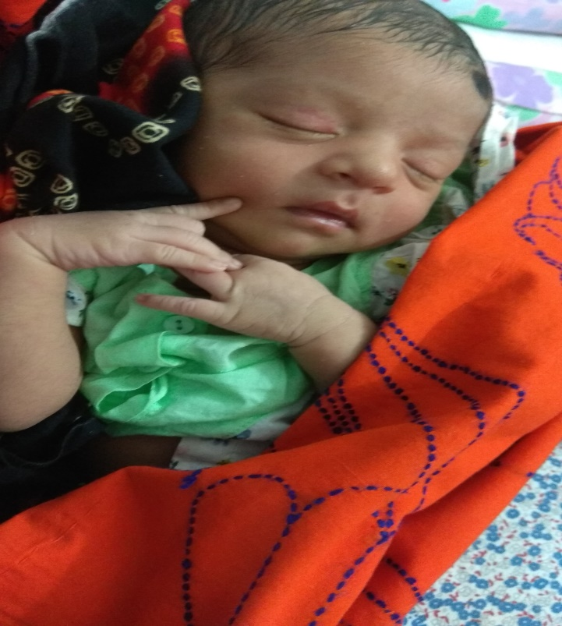
Why this study was conducted on Ready made garments sector?

Slide 7
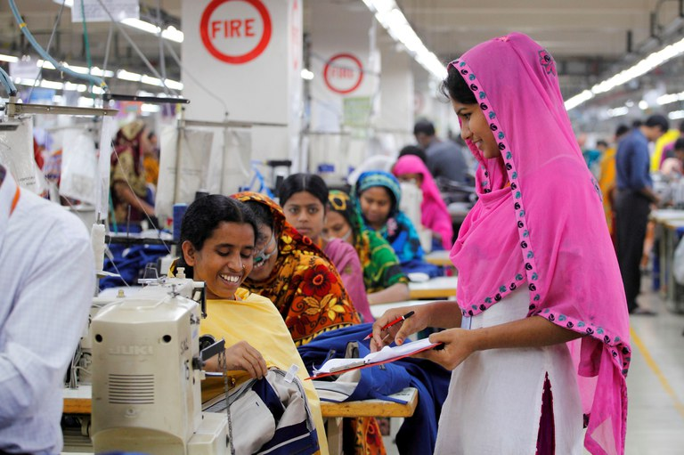
In RMG sectors, Female workers always maintain tight schedule due to their production, efficiency bonus.
Mothers are facing difficulties to maintain breast feeding schedule to their child due to work load.
Maximum Mother separate their baby just after birth or after re-joining from maternity leave.
Due to get used to stay without mother for long time, they try to give other liquids besides breast milk at the beginning

Slide 8
What are the barriers in practicing early initiation of breast feeding in the female readymade garments worker?

Slide 9
Objectives
To determine the barriers of the early initiation breastfeeding among mothers who are working in the RMG sector

Slide 10
Methodology
Study design | cross-sectional quantitative study
Study area | Libas Textile Ltd, Nippon Garments and Industries Ltd, Ever Smart Bangladesh Ltd and Amigo Bangladesh Ltd (Gazipur, Bangladesh)
Study period | June 2022-November 2022
Sampling technique | Simple random sampling technique
Sample Size | 452

Slide 11
Method
Inclusion Criteria
Inclusion Criteria
Exclusion Criteria
Mothers who are working for 1 year before their child were born.
Female workers of the RMG sectors with 6 months aged children.
Mothers with consent.
Workers who joined recently (within the study period)
Workers who are not willing to give interviews
Workers who have children below 6 months of age or over 6 months.

Slide 12
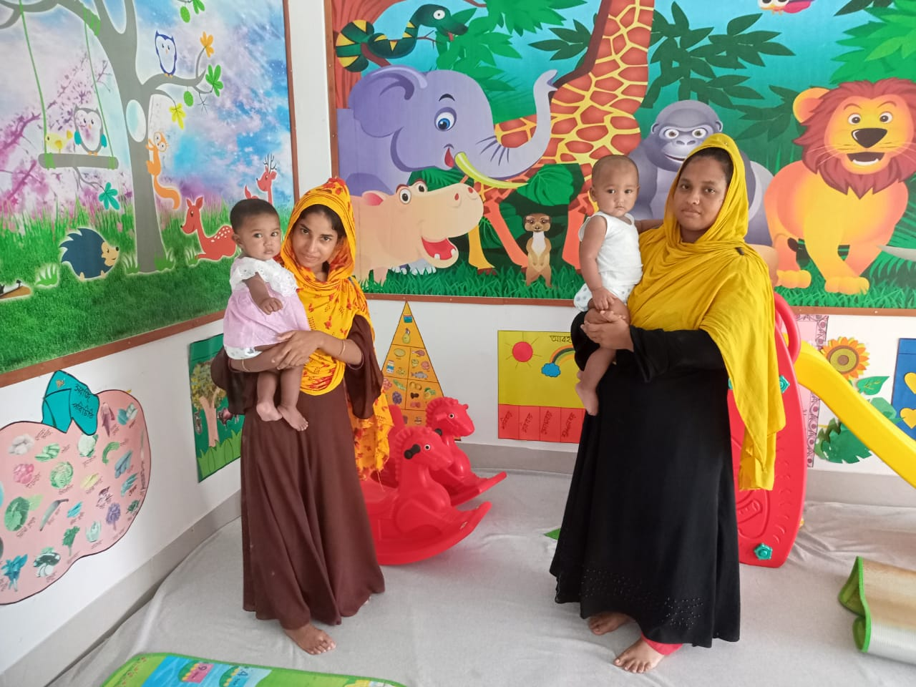
Result

Slide 13
Table .1.A: Distribution of the characteristics of mothers in the study subject
Variables | Frequency (n) | Percentage (%)
Age of the Mother
18-25 | 214 | 47.3
26-30 | 203 | 44.9
31 -45 | 35 | 7.7
(Mean ± SD) | 25.91(±3.686)
Religion
Muslim | 389 | 86.1
Hindu | 63 | 13.9
Maternal education
No education | 19 | 4.2
Primary | 271 | 60.0
Secondary or Above | 162 | 35.8
ANC visit during pregnancy
No ANC | 42 | 9.3
1-4 ANC | 324 | 71.7
More than 4 ANC | 86 | 19.0

Slide 14
Variables | Frequency (n) | Percentage (%)
Counsel on EBF during ANC visit
No | 202 | 44.7
Yes | 250 | 55.3
EBF planning during pregnancy
Planned | 297 | 65.7
Did not plan | 155 | 34.3
Maternal BMI
Normal | 322 | 71.2
Thin | 87 | 19.2
Overweight or obese | 43 | 9.5
Type of family
Joint | 211 | 46.7
Nuclear | 241 | 53.3
Monthly household income
10000-20000 | 109 | 24.1
21000-30000 | 278 | 61.5
30000 or above | 65 | 14.4
(Mean ± SD) | 24763.27(±5039.021)
Head of the family
Male | 354 | 78.3
Female | 98 | 21.7

Slide 15
Figure 1: Different Age group status of mother
Figure 3: The percentage of the monthly household income
Figure 2: The history of ANC visit during pregnancy

Slide 16
Table.1.B: Distribution of the characteristics of the baby in the study subjects
Variables | Frequency (n) | Percentage (%)
Age of the baby
0 to 2 Months | 75 | 16.6
3 to 4 Months | 297 | 65.7
5 to 6 Months | 80 | 17.7
(Mean ± SD) | 3.49(±1.060)
Gender of the baby
Male | 240 | 53.1
Female | 212 | 46.9
Birth order of the baby
1st child | 233 | 51.5
2nd child | 166 | 36.7
3rd or over | 53 | 11.7

Slide 18
Table.1.C: Distribution of the Postnatal care system
Variables | Frequency (n) | Percentage (%)
Receiving Breastfeeding counselling
No | 125 | 27.7
yes | 327 | 72.3
From where
Doctor | 169 | 37.4
Trained birth attendant | 78 | 17.3
Relatives | 47 | 10.4
NGO health staff | 33 | 7.3

Slide 19
Table.1.D: Distribution of the characteristics of breast feeding process
Variables | Frequency (n) | Percentage (%)
Pre lacteal feed
No | 188 | 41.6
Yes | 264 | 58.4
Colostrum feeding
No | 171 | 37.8
yes | 281 | 62.2
Breast feeding frequency per 24 hour
≥8 | 281 | 62.2
≤8 | 171 | 37.8
Time to give BF
On demand | 275 | 60.8
When baby cry | 172 | 38.1
On schedule | 5 | 1.1

Slide 20
Figure 8: Early initiation of breast feeding

Slide 21
Figure 9: The diagram of exclusive breast feeding
Figure 10: Reasons for not feeding properly

Slide 22
Table.2: Distribution of Early Initiation of Breast Feeding
Variables | Early Initiation of Breast Feeding (less than 1 hour) |  | P value
 | Yes (%) | No (%)
Age of the Mother
18-25 years | 41.6 | 58.4
26-30 years | 38.9 | 61.1 | 0.801
31 -45 years | 37.1 | 62.9
Religion
Muslim | 40.9 | 59.1
Hindu | 34.9 | 65.1 | 0.371
Maternal education
No education | 10.5 | 89.5
Primary | 37.6 | 62.4 | 0.003
secondary or Above | 47.5 | 52.5
ANC visit during pregnancy
No ANC | 38.1 | 61.9
1-4 ANC | 40.1 | 59.9 | 0.960
More than 4 ANC | 40.7 | 59.3
Counsel on EBF during ANC visit
No | 39.6 | 60.4
Yes | 40.4 | 59.6 | 0.864
EBF planning during pregnancy
Planned | 40.7 | 59.3
Did not plan | 38.7 | 61.3 | 0.676
Continue..

Slide 23
Variables | Early Initiation of Breast Feeding (less than 1 hour) |  | P value
Type of family | Yes (%) | No (%)
Joint | 42.2 | 57.8
Nuclear | 38.2 | 61.8 | 0.386
Monthly household income (BDT)
10000-20000 tk | 51.4 | 48.6
21000-30000 tk | 35.3 | 64.7 | 0.014
30000 or above tk | 41.5 | 58.5
Head of the family
Female | 38.8 | 61.2
Male | 40.4 | 59.6 | 0.772
Gender
Male | 37.9 | 62.1
Female | 42.5 | 57.5 | 0.326
Birth order of the baby
1st child | 40.3 | 59.7
2nd child | 39.2 | 60.8 | 0.946
3rd or over | 41.5 | 58.5

Slide 24
Variables | Early Initiation of Breast Feeding (less than 1 hour) |  | P value
 | Yes (%) | No (%)
Place of delivery
Home delivery | 40.1 | 50.9
Facility delivery | 34.6 | 65.4 | 0.002
Mode of delivery
Normal vaginal delivery | 50.2 | 49.8
Caesarean section | 25.7 | 74.3 | <0.001
Received postnatal care service
No | 35.2 | 64.8
Yes | 46.8 | 53.2 | 0.013
Pre lacteal feed
No | 77.1 | 22.9
Yes | 13.6 | 86.4 | <0.001
Colostrum feeding
No | 8.2 | 91.8
Yes | 59.4 | 40.6 | <0.001
Breast feeding frequency per 24 hour
≥8 | 53.4 | 46.6
≤8 | 18.1 | 81.9 | <0.001

Slide 25
Table.3: Factors associated with Early Initiation of Breast Feeding
Variables | Crude OR | 95% CI |  | P value
 |  | Lower limit | Upper limit
Age of the Mother
18-25 years | Reference
26-30 years | 1.118 | .755 | 1.654 | .578
31 -45 years | 1.205 | .576 | 2.519 | .620
Religion
Muslim | Reference
Hindu | 1.288 | .739 | 2.247 | .372
Maternal education
Secondary or Above | Reference
Primary | 1.501 | 1.012 | 2.226 | .044
No education | 7.700 | 1.723 | 34.414 | .008
ANC visit during pregnancy
More than 4 ANC | Reference
1-4 ANC | 1.024 | .631 | 1.662 | .923
No ANC | 1.115 | .523 | 2.377 | .778
Counsel on EBF during ANC visit
Yes | Reference
No | 1.034 | .708 | 1.509 | .864
Continue..

Slide 26
Variables | Crude OR | 95% CI |  | P value
 |  | Lower limit | Upper limit
EBF planning during pregnancy
Did not plan | Reference
Planned | .919 | .617 | 1.367 | .676
Maternal BMI
Overweight or obese | Reference
Normal | 1.231 | .642 | 2.360 | .531
Thin | 1.241 | .592 | 2.602 | .568
Type of family
Nuclear | Reference
Joint | .846 | .581 | 1.234 | .386
Monthly household income (BDT)
30000 or above | Reference
21000-30000 | 1.305 | .752 | 2.265 | .344
10000-20000 | .672 | .362 | 1.250 | .210
Head of the family
Female | Reference
Male | 1.070 | .677 | 1.692 | .772

Slide 27
Variables | Crude OR | 95% CI |  | P value
 |  | Lower limit | Upper limit
Gender of baby
Male | Reference
Female | .828 | .568 | 1.207 | .326
Birth order (Reference child)
3rd or over | Reference
2nd baby | 1.103 | .588 | 2.068 | .761
1st baby | 1.049 | .573 | 1.923 | .876
Place of delivery
Home delivery | Reference
Facility delivery | 1.822 | 1.235 | 2.687 | 0.002
Mode of delivery
Normal vaginal delivery | Reference
Caesarean section | 2.918 | 1.942 | 4.383 | <0.001
Received postnatal care service
Yes | Reference
No | .618 | .422 | .905 | .014
Pre lacteal feed
No | Reference
Yes | .047 | .029 | .076 | <0.001
Colostrum feeding
Yes | Reference
No | 16.428 | 9.049 | 29.823 | <0.001

Slide 28
Table.4: Determinants of failure of Early Initiation of Breast Feeding of the mothers
Variables | Adjusted OR | 95% CI |  | P value
 |  | Lower limit | Upper limit
Age of the Mother
18-25 | Reference
26-30 | 2.448 | .652 | 9.190 | .185
31 -45 | 3.927 | 1.183 | 13.038 | .025
Maternal education
Illiterate | 6.864 | 1.109 | 42.490 | .038
Primary | 1.291 | .695 | 2.396 | .419
Secondary or Above | Reference
ANC visit during pregnancy
No ANC | .964 | .253 | 3.670 | .957
1-4 ANC | 1.393 | .652 | 2.977 | .392
More than 4 ANC | Reference
Counsel on EBF during ANC visit
No | 1.196 | .640 | 2.236 | .575
Yes | Reference
Maternal BMI
Normal | 1.371 | .562 | 3.345 | .487
Thin | 1.584 | .533 | 4.705 | .408
Overweight or obese | Reference
Continue..

Slide 29
Variables | Adjusted OR | 95% CI |  | P value
 |  | Lower limit | Upper limit
Type of family
Joint | 1.004 | .566 | 1.780 | .989
Nuclear | Reference
Monthly household income (BDT)
10000-20000 | .523 | .184 | 1.487 | .224
21000-30000 | 1.408 | .568 | 3.488 | .460
30000 or above | Reference
Head of the family
Male | .857 | .424 | 1.729 | .666
Female | Reference
Gender of baby
Male | Reference
Female | 1.234 | .692 | 2.200 | .476
Birth order (Reference child)
1st baby | .893 | .275 | 2.898 | .850
2nd baby | .631 | .214 | 1.858 | .403
3rd or over | Reference

Slide 30
Variables | Adjusted OR | 95% CI |  | P value
 |  | Lower limit | Upper limit
Place of delivery
Home delivery | reference
Facility delivery | .784 | .386 | 1.589 | .499
Mode of delivery
Normal vaginal delivery | Reference
Caesarean section | .708 | .328 | 1.531 | .380
Received postnatal care service
No | 1.287 | .659 | 2.513 | .459
Yes | Reference
Pre lacteal feed
No | Reference
Yes | .060 | .033 | .110 | <0.001
Colostrum feeding
No | 8.963 | 4.297 | 18.696 | <0.001
Yes | Reference

Slide 31
Limitations
We couldn’t cover up all the garments factories in Bangladesh and couldn’t elaborate our sample size during study period due to our shortness of time and limitation of fund.
If the data was recorded within 24 hours or 1 day after delivery bias may be minimized.
Due to cross sectional study we could not draw a causal association.

Slide 32
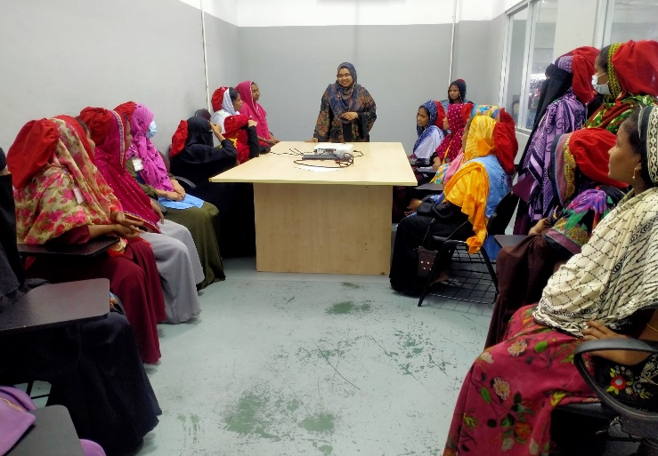
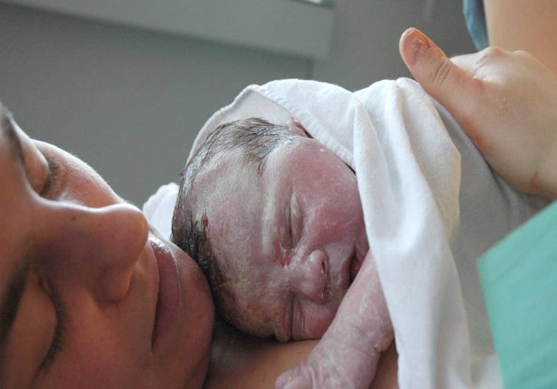
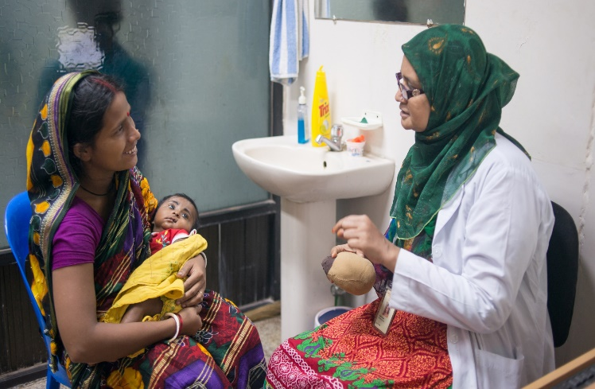
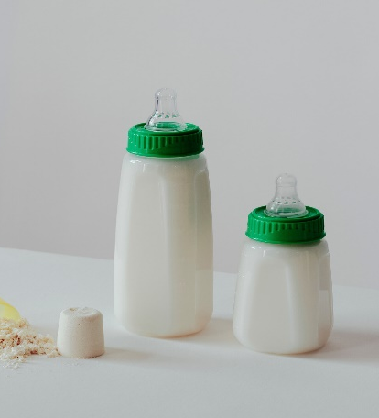
Recommendation
Counselling during Maternity period in the factory premises
Arranging early skin-to-skin contact after caesarean sections due to EIBF
Counselling during PNC
Avoid formula milk

Slide 33
Conclusion
This study was conducted on the busiest RMG working women who are neglected maximum time and the study subject was barriers in practicing early initiation of breast feeding .
Maternal age, Poor education, delivery procedure, pre lacteal feeding and colostrum feedings were the determinants of the failure of EIBF.
For healthy outcomes in future, it’s necessary to correct all barriers, enforce women education and aware about the benefits of early initiation of breastfeeding among all women in the RMG factory through proper counselling.

Slide 34
Reference
WHO and, UNICEF. Capture the Moment – Early initiation of breastfeeding: The best start for every newborn. New York. 2018
World Health Organization (WHO). Breastfeeding [Internet]. Geneva (Switzerland): WHO; c2022 [cited 2019 Feb 26];
Sinha B, Chowdhury R, Sankar MJ, Martines J, Taneja S, Mazumder S, Rollins N, Bahl R, Bhandari N. Interventions to improve breastfeeding outcomes: a systematic review and meta-analysis. Acta Paediatr. 2015; 104(S467):114–34.
Akhter S, Rutherford S, Chu C. What makes pregnant workers sick: why, when, where and how? An exploratory study in the ready-made garment industry in Bangladesh. Reprod Health. 2017;14:142
Akhter S, Rutherford S, Akhter Kumkum F, Bromwich D, Anwar I, Rahman A, et al. Work, gender roles, and health: neglected mental health issues among female workers in the ready-made garment industry in Bangladesh. Int J Women's Health. 2017; 9:571–9.
UNICEF, Breastfeeding from the first hour of birth, july 3, 2018

Slide 35
Thank You

