Slide 1
Barriers of Exclusive Breastfeeding Practice among Readymade Garments working mothers in Bangladesh: A qualitative exploration
Presented by:
DR. NUSRAT AZRIN MOHSIN, ID: 2131149

Slide 2
Introduction:
Breastfeeding is crucial for infant health and survival, providing essential nutrients and immunity during the first months of life.
Exclusive breastfeeding, offering only breast milk without any other food or liquids, is recommended by health experts for the first six months
Despite its benefits, exclusive breastfeeding rates remain low globally, including in low and middle-income countries like Bangladesh, where the rate of EBF has been decreased in 55%.

Slide 3
Introduction:
In Bangladesh, the ready-made garments (RMG) sector employs a significant number of female workers of reproductive age
Working in the RMG sector poses challenges for mothers to practice exclusive breastfeeding due to long working hours and limited childcare facilities
This study aims to investigate the barriers and perceptions of exclusive breastfeeding among working mothers in the RMG sector.

Slide 4
Research Question:
What are the challenges/barriers in practicing Exclusive breast feeding among the Ready-made garment's workers?

Slide 5
Objective
To measure the obstacles of breastfeeding exclusively and understandings about exclusive breast feeding among mothers those who are working in the RMG sector

Slide 6
methodology:
Study design | Cross-sectional qualitative study
Study area | Libas Textile Ltd, Nippon Garments and Industries Ltd, Ever Smart Bangladesh Ltd and Amigo Bangladesh Ltd (Gazipur, Bangladesh)
Study period | June 2022-November 2022
Sampling technique | Convenience sampling technique
Sample Size | 30

Slide 7
Methods (Cont.)
Inclusion Criteria
Exclusion Criteria
Female workers of RMG sectors with 6 months aged children
Mothers who are working before their child were born, working for 1 year.
Mothers with consent
Workers who have children below 6 months of age
Workers who joined recently (within the study period.)
Workers who are not willing to give interviews.

Slide 8
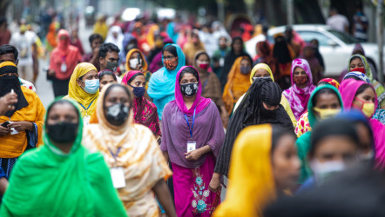
result

Slide 9
Result:
Exclusive Breastfeeding (EBF) Practice:
•Among the 30 mothers, only 6 practiced exclusive breastfeeding up to 6 months.
•Working hours in RMG sectors were a significant barrier to EBF.
•Limited childcare facilities within RMG factories hindered exclusive breastfeeding.
•Some mothers faced challenges with privacy for breastfeeding.
Early Initiation of Breastfeeding:
•30 female RMG workers with children aged 6-10 months participated in the study.
•8 mothers did not initiate breastfeeding within 1 hour of birth.
•Reasons for delayed initiation included cesarean sections, lack of lactation knowledge, and sickness.
•22 mothers provided colostrum to their infants.

Slide 10
Result (con…):
Prelacteal Feeding and Colostrum Refusal:
•8 mothers gave prelacteal feeds to their infants.
•Cultural beliefs and familial pressure influenced prelacteal feeding practices.
•22 mothers provided colostrum, indicating awareness of its importance.
Healthcare Provider Perspectives:
•Healthcare professionals emphasized the importance of exclusive breastfeeding.
•Recommended targeted educational programs to promote EBF.
•Identified common infant health issues in non-exclusive breastfeeding infants.

Slide 11
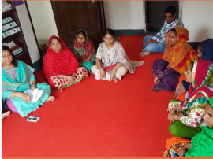
Result (con…):
RMG Sector Managers' Views:
•RMG sector managers acknowledged the importance of EBF.
•Recognized the challenges faced by working mothers in practicing EBF.
•Some high-profile factories offered supportive initiatives for breastfeeding mothers.
Insights from Focus Group Discussions (FGDs):
•FGDs provided additional perspectives from working mothers.
•Few mothers had a conception about colostrum during their pregnancies.
•ANC and PNC visits played a role in awareness of EBF.
•Challenges with childcare facilities were discussed.

Slide 12
Limitations:
The recording of Early initiation of breast feeding and the definition of Exclusive BF may subject to bias and misreporting
Causal association is absent due to the cross-sectional study.

Slide 13
Recommendations:
Comprehensive strategies are needed to promote exclusive breastfeeding.
Improve lactation education and support during ANC and PNC checkups.
Create supportive workplace environments with accessible childcare facilities.
Address cultural beliefs and misconceptions related to breastfeeding.

Slide 14
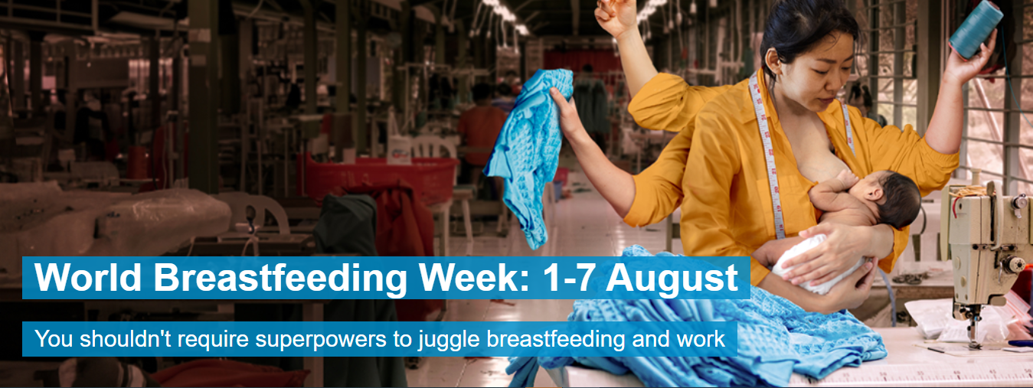
Recommendations:

Slide 15
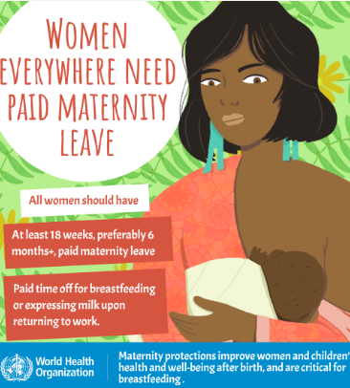
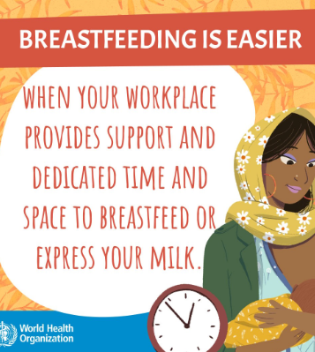
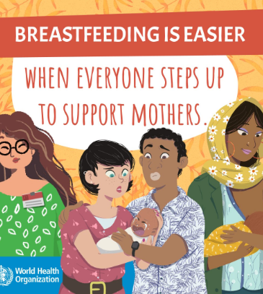
Steps taken by WHO:

Slide 16
conclusion
The study highlights the challenges faced by working mothers in practicing exclusive breastfeeding.
Targeted interventions are crucial to empower working mothers in RMG sectors for EBF.
Promoting exclusive breastfeeding can lead to better health outcomes for both mothers and infants

Slide 17
Thank you

