Slide 1
My Respected Faculty
Best wishes and my gratitude to you

Slide 2
A trend under 5 years stunted children for the last 2 decades in Bangladesh: A Systematic Review.
Presented by : Khalid Shams Choudhury
Student ID : 2120680
School of Pharmacy and Public Health, Independent University, Bangladesh
Date of Presentation: 10th August, 2023.
Course ID: HSC575

Slide 3
INTRODUCTION
Stunting Consequence: Frequent illness and in extreme cases death.
Lack of essential food
Elements:
Undernutrition
Imbalance of intake nutrients
Excess food consumption
Stunting
Wasting
Underweight
Overweight
Obesity
Notes:
Wasting is defined as low weight-for-height. It often indicates recent and severe weight loss ; WHZ <-2 SD
Stunting is defined as low height-for-age. It is the result of chronic or recurrent undernutrition; HAZ <-2SD
Underweight is defined as low weight-for-age. A child who is underweight may be stunted, wasted or both. weight-for-age < −2SD
Overweight if their weight-for-height (WHZ) was >2 SD.

Slide 4
STUNTING : A GLOBAL CRISIS
In 2020, globally, 149.2 million children under the age of 5 were stunted. Whereas it is estimated that 1.2 million under-5 stunted children die globally every year.
In developing countries, approximately 13 million under-five children die annually, where malnutrition is one of the leading causes of mortality.
Bangladesh is one of the countries that experienced a high prevalence of stunted children (71%) in 1974 due to frequent natural disasters, the possibility of childhood infectious diseases, and inadequate nutrition. It came down by 60% and 51.2% in 1996/97 and 1999/2000, respectively.

Slide 5
RESEARCH QUESTION
RESEARCH QUESTION?
What are the significant changes that contributed to the reduction of Stunting among under-five children in Bangladesh in the last two decades?

Slide 6
OBJECTIVES OF THIS STUDY
OBJECTIVES
GENERAL OBJECTIVE
To figure out the Stunting status of under-5 children in Bangladesh in the last 20 years (2002–2022).
SPECIFIC OBJECTIVES
To identify the prevalence of stunting in Bangladesh.
To identify the major contributing risk factors for stunting in Bangladesh.
To identify the association between the risk factors and stunting.

Slide 7
METHODS
Search Strategy Formulation:
PubMed
Scopus
Cochrane
N=338
N=16
N=22
Database | Searching Keywords
PubMed | (("chronic malnutrition") OR (stunt*)) AND ( Bangladesh*) ((“chronic malnutrition”) OR (stunt*) AND ((under 5 child*))) AND (Bangladesh*) ((“chronic malnutrition”) OR (stunt*) AND ((under five child*))) AND (Bangladesh*)
Cochrane library | Chronic malnutrition OR stunt* AND (under 5 child*) AND Bangladesh*
Scopus | "chronic malnutrition" OR stunt* AND ("under 5 child*) AND Bangladesh*
Google scholar ( Additional) | chronic malnutrition OR stunt* AND ("under 5 child*) AND Bangladesh*

Slide 8
ELIGIBILITY
Traits | Inclusion Criteria | Exclusion Criteria
Population age | 0 - ≤59 months | ≥60months. 0-30 months
Country | Bangladesh | Other than Bangladesh
Anthropometric measures | Height-for-age <-2 SD of the WHO Child growth standards median | Excess nutrition/Obese/Obesity/ Wasting (low weight-for-height), and underweight (low weight-for-age)
Scope ( Search Engine)/ Data base | PubMed, Scopus, Cochrane Library
Language | English | Other than English
Research conducted in | Human | Animal
Publication year | 2012 to 2022 | Before 2012 and after 2022
Research paper | Full text, Peer reviewed. Bangladesh or multi-country including Bangladesh | Non peered reviewed, Only Abstract, Irrelevant, Conference documents, Reports, Narrative review article
Data extraction types | Prevalence and Risk factors association/determinants data between 2002 to 2022 | Data study period before 2002 and after 2022. Data (Bangladesh) merged with multi-countries countries. Joint estimation of the child undernutrition/Wasting.

Slide 9
RESULT
DATA BASE SEARCH RESULT
Duplication
11
IDENTIFICATION
376
REPORTS
SCREENING
FOR ELIGIBILITY
72
RECORDS
SCREENED
365
RECORDS
EXCLUDED
286
NOT
RETRIEVAL
7
STUDIES
INCLUDED
21
RETRIEVAL
79
REPORTS
EXCLUSION
51

Slide 10
RESULT CONTINUE : DEMOGRAPHY OF (1-5 ) SELECTED ARTICLES
Study Ref & Paper ID | Study Title | Authors | Year of Published | Search Engine | Journal Name Link of article and doi
Rahman et al.,2021 ID-1 | Poverty and childhood malnutrition: Evidence-based on a nationally representative survey of Bangladesh | Md. Ashfikur Rahman ,Henry Ratul Halder ,Md. Sazedur Rahman, Mahmood Parvez | 23-Aug-21 | PubMed/ Scopus | PLOS ONE https://doi.org/10.1371/journal.pone.0256235
Saha et al., 2019 ID-2 | Trends, prevalence and determinants of childhood chronic undernutrition in regional divisions of Bangladesh: Evidence from demographic health surveys, 2011 and 2014 | Unnati Rani Saha ,Aparajita Chattapadhayay,Jan Hendrik Richardus | 09-Aug-19 | PubMed/ Google Scholar | PLOS ONE https://doi.org/10.1371/journal.pone.0229677
Chowdhury et al.,2022 ID-3 | Risk factors for child stunting in Bangladesh: an analysis using MICS 2019 data | Tuhinur Rahman Chowdhury , Sayan Chakrabarty , Muntaha Rakib , Stephen Winn and Jason Bennie | 21-Apr-22 | PubMed/ Scopus/ Google Scholar | BMC https://doi.org/10.1186/s13690-022-00870-x
Rahman et al.,2016 ID-4 | Association of Low-Birth Weight with Malnutrition in Children under Five Years in Bangladesh: Do Mother's Education, Socio-Economic Status, and Birth Interval Matter? | M. Shafique Rahman ,Tamanna Howlader, Mohammad Shahed Masud, Mohammad Lutfor Rahman | 29-Jun-16 | PubMed/ Google Scholar | PLOS ONE https://doi.org/10.1371/journal.pone.0157814
Hasan et al., 2020 ID-5 | Socioeconomic Inequalities in Child Malnutrition in Bangladesh: Do They Differ by Region? | Mohammad Monirul Hasan ,Jalal Uddin ,Mohammad Habibullah Pulok ,Nabila Zaman and Mohammad Hajizadeh | 08-Feb-20 | PubMed/ Scopus/ Google Scholar | IJERPH https://doi.org/10.3390/ijerph17031079

Slide 11
RESULT CONTINUE : METHODOLOGY OF ( 1-10) SELECTED ARTICLES
Paper ID | Author/Year | Year of Data Collection | Location/ Area | Urban/ Rural | Sample size | Age | Gender
1 | Rahman et al.,2021 | 2017-18 | 8 Division | Urban & Rural | 7738 | 0-≤59 months | M/F
2 | Saha et al., 2019 | 2011 and 2014 | 7 Division | Urban & Rural | 13378 | 0-≤59 months | M/F
3 | Chowdhury et al.,2022 | 2018-19 | 8 Division | Urban & Rural | 17490 | 0-≤59 months | M/F
4 | Rahman et al.,2016 | 2011 | 7 Division | Urban & Rural | 7530 | 0-≤59 months | M/F
5 | Hasan et al., 2020 | 2011 and 2014 | 7 Division | Urban & Rural | 14602 | 0-≤59 months | M/F
6 | Kumar et al., 2021 | 2004 and 2017-18 | 6 Division*, | Urban & Rural | 6375 (2004), 8312 ((2017-18) | 0-≤59 months | M/F
7 | Khanam et al., 2019 | 2014 | 7 Division | Urban & Rural | 7256 | 0-≤59 months | M/F
8 | Das et al., 2022 | 2019 | 64 District | Urban & Rural | 24686 | 0-≤59 months | M/F
9 | Win et al., 2022 | 2020 | Dhaka & Gazipur | Urban Slums | 2100 | 0-≤59 months | M/F
10 | Sultana et al.,2019 | 2014 | 7 Division | Urban & Rural | 6965 | 0-≤59 months | M/F
Notes:
*6 Division (2004), 6 Division (2017-18), Mymensingh merged in Dhaka, Rangpur merged in Rajshahi.

Slide 12
RESULT : METHODOLOGY OF (10-15) SELECTED ARTICLES.
Paper ID | Author | Study Design | Source of Data | Dependent Variables | Independent Variables | Data Analysis methods
10 | Sultana et al.,2019 | Cross sectional | BDHS | Stunting, Wasting, Underweight | Size of child at birth, Mother’s BMI, Educational level, and The wealth index. Urban and rural areas. | Descriptive analysis, Bi variate analysis, Multilevel logistic regression model.
11 | Bhowmik & Das, 2018 | Cross sectional | BDHS | Stunting | Child level (Sex, age, birth interval and diarrhoea), Mother (age, education and nutritional status), Household (wealth status), Community level (place of residence), Regional level (Division). | Logistic Model
12 | Rahman et al., 2012 | Cross sectional | BDHS | Stunting, Wasting, Underweight | Women’s experience of IPV | Descriptive analysis, Multiple regression model
13 | Mistry et al., 2019 | Cross sectional | Survey by BRAC | Stunting | Administrative zone, Household wealth status, Child age, Gender, Maternal age, Education, Occupation, Child feeding practice. | Descriptive analysis was performed to assess the distribution of variables. The Chi-square test was used for comparing maternal knowledge, practice, and childhood stunting between comparison and intervention areas with 5% level of significance.
14 | Khatun et al.,2019 | Cross sectional | BDHS | Stunting and Wasting | Women's age at birth, Maternal education, Maternal occupation, Child age, sex, Birth order, Birth interval, Household wealth, Husband education, Location ( Rural or Urban), Region, Year of survey, Recall period. | Frequencies and cross-tabulations. Multivariable models using Poisson Regression with robust error variance
15 | Haque et al.,2022 | Cross sectional | BDHS | Under 5 Stunting& Ever married stunting girls | Ever married characteristics, Household, Maternal, Child characteristics. | Descriptive studies, Bivariate, Chi-squared test, Multiple logistic regression analysis

Slide 13
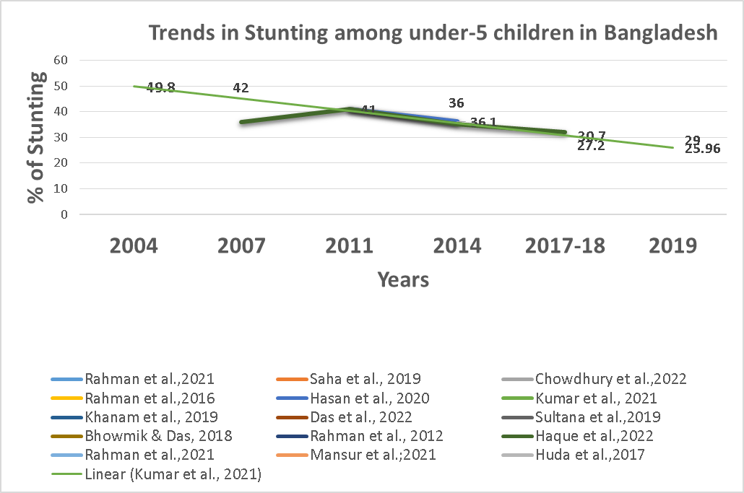
RESULT: FINDINGS AND DISCUSIONS
Figure: Trends of Stunting of Under 5 Children (%) in Bangladesh

Slide 14
RESULT: FINDINGS AND DISCUSION CONTINUE…
Division: From 2004 to 2017-18 indicating an overall decline in the national stunting trend of under – five children in Bangladesh.
Determinants have influenced the reduction of Stunting in Bangladesh in the last two decades.
Administrative Zone

Slide 15
RESULT: FINDINGS AND DISCUSION CONTINUE…
Place of Residence
Place
Both Urban and Rural places, Stunting of under 5 children is declining from 2004 to 2017/18.
Age at first birth less than 18 years mothers:
Stunted under 5 children:
51.7% in 2004,
33.5% in 2017-18 (Difference -18.2%, p-value <0.001).
Mother’s Characteristics

Slide 16
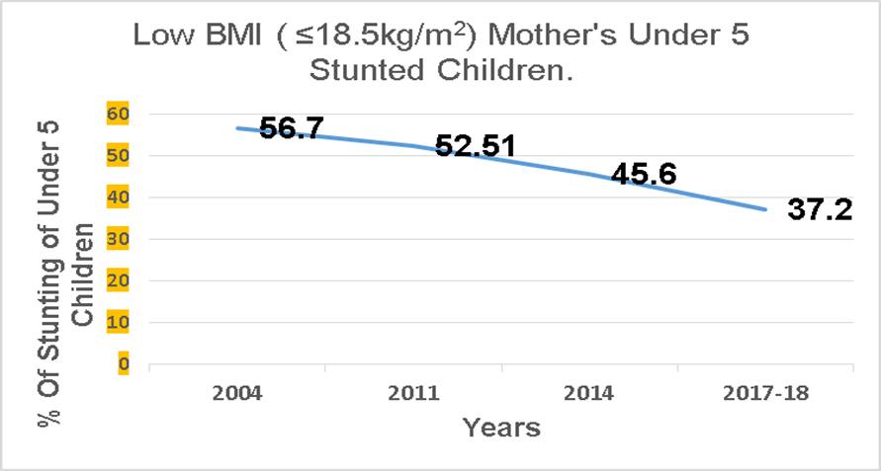
RESULT: FINDINGS AND DISCUSION CONTINUE…
Mother’s Low BMI:
Mother’s Characteristics
Mother’s Education:
Stunting rates for under-5 children of mothers with no education and low BMI have steadily declined since 2004.

Slide 17
RESULT: FINDINGS AND DISCUSION CONTINUE…
Father’s Characteristics
Fathers Education:
Stunting prevalence was very high (p < 0.001) among those fathers who did not attend school at any time.
Figures: The Prevalence of Stunting of under 5 children whose fathers did not attend School from 2011 to 2019.

Slide 18
RESULT: FINDINGS AND DISCUSION CONTINUE…
Mother’s working status:
Decreased stunting in under-5 stunting children.
2004 : 49.5%
2017-18: 28.3% (difference: 21.2%).
Mother’s Characteristics
Mother’s ANC visit Number:
Mothers who had ANC visits >4 in 2017–18 had less stunting in under-5 children (21.9%) compared to those who did not have ANC visits (30.2%).
Maternal height:
Pregnant mothers with short stature (<145 cm height) had 45.9% under-5 stunting children, which was 2.36 times more than pregnant mothers with height above 155 cm (RR 2.36, p value <0.001 ).
Experience with domestic violence and Child Stunting:
Stunting prevalence high in children whose mothers had experienced domestic violence (OR: 1.16).

Slide 19
RESULT: FINDINGS AND DISCUSION CONTINUE…
Child
Characteristics
Low Birth Weight:
The prevalence of stunting was noticeably higher in children with LBW (51%) than those with Normal birth weights (39%).
Children's age (in months):
The prevalence of under-5 stunting is highest among children aged 23–47 months.
Child Feeding Practice:
The prevalence of stunting low (28.77%) in the intervention areas .
Children Sex:
Male stunting decreased from 50.6% in 2004 to 30.8% in 2017-18 (a difference of -19.8%),
Female stunting decreased from 49.1% to 30.7% (a difference of -18.4%).

Slide 20
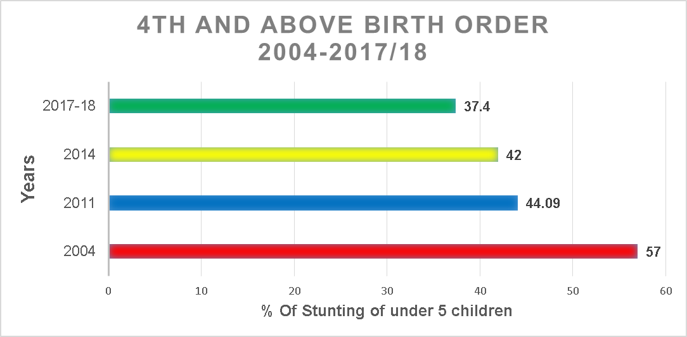
RESULT: FINDINGS AND DISCUSION CONTINUE…
Child Characteristics
Child
Characteristics
Birth Order:
The stunting rate is highest among 4th and above under-5 children,
Child Infections:
Stunting was associated with those babies who had recently experienced fever (39.59%, AOR: 1.19) and diarrhea (45.70%, AOR: 1.37), and ARI (38.17%, AOR: 1.01).

Slide 21
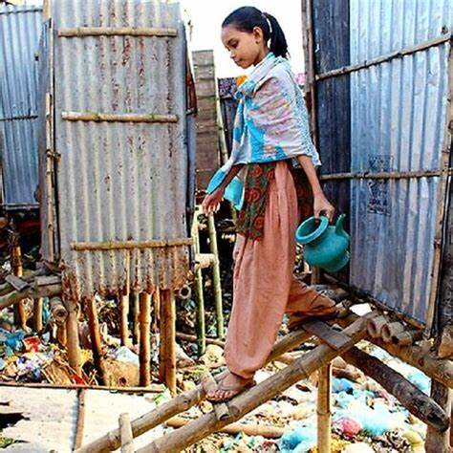
RESULT: FINDINGS AND DISCUSION CONTINUE…
Household Characteristics
Water Source:
2004, children using safe water sources had a stunting rate of 49.7%, compared to 55% of unsafe water sources.
2017-18, the stunting rate in improved water sources families was 27.0% compared to unimproved 40%.
Toilet Facility:
In 2004 :Stunting was found 56.9% in families with unhygienic sanitation.
In 2017-18 : 34.15%
Photo courtesy: Open Net Access, Bangladesh

Slide 22
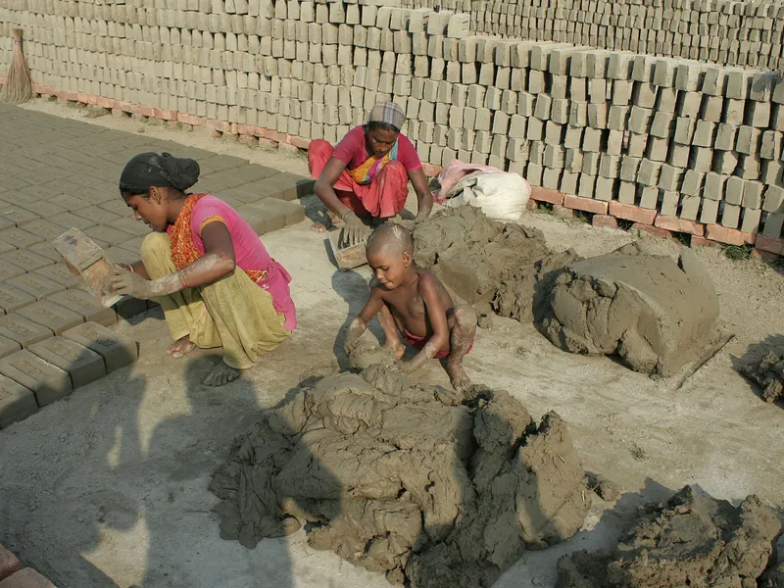
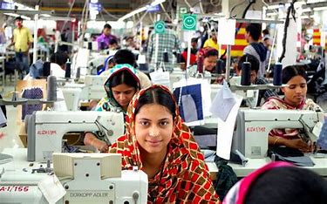
RESULT: FINDINGS AND DISCUSION CONTINUE…
Wealth Index:
The most stunting in wealth indexing was found in the poorest families. The wealth index is statistically significant (P < 0.001) in all classifications (Poorest, Poorer, Middle, Richer, and richest)

Slide 23
RESULT: FINDINGS AND DISCUSION CONTINUE…
STRENGTH OF THIS SYSTEMATIC REVIEW :
Used well recognised database (PubMed, Scopus, Cochrane).
Published papers in the most recognized peer-reviewed journals were analyzed.
Selected all papers used national and international well-recognized data (BDHS, MICS, Survey by icddr,b. BRAC, UHDSS ) which represents generally whole Bangladeshi population.
Large data sample of all research papers
All the research papers had good citation index.
LIMITATIONS OF THIS SYSTEMATIC REVIEW:
No relevant published papers were found on these topics in Paper Selection Years: 2002–2003, 2005–2006, 2008–2010, 2012–13, and 2020–2022.
This research analysis used cross-sectional data where both exposure and outcome variables were measured at the same time frame. Therefore, no causal relationships can be inferred.
The determinants of the selected papers were not identical due to the authors' own interest in independent variables.

Slide 24
CONCLUSION
CONCLUSION
This systematic review identified some important determinants which are significantly associated with under 5 stunting in Bangladesh, such as:
No parental education,
Unsafe drinking water,
Unhygienic toilet facilities,
Low birth weight,
Low maternal BMI,
Short birth interval,
4+ birth order,
Recurrent respiratory infections, gastrointestinal infections,
Exclusive Breastfeeding Practices,
Child Age Between 36-47 Months,
Adolescent Nutrition and Health Care,
Parental Working Status,
ANC Service Coverage, Legal Age of Marriage,
Child Diet Diversity at Weaning,
High Stunting Administrative Regions ( Rural, Sylhet)
Poorest Wealth Index
The trend of stunting in children under five years of age in Bangladesh has been reduced over the last two decades and currently lies at approximately 26% in 2019.

Slide 25
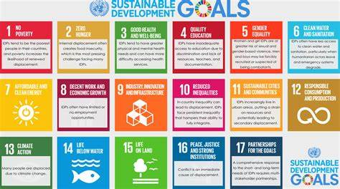
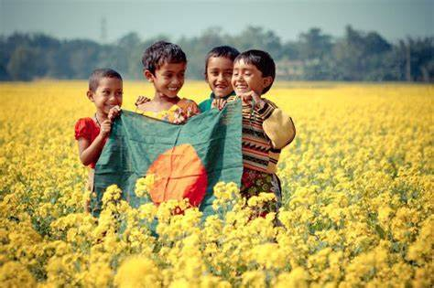
RECOMMENDATION
RECOMMENDATIONS
Overall, the determinants of stunting are multi-sectoral. Multi-sectoral approaches will progress the further reduction of the stunting rate among under-five children in Bangladesh.
For this, integrated planning by the government and development agencies and considering the results obtained in research studies in the last 2 decades, a strategy should be set up through a holistic approach where exclusive breast feeding programs will be strengthened, ANC services for pregnant mothers, adolescent-friendly health services, sanitation, and safe drinking water must be guaranteed at every community level. The stunting rate can be reduced by mobilizing the counseling unit at IMCI to reduce regular respiratory and diarrhea-related problems among under-5 children.
Above all, taking climate pollution control seriously, bringing extreme poverty to the zero line, and scaling up a high-protein rice mutation development project could ensure good nutrition for every child. A multi-sectoral approach involving the government and development partners will help achieve the Sustainable Development Goals by 2030 and further reduce stunting among under-5 children in Bangladesh
Photo courtesy: Internet

Slide 26
THE END

