Slide 1
Department of Public Health
School of Pharmacy and Public Health, Independent University, Bangladesh
Understanding the status of menstrual hygiene management among adolescent girls in low and middle-income countries to determine unmet needs: A Systematic review
Thesis presented by Prema Nath ID: 2120572

Slide 2
Through the WHO/UNICEF Joint Monitoring
Programme for Drinking Water, Sanitation, and Hygiene (JMP) defined MHM as
“Women and adolescent girls are using a clean menstrual management material to absorb or collect menstrual blood, that can be changed in privacy as often as necessary for the duration of a menstrual period, using soap and water for washing the body as required, and having access to facilities to dispose of used menstrual management materials.”
Introduction

Slide 3
Rationality of the study
Menstruation is a natural fact of life and a monthly occurrence for the 1.8 billion girls, women, transgender men and non-binary persons of reproductive age.
Adolescent girls may face stigma, harassment and social exclusion during menstruation.
Improving menstrual hygiene management aligns with several of the United Nations' Sustainable Development Goals, including Goal 3 (Good Health and Well-Being), Goal 4 (Quality Education), Goal 5 (Gender Equality), and Goal 6 (Clean Water and Sanitation)

Slide 4
Research question
What are the prevailing Menstrual Hygiene Management (MHM) practices, beliefs, and behaviors along with the main challenges, barriers, and cultural factors that hinder the adoption of proper MHM practices among adolescent girls in LMICs?

Slide 5
General Objective
The primary objective of this systematic review is to comprehensively assess the current status of menstrual hygiene management (MHM) practices among adolescent girls in low and middle-income countries (LMICs) and identify the unmet needs in terms of menstrual hygiene support, resources, and interventions.
Specific Objectives
1. To examine the prevailing menstrual hygiene practices, beliefs, and behaviors among adolescent girls in LMICs
2. To identify the challenges, barriers, and cultural factors that hinder the adoption of proper MHM practices among adolescent girls in LMICs.
3. To evaluate the impact of inadequate MHM practices on the educational experiences of adolescent girls in LMICs by assessing the availability, accessibility, and adequacy of menstrual hygiene resources, including sanitary products, sanitation facilities, and water supply, in educational institutions and communities in LMICs.

Slide 6
M
E
T
H
O
D
O
L
O
G
Y
Tools Used
Table List of Keywords Used
Search Engines 1. Cochrane 2. Springer 3. hand search using PubMed 4. hand search using Google Scholar
Information Management Microsoft Excel Mendeley
Study Quality Assessment STROBE
Concept | Keywords
Population | Adolescent, Adolescent girl, teenage, teenage girl, pubescent, young girl, teen, young
Condition | Menstrual*, Menstruation, menstrual cycle, menses, period, menarche, Menstrual hygiene management, Menstrual hygiene
Outcome | knowledge and practice, norms, knowledge, practice, attitude, View, Viewpoint
Setting | LMIC, Low and middle Income country, Low and middle Income countries, developing countries, Economically developing countries, developing country

Slide 7
Methodology
Table: Selection Criteria for Paper Selection
Inclusion criteria | Exclusion Criteria
Studies with Menstrual Hygiene Management Knowledge, Practice, Norms, Challenges, Menstrual Literacy, Menstrual Health, | Mostly the issues, which are not directly linked with Menstrual Hygiene Management like Menstrual Cycle, Early Motherhood,
Adolescent Girls, School going girls, Young girls, female adolescent students | Women, Young women,
Qualitative studies, Quantitative studies such as Cross-sectional survey, Randomized Control Trials etc. | Review Articles such as Systematic or Narrative reviews
Studies between 1st January 2012 to 31th December 2022 | Studies published before 1 January 2012 and studies published after 31 December 2022
Studies Published in English Language | Any language except English

Slide 8
Listing Literature for literature searching
Choosing suitable search engine
Searching literature using different combination of keywords
Artile title screening
Selecting relevent articles for further work
Organizing articles in a reference manager software like Mendeley and in an Excel sheet
Reviewing artile abstract
Creating a more details Excel database extrecting specific features from the choosen articles
Study Quality assesment Using STROBE guideline
Selecting articles according to the inclusion and exclusion criteria
Descreptive annalysis of the extrected Data
Methodology

Slide 9
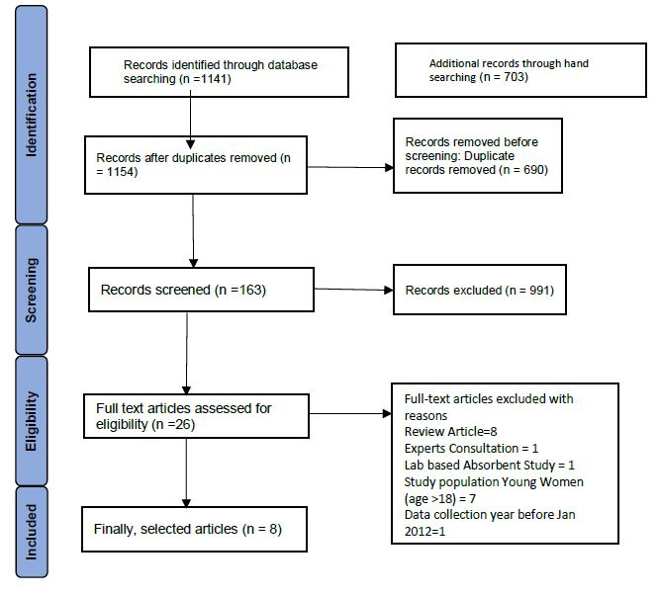
RESULTS
PRISMA Flow Diagram Summarizing the Findings from Literature Searching

Slide 10
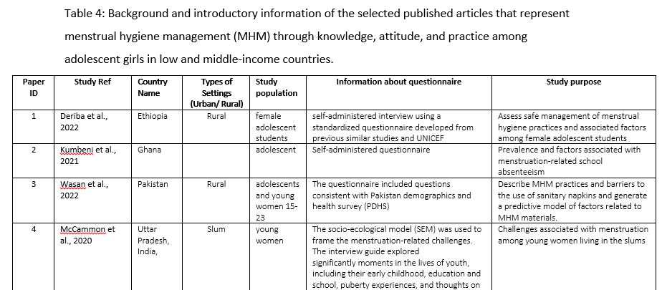
Introductory information for all nine selected articles has been illustrated in Table 4 including the corresponding country name, type of affected population, type of Settings (Urban/ Rural), Methods of data collection and Study purpose.

Slide 11
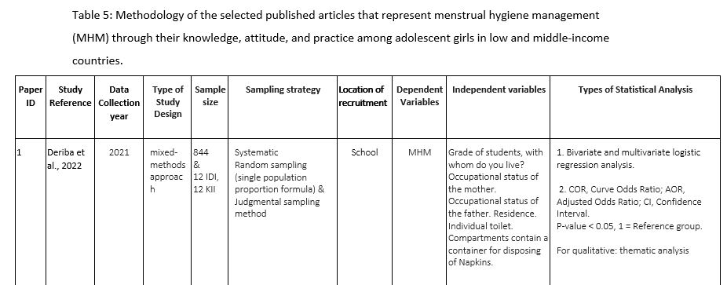
Methodology of the Selected Articles

Slide 12
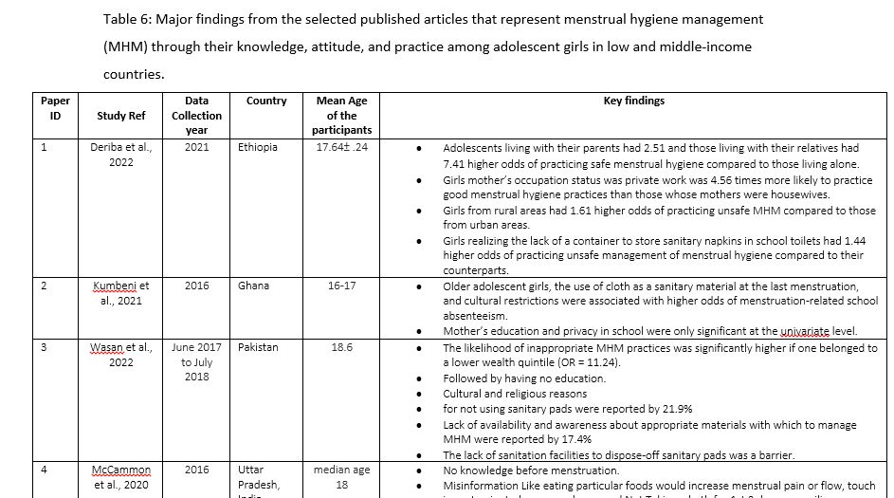
Findings from the Selected Articles

Slide 13
Factors associated with Menstrual Hygiene Management among Adolescents
Age: young girls or students in lower grades were more likely to have poor MHM practice. Adolescents were not more likely to have knowledge about menstruation before menstruation. On the other site older adolescents use old cloth as a sanitary material were associated with higher odds of menstrual related school absenteeism.
Living Arrangements: Adolescents living with parents or relatives had significantly higher odds of practicing safe menstrual hygiene compared to those living alone.
Rural-Urban Disparity: Girls from rural and slum areas had higher odds of practicing unsafe MHM compared to urban areas.

Slide 14
Factors associated with Menstrual Hygiene Management among Adolescents
School Environment: Lack of sanitary napkin storage,disposal in school toilets led to unsafe MHM practices.
School Absenteeism: Cultural restrictions, teased by the boys were associated with higher odds of menstruation-related school absenteeism.
Socio-Economic Factors: Lower wealth quintile significantly increased the likelihood of inappropriate MHM practices.

Slide 15
Factors associated with Menstrual Hygiene Management among Adolescents
Mother's Occupation and Education: Girls whose mothers had private work were more likely to practice good menstrual hygiene practices than those whose mothers were housewives. higher maternal education were associated with better MHM practices.
Knowledge and Misinformation: Misinformation, lack of knowledge, and conflicting beliefs impacted MHM practices.
Social Stigma: Menstrual stigma, limited discussion, and restricted interactions affected MHM.

Slide 16
Factors associated with Menstrual Hygiene Management among Adolescents
Adolescents from homes with no television and radio sets were more likely to have poor menstrual knowledge compared to those from homes with television and radio sets.
Cost, Safety and comfortability are associated with the use of menstrual materials

Slide 17
Prevalence of Poor MHM Practice

Slide 18
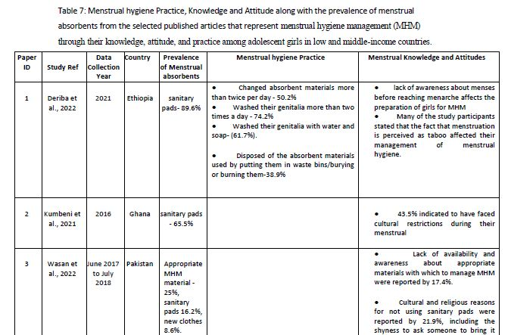
Findings focused on Knowledge, Attitude and Practice along with Prevalence of Menstrual absorbent

Slide 19
The studies represent prevalence of the use of sanitary pad, which are not showing the prevalence of the use of sanitary pad is not up to the mark, except one study from Central Ethiopia and another one from Indonesia represents 89.6% and 98.3%. Which are quite
In terms of practice we get a prevalence of changing absorbent per day, Washing genitalia per day, taking regular showers, practice of disposal, where most of them are alarming and any of them are not up to the mark.
In terms of getting information about menstruation young girls mostly get ideas from their mother, though in one study from Kenya It was 69.1% from the teachers.

Slide 20
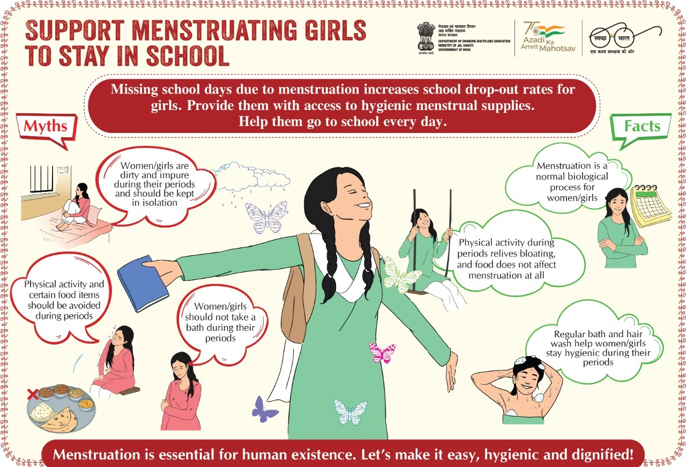
Access to Clean Water
functioning hand washing facilities
Clean and sex-separated Toilet Facilities
Sanitary Disposal
Privacy
Emergency Situations
Separate changing rooms-

Slide 21
Quality Rating of the Selected Studies
Paper ID | Study Ref | Quality rating of the study
1 | Deriba et al., 2022 | 48%
2 | Kumbeni et al., 2021 | 74%
3 | Wasan et al., 2022 | 68%
4 | McCammon et al., 2020 | 62%
5 | Davis et al. | 51%
6 | Mohammed & Larsen-Reindorf, 2020 | 71%
7 | Korir et al., 2018 | 54%
8 | Habtegiorgis et al., 2021 | 65%

Slide 22
Discussions
Variety of Contexts Covered
Outcome Assessment Challenges
Sampling and Generalizability
Study Quality Assessment
Diverse studies spanning African and South Asian countries.
Encompasses rural, urban, pastoralist communities, and schools.
Offers comprehensive insights into challenges and factors affecting MHM.
Prevalence of cross-sectional designs limits causal relationships.
Lack of qualitative data omits context and decision-making insights.
Qualitative data could have explored cultural beliefs and norms.
Non-representative sampling restricts generalizability.
Specific settings' focus may limit transferability.
Variability in cultural norms affects MHM practices.
Study quality assessed using STROBE checklist.
Study quality scores <80% across articles.
Follow-up of CONSORT/STROBE checklists recommended.

Slide 23
Limitation of the study
Limited Literature Sources
Narrowed Outcome Scope
- Utilized a limited number of databases.
- Missed potential relevant studies from broader databases (e.g., Medline, Scopus).
- Predominantly addressed knowledge, attitude, and practice.
- Lacks exploration of broader factors like reproductive health and violence.
1st
2nd
3rd
Strict Inclusion Criteria
- Exclusively focused on adolescent girls.
- Limited scope due to specific criteria.

Slide 24
RECOMMENDATION
-Integrate qualitative methods (interviews, focus groups) for deeper understanding of decision-making and experiences - Use various recruitment methods, including community-based approaches, to mitigate bias.
- Involve health managers and market suppliers to assess menstrual hygiene material availability.
- Engage communities, parents, and schools for comprehensive insights.
- Aim for larger, more representative sample sizes to enhance generalizability.
- Include diverse regions and population groups to broaden applicability.

Slide 25
CONCLUSION
This systematic review comprehensively assessed the field of MHM among adolescent girls in LMICs, revealing knowledge gaps and unmet needs.
The review's systematic identification and analysis highlighted limited research areas and interventions. Positive outcomes in reducing absenteeism were observed, but overall study quality was suboptimal according to checklists.
Addressing biases and enhancing study quality can empower girls to manage menstruation confidently and break taboos.

Slide 26
REFERENCES
(Sumpter, Colin, and Belen Torondel. “A Systematic Review of the Health and Social Effects of Menstrual Hygiene Management.” PLoS ONE, edited by Hamid RezaBaradaran, no. 4, Public Library of Science (PLoS), Apr. 2013, p. e62004. Crossref, doi:10.1371/journal.pone.0062004.)
“WHO Statement on Menstrual Health and Rights.” World Health Organization (WHO), https://www.who.int/news/item/22-06-2022-who-statement-on-menstrual-health-and-rights. Accessed 20 July 2023. / (“WHO Statement on Menstrual Health and Rights”.
Jones LL, Griffiths PL, Norris SA, Pettifor JM, Cameron N (2009) Age at menarche and the evidence for a positive secular trend in urban South Africa. Am J Hum Biol 21: 130–132.
Sharma K (1990) Age at menarche in northwest Indian females and a review of Indian data. Ann Hum Biol 17: 159–162.
Walker AR, Walker BF, Ncongwane J, Tshabalala EN (1984) Age of menopause in black women in South Africa. Br J ObstetGynaecol 91: 797–801.
Sommer M, Hirsch JS, Nathanson C, Parker RG. Comfortably, safely, and without shame: defining menstrual hygiene management as a public health issue. Am J Public Health. (2015) 105:1302–11. doi: 10.2105/AJPH.2014.302525.
Sommer, M. (2018). Menstrual hygiene management in schools: midway progress update 2018. UNESCO.U
UNICEF. (2018). Menstrual hygiene matters: a resource for improving menstrual hygiene around the world

