Slide 1
Prevalence and Risk Factors of Depression and Anxiety, and Perception of Mental Health Disorders among University Students in Bangladesh
Azizun Nahar
Student ID: 2010571
Master of Public Health
Department of Public Health
School of Pharmacy and Public Health
Independent University, Bangladesh

Slide 2
Presentation Outline
Background
Motivation
Methodology
Analytical Approach
Results
Discussion
Conclusion
Objectives

Slide 3
Background
Mental Health Disorders (MHDs) affect approximately 1 in 8 individuals globally, with depression and anxiety being the most common conditions
Depression and Anxiety Disorders are significant public health concerns, as they impact individuals’ quality of life and are associated with major impairments in daily functioning
University students, facing transitional challenges and stress, are particularly susceptible to experiencing depression and anxiety disorders, with high prevalence rates worldwide

Slide 4
Motivation
Gap analysis of current literature reveals that previous studies:
Have not explored the impact of social activity and recession concerns
Have not sufficiently examined knowledge and perception of mental health disorders
Have mostly focused on specific populations (i.e. either particular university or medical students cohort)

Slide 5
Objectives
General Objective:
To find out the prevalence and risk factors of depression and anxiety, and perception of mental health disorders among University students in Bangladesh.
Specific Objectives:
To explore the prevalence of depression and anxiety disorders among university students in Bangladesh,
To identify the potential risk factors associated with the symptoms and
To learn about students’ knowledge and perception about mental health disorders.

Slide 6
Methodology
Data Collection Process
Survey Contents
Data was collected by random sampling technique using a self-administered questionnaire (survey)
Inclusion Criteria:
Registered university students
Participants who participated voluntarily
Participants who successfully answered all survey questions
Exclusion Criteria:
Students already taking treatment for MHD
Students not willing to participate
PHQ-9 questionnaire to assess level of depression
GAD-7 questionnaire to assess the level of anxiety
Demographic factors (gender, area of study, place of residence, accommodation)
Socio-Economic factors (social activity, physical activity, smoking habit, financial stress and recession concern)
MHD Perception related factors (reason for MHD, MHD curability, care willingness, MHD care provider)

Slide 7
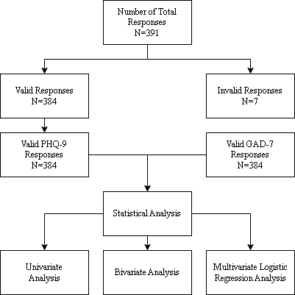
Analytical Approach
Data source and Survey population:
3 different private universities and 2 private medical colleges
University registered undergrad students
Age Range: 18-24 years old
Residence: Bangladesh
Study Period: February 19 to March 6, 2023
Statistical analysis was performed using Microsoft Excel and IBM SPSS (Version 22.0)

Slide 8
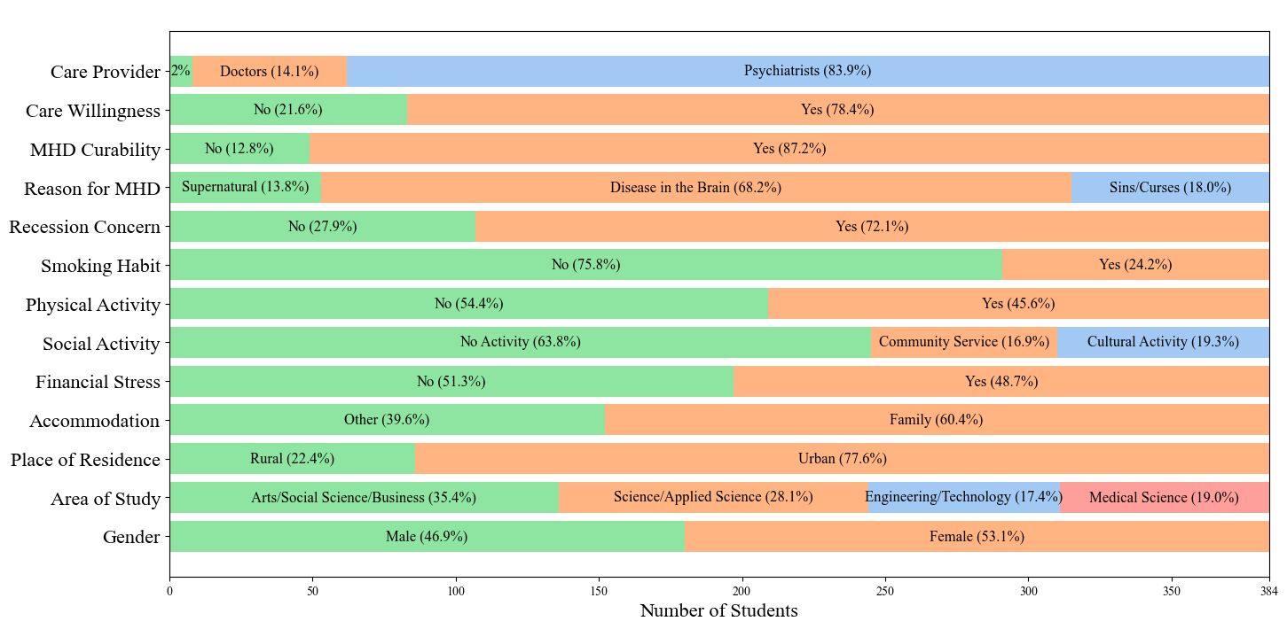
Univariate Analysis: Percentage frequency for each variable

Slide 9
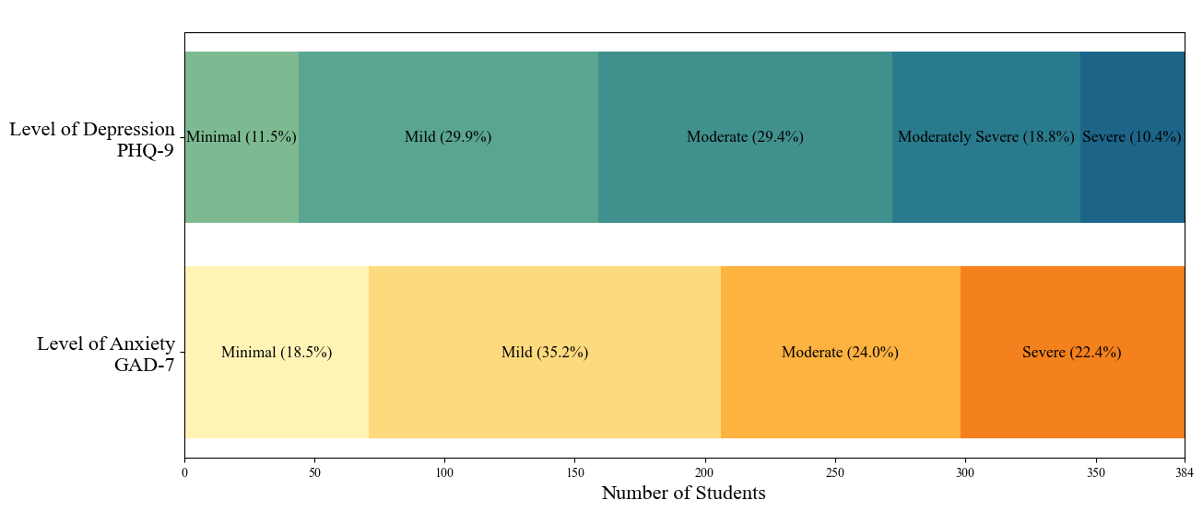
Univariate Analysis: Percentage frequency for level of depression and anxiety

Slide 10
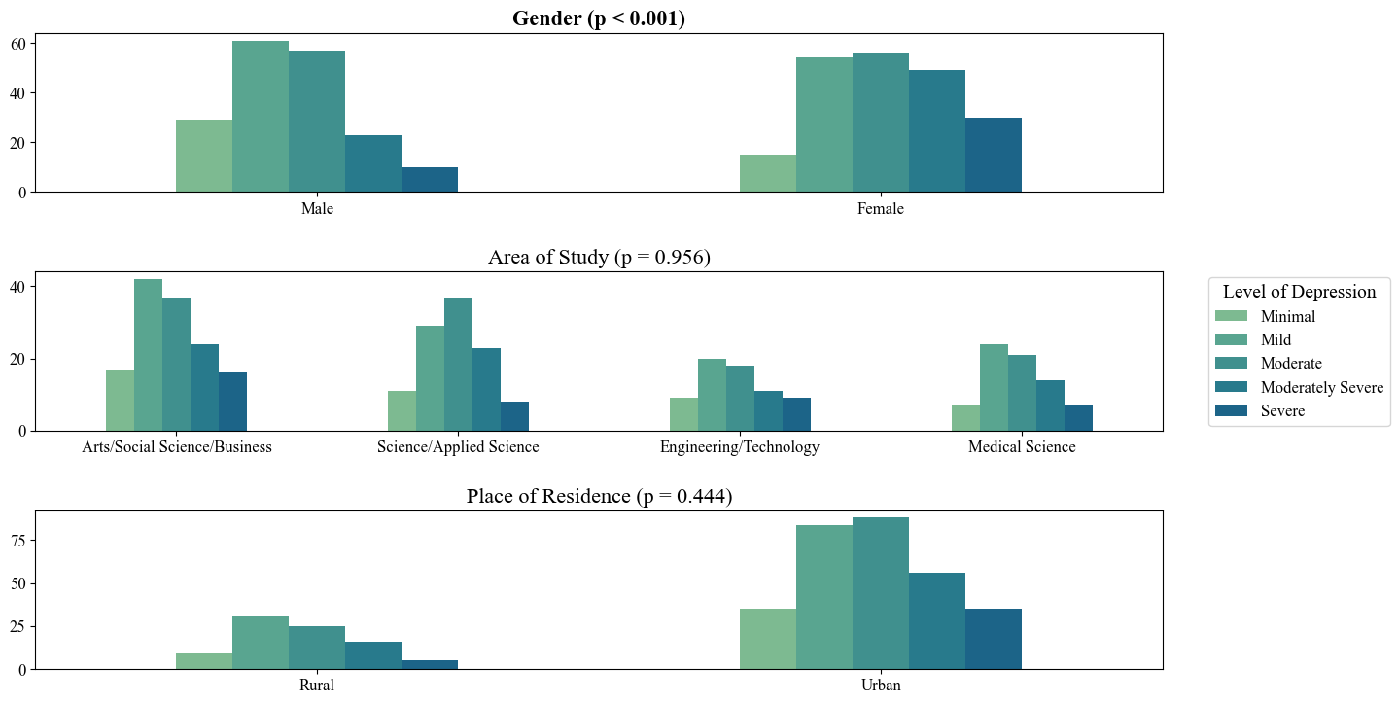
Bivariate Analysis: Association Between Depression and Covariates

Slide 11
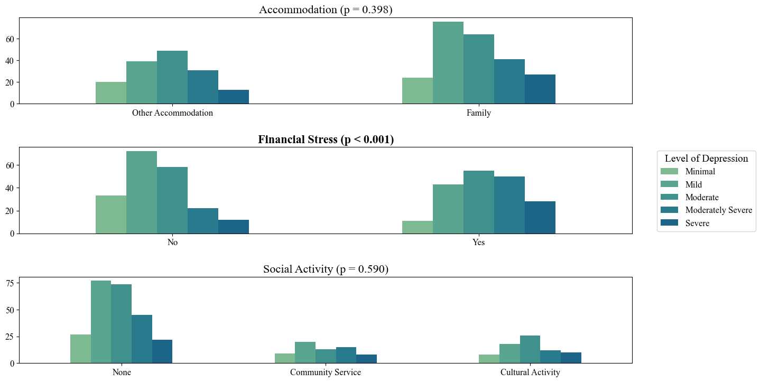
Bivariate Analysis: Association Between Depression and Covariates (Cont.)

Slide 12
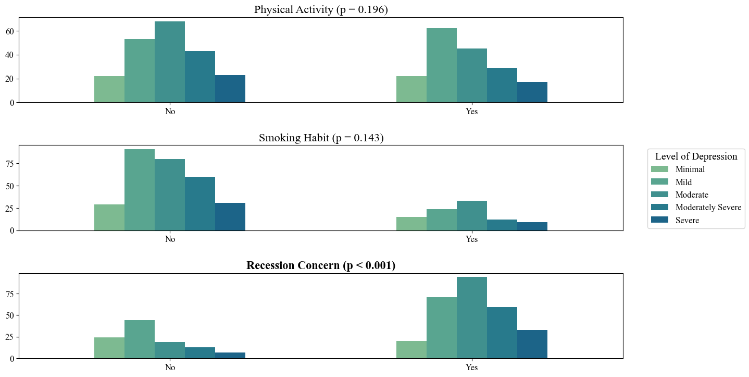
Bivariate Analysis: Association Between Depression and Covariates (Cont.)

Slide 13
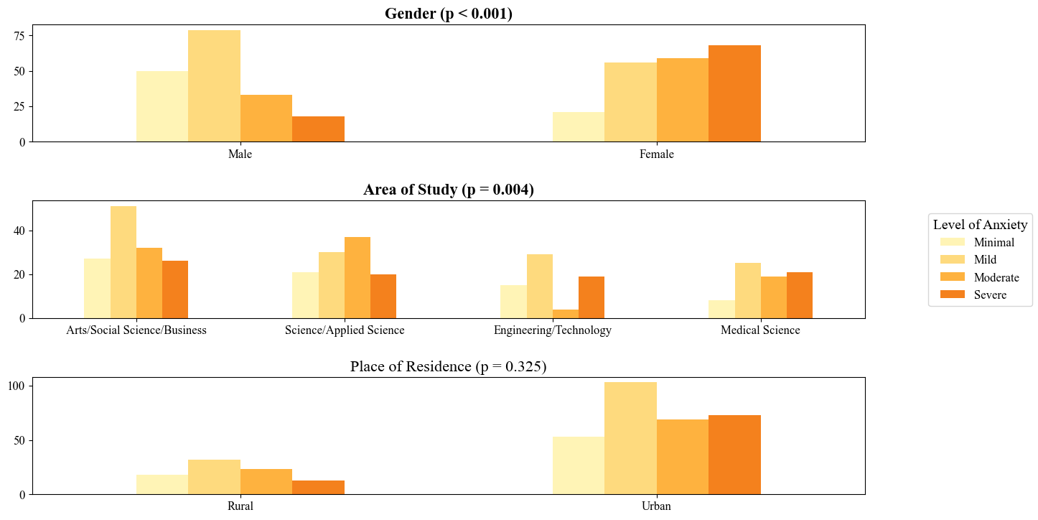
Bivariate Analysis: Association Between Anxiety and Covariates

Slide 14
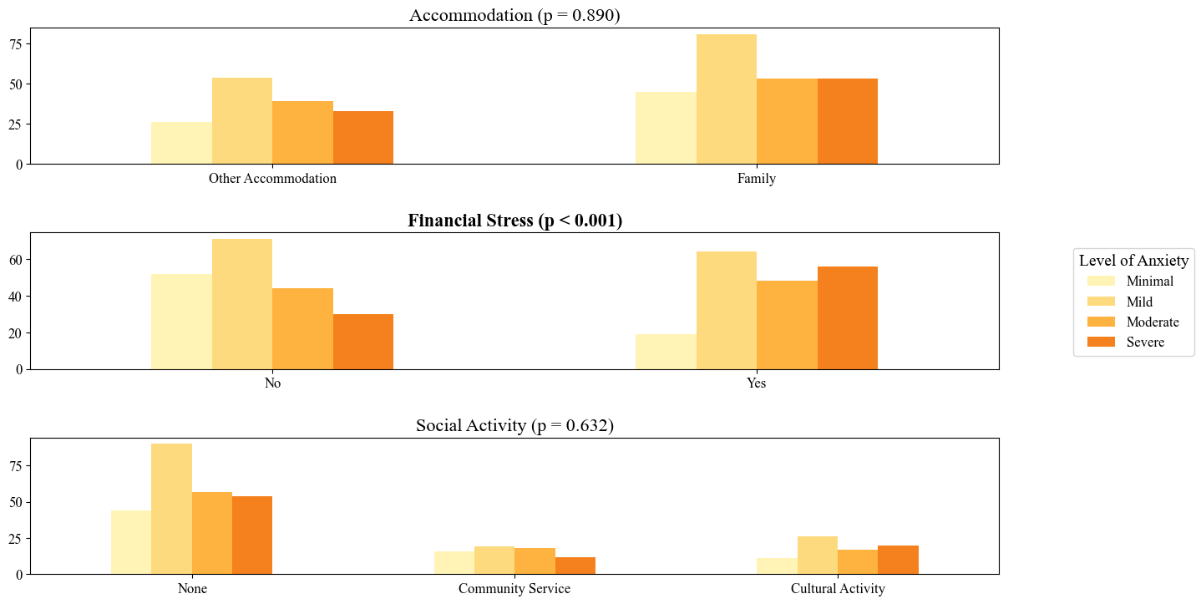
Bivariate Analysis: Association Between Anxiety and Covariates (Cont.)

Slide 15
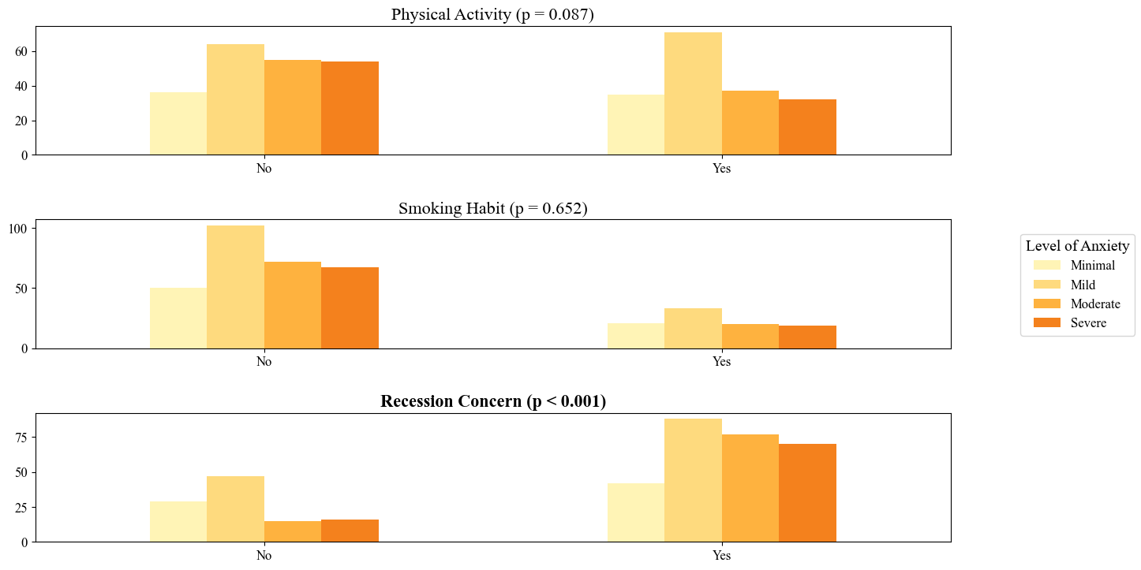
Bivariate Analysis: Association Between Anxiety and Covariates (Cont.)

Slide 16
Binary Logistic Regression Model For Depression
Covariates (Variables Categorized) | Regression Coefficient | p-value | OR | 95% Confidence Interval for odds ratio (lower - upper)
Constant | 0.629 | 0.296 | 1.875
Gender
Male (Ref) | - | - | - | -
Female | 0.737 | 0.094 | 2.090 | (0.883 - 4.948)
Area of Study
Arts/ Social science /Business (Ref) | - | - | - | -
Science/Applied science | -0.215 | 0.637 | 0.807 | (0.331 - 1.967)
Engineering &Technology | -0.055 | 0.910 | 0.947 | (0.366 - 2.448)
Medical Science | 0.089 | 0.874 | 1.093 | (0.366 - 3.266)
Place of Residence (Original)
Rural (Ref) | - | - | - | -
Urban | -0.072 | 0.863 | 0.931 | (0.410 - 2.113)
Accommodation
Other Accommodation (Ref) | - | - | - | -
Family | 0.438 | 0.223 | 1.549 | (0.767 - 3.132)

Slide 17
Binary Logistic Regression Model For Depression
Covariates (Variables Categorized) | Regression Coefficient | p-value | OR | 95% Confidence Interval for odds ratio (lower - upper)
Financial Stress
No (Ref) | - | - | - | -
Yes | 0.964 | 0.015 | 2.623 | (1.204 - 5.713)
Social Activity
No Activity (Ref) | - | - | - | -
Community Service | -0.034 | 0.940 | 0.967 | (0.403 - 2.320)
Cultural Activity | -0.133 | 0.775 | 0.876 | (0.352 - 2.180)
Physical Activity
No (Ref) |  |  |  | -
Yes | -0.006 | 0.988 | 0.994 | (.485 - 2.038)
Smoking Habit
No (Ref) |  |  |  | -
Yes | -0.279 | 0.506 | 0.757 | (0.333 - 1.720)
Recession Concern
No (Ref) |  |  |  | -
Yes | 1.128 | 0.001 | 3.088 | (4.550 - 6.152)

Slide 18
Binary Logistic Regression Model For Anxiety
Covariates (Variables Categorized) | Regression Coefficient | p-value | OR | 95% Confidence Interval for odds ratio (lower - upper)
Constant | -0.060 | 0.906 | 0.941
Gender
Male (Ref) | - | - | - | -
Female | 1.295 | ˂ 0.001 | 3.650 | (1.816 - 7.335)
Area of Study
Arts/ Social science /Business (Ref) | - | - | - | -
Science/Applied science | -0.378 | 0.307 | 0.685 | (0.332 - 1.415)
Engineering &Technology | 0.034 | 0.933 | 1.034 | (0.472 - 2.267)
Medical Science | 0.450 | 0.360 | 1.569 | (0.599 - 4.111)
Place of Residence (Original)
Rural (Ref) | - | - | - | -
Urban | 0.174 | 0.598 | 1.190 | (0.624 - 2.269)
Accommodation
Other Accommodation (Ref) | - | - | - | -
Family | -0.027 | 0.930 | 0.974 | (0.537 - 1.765)

Slide 19
Binary Logistic Regression Model For Anxiety
Covariates (Variables Categorized) | Regression Coefficient | p-value | OR | 95% Confidence Interval for odds ratio (lower - upper)
Financial Stress
No (Ref) | - | - | - | -
Yes | 1.110 | ˂ 0.001 | 3.035 | (1.625 - 5.669)
Social Activity
No Activity (Ref) | - | - | - | -
Community Service | -0.177 | 0.628 | 0.838 | (0.409 - 1.715)
Cultural Activity | 0.163 | 0.685 | 1.178 | (0.535 - 2.594)
Physical Activity
No (Ref) | - | - | - | -
Yes | 0.139 | 0.647 | 1.149 | (0.635 - 2.078)
Smoking Habit
No (Ref) | - | - | - | -
Yes | 0.266 | 0.450 | 1.305 | (0.654 - 2.603)
Recession Concern
No (Ref) | - | - | - | -
Yes | 0.471 | 0.121 | 1.602 | (0.883 - 2.909)

Slide 20
Discussion |Key Findings
Prevalence of mild to severe depression and anxiety was 88.5% and 81.6% respectively
Large gender gap in MHD occurrence
Bivariate analysis showed gender had a highly significant (p < 0.001) influence on both depression and anxiety,
Multivariate analysis showed 109% higher odds of depression and 265% significantly higher odds of anxiety for women.
Knowledge and Perception of MHDs among university students surprisingly found to be at good level
68.2% of students believed that MHDs caused by diseases in the brain;
the rest believed they are due to supernatural forces, or sins and curses,
78.4% of students displayed willingness to seek treatment for MHDs,
83.9% of students correctly knew that psychiatrists/clinical psychologists are care providers for MHD.
Cont.

Slide 21
Discussion |Key Findings
Economic concerns play a major role in MHD incidence
72.1% of students had concerns about a financial recession and 48.7% of students were under financial stress.
Bivariate analysis showed recession concerns and financial stress had significant influences (p < 0.001) on depression and anxiety.
Regression analysis showed that students with recession concerns and financial stress had 208.8% and 162.3% higher odds of depression, respectively.
Our regression analysis also showed that students with recession concerns and financial stress had 60.2% and 203.5% higher odds of anxiety, respectively.
Study Limitations
Data collection excluded students already under treatment for MHDs.
Data was collected in a short span of time, and sample size was only 384.

Slide 22
Conclusion
Our study found high prevalence of Depression and Anxiety among university students in Bangladesh
Which had impacts on academic performance, social relationships, communication of the students.
Our study also found recession concern for depression and gender for anxiety, and financial stress for both, as the main stressors.
Knowledge and Perception about MHDs among university students were found to be at good level in our study and most of them were willing to get mental health treatment or care.
Cont.

Slide 23
Conclusion
Recommendations
Universities, in partnership with the government, should work together to deliver financial and psychological support for students at risk.
NGOs and Global Agencies should work to improve community awareness of MHDs, their causes, and their treatments.
Future Works
Further explore the gender gap in prevalence of MHDs, analyzing challenges uniquely faced by female university students as opposed to their male counterparts.
Expand scope of data collection in terms of number and location, and include students currently under treatment for MHDs to get a better understanding of the full severity of depression and anxiety among university students in Bangladesh.

Slide 24
Thank You So Much For Attending
Please send any questions to: 2010571@iub.bd.edu

