Slide 1
A Narrative review on Acceptance, hesitancy of COVID-19 vaccination on Pregnant & breastfeeding mother.
Submitted by: Faijunnesa Khanam Jui
Student ID: 232008
Master of Public Health
Independent University, Bangladesh.
Supervised by:
Zenat Zebin Hossain, Ph,D
Assistant Professor
Department of Public Health
Independent University, Bangladesh.

Slide 2
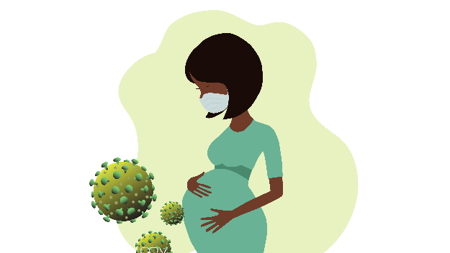
introduction
The COVID-19 pandemic has led to the death of many people Worldwide. More than six million deaths have been recorded worldwide up to July 2023.
In the absence of an effective treatment for coronavirus disease non‐pharmaceutical interventions are the only available methods of disease control, but maintaining these actions is not practicable in the long term. As a result, herd immunity by vaccination becomes the most effective eradication method for COVID-19.
The World Health Organization (WHO) has declared vaccine resistance as one of the greatest health threats in the world.
One of the largest groups for vaccine hesitancy are pregnant people. Despite concern about being exposed to COVID-19, only 25% of expectant mothers have had at least one dose of the COVID-19 vaccine, compared with 76.9% of all women in the USA.
Pregnancy is considered a state of relative immunosuppression with a decrease in cellular immunity and possible susceptibility to infections.
Furthermore, the immaturity of the immune system of fetuses and newborns makes them more vulnerable to infections. Therefore, pregnant women and neonates could be considered high-risk groups for COVID-19 infection.

Slide 3
8 Mar. 2020
First 3 cases of novel coronavirus detected in Bangladesh.
11 Mar. 2020
WHO declared global pandemic.
18 Mar. 2020
First COVID-19 deaths in Bangladesh.
26 Mar. 2020
First lockdown declared by Bangladesh Government.
2 Dec. 2020
UK was the first country to approve a vaccine against COVID-19.
27 Jan. 2021
Bangladesh began the administration of COVID-19 vaccines.
8 Aug. 2021
COVID-19 vaccine eligibility in Bangladesh was expanded to include pregnant and lactating women following the recommendation of the NITAGs and DGHS.
Timeline of events for COVID-19 outbreak and vaccine recommendations in Bangladesh.

Slide 4
Vaccine recommendation
The American College of Obstetrics and Gynecologists (ACOG) recommends vaccination against several vaccine preventable infectious diseases during pregnancy, including COVID-19 vaccine.
COVID-19 infections in pregnancy can have severe outcomes.
The risk of COVID-19 vertical transmission from mother to child is still unclear. However, data suggests 62% higher odds of preeclampsia developing during a COVID-19 infection in addition to a significantly high risk for maternal mortality in unvaccinated mothers.
Infants born to vaccinated mothers that contracted COVID had less severe infections and were less likely to require hospitalization.

Slide 5
Vaccine hesitancy
Vaccine hesitancy and refusal are multifactorial, complex issues that both the medical and public health systems need to address synergistically.
Vaccine hesitancy in pregnant people is a unique issue as a pregnant mother may view concern for vaccination through either a parental lens - having concern for the vaccine’s impact on the health of the unborn baby, and/or through a personal lens – having concern for the vaccine’s impact on her own health.

Slide 6
objectives
1.
The acceptance rate of COVID-19 vaccine among pregnant and breast-feeding mothers.
2.
The relative factors of vaccine hesitancy.
3.
Their reported reason of vaccine hesitancy.
with the goal of assisting in the development of COVID-19 vaccine program efficacy and promoting more research in this area.

Slide 7
Methodology
As this is a review article, direct data collection method was not applied in this study.
Rather, results from different original research paper on the same topic were investigated. To conduct this narrative review, articles related to the topic were searched through Google scholar databases and some electronic databases like PubMed, frontiers in Public health using the search terms ‘‘vaccine acceptance” AND ‘‘vaccine hesitancy” AND ‘‘pregnancy”.
This search was continued from December 2021 to July 2023, by following the requirements to conduct a narrative review.

Slide 8
methodology
Inclusion Criteria
50 % of subjects included study must be pregnant at the time of the study
Reasons of Exclusion
Studies that focused on parental acceptance of vaccination for children
Studies that focused on opinions of health care workers
Studies with subject groups composed of <50 % pregnant women, only post-partum women, or only non-pregnant women
All Review articles
Studies surveyed pregnant women about maternal vaccination during the course of their pregnancy
Cross-sectional study

Slide 9
methodology
Records Identified, n=31
Records excluded for not meeting criteria, n=20
Records Screened, n=11
Records identified through database searching,
PubMed= 242
Frontier in PH= 309
Records after duplicates removed, n= 230
Original and full text articles assessed, n= 215

Slide 10
results
After screening several articles, results of relevant research papers were summarized to understand the acceptance of COVID-19 vaccines on pregnant mother.
Types of studies taken into account for review.

Slide 11
results
Population or sample sizes of reviewed studies.
Saudi Arabia= 5307
Australia= 287

Slide 12
results
More than 60%
Less than 40%
Malaysia
Ethiopia
Australia
Saudi Arabia
Sudan
West indies
South Korea
Nepal
India
Switzerland

Slide 13
Demographic predictors of COVID-19 vaccine acceptance among pregnant women
The acceptance rate of vaccination against COVID-19 among pregnant women according to the studies included in the review and related factors of hesitancy (i.e., maternal age, gestational age, educational level, partners education level).
Out of eleven studies median maternal age were 28-33years.
Out of eleven studies, Two studies found that pregnant women in their third trimester were more likely to accept vaccination against COVID-19 than pregnant women in early pregnancy. But in the study of India showed different results as, among all stage of pregnancy the maximum hesitancy was seen in the third trimester of pregnancy 29.5%.
Out of the eleven studies that investigated whether eight studies showed that education level is a predictor of vaccine acceptance. More specifically, In a study of Saudi Arabia, Pregnant women with primary education were 2.8 times more likely to accept vaccination against COVID-19 than illiterate pregnant women. In the study of Switzerland showed, The PW with a master’s degree or higher (85.3%) had a significantly higher acceptance level than the PW with basic education (42.9%). In the study of Nepal showed female less than Bachelor’s degree graduates were 3.5 times less likely to accept being vaccinated against COVID-19 in relation to pregnant women who had a Bachelor’s degree.

Slide 14
Cont.
Seven out of the eleven studies showed that occupational status is a predictor of acceptance of COVID-19 vaccination among pregnant women. Employed pregnant women were found to be more likely to accept being vaccinated against COVID-19 than pregnant women who were unemployed/housewife. In a study of Saudi Arabia showed, Government sector workers (75.1%) are more likely to accept vaccinated against COVID-19 than non-government sector workers. On the other hand, in the study of Ethiopia we can seen, private employees were high acceptance rate than government employees. Two studies show, The pregnant healthcare workers (74%) had an insignificantly lower acceptance level compared to the non-healthcare workers/non-medical person (80.7%).
Only one study found that husband’s education is a predictor of acceptance of COVID-19 vaccination among pregnant women. In the study of Sudan, showed that PW with secondary level education completed husband were 4.5 times more significantly to accept vaccination than lower than secondary school.

Slide 15
Higher vaccine acceptance
Maternal Age
25-33 years
Gestational Age
Third trimester
Education level
Employment status
Partner’s Education level
Primary education, more than Bachelors degree or Master’s degree
Employed pregnant women, Government sector workers
Secondary level education

Slide 16
Covid-19 vaccine acceptance among pregnant women and lactating mothers
One study showed, Out of the 362 included participants, 278 were pregnant (PW) and 84 were lactating women (LW). The overall COVID-19 vaccine acceptance level was substantially high (70.2%), with a significant difference between PW (76.6%) and LW (48.8%).
Another analysis revealed that, even after government approval, 26% of pregnant and lactating women showed vaccine hesitancy and 58% of individuals were willing to take COVID‑19 vaccine. When compared, lactating individuals showed less vaccine hesitancy (22%) than pregnant individuals (27%)

Slide 17
Reasons of hesitancy
The Primary reason mentioned throughout a majority of the literature reviewed was COVID-19 vaccine can harm their unborn child.
The Second most frequent reason was fear of side effects or adverse events.
The Third most frequent reason was lack of information or data about COVID-19 vaccine safety about pregnant women.
Additional less frequently reasons included: religion beliefs; family decision; vaccine cost; spousal hesitation for the pregnant partner to receive the vaccine; and misinformation and misconceptions about vaccination.
Our question was, ‘‘What are the primary concerns of pregnant people that lead them to be hesitant about receiving vaccinations?”, was addressed by authors of 7 articles and revealed several thematic reasons explaining why people are concerned about receiving vaccination during pregnancy

Slide 19
Psychosocial Predictors of Vaccine Hesitancy
The impact of media/social media on participants’ decisions was reported by only 8.3% of the participants.
Most PLW (58.7%) did not think that the government made decisions in the participants’ best interest concerning the offered vaccines.
Only 15% of the participants believed that the pharmaceutical companies were honest and transparent regarding safety data for pregnant women.
Nearly one quarter (24.7%) agreed, and another quarter (26.9%) disagreed with the notion that healthcare professionals would tell them honestly about the risks and benefits of vaccines, less than those (48.3%) who were still hesitant.

Slide 20
Impact of tele-educational program on COVID-19 vaccine hesitancy
The study presented, a statistically significant difference in the levels of hesitancy in the intervention group. Before the program, women in the intervention group reported significantly higher levels of hesitancy compared to those after the program. However, results for the control group showed no statistically significant difference in the mean score of the hesitancy to get the vaccine before and after the program.
The program significantly lowered the mean score of hesitating to get the vaccine for the intervention group only. Results showed that women in the intervention group received the vaccine at a significantly higher rate after the program than before it. However, receiving the vaccine did not differ for the control group.

Slide 21
Discussion
The present narrative review included 11 studies that met certain inclusion and exclusion criteria and aimed to estimate the acceptance of COVID-19 vaccination among pregnant women. 11 studies including 11,368 pregnant women from 11 countries were included in the analysis. Additionally, we intended to investigate factors associated with vaccination acceptance, as well as reasons for vaccination hesitancy.
The acceptance rate of vaccination against COVID-19 among pregnant women ranged from 2.7% to 77.1%. The results of our study are significantly vary from the results of two earlier meta-analyses and found that the global prevalence of pregnant women receiving the vaccine for COVID-19 was approximately 49–54%. Another, COVID-19 vaccination acceptability in pregnant women was 54% globally.
Acceptance of COVID-19 vaccination was associated with several factors, including older age, occupational status, higher level of education, advanced gestation, knowledge about COVID-19, and confidence that COVID-19 vaccines are safe and effective.
Older age was found to be associated with higher acceptance of COVID vaccines. Pregnancy at advanced maternal age is known to be a risk factor for adverse outcomes. It is probable that older pregnant women face COVID-19 with added fear, resulting in their higher acceptance of COVID-19 vaccination.
Moreover, in our review, the rate of COVID-19 vaccination acceptance was highest among Malay and Swiss pregnant women and lowest among those of Sudanese Arabs and Nepalis.
Pregnant women in their third trimester were more likely to accept vaccination against COVID-19 than pregnant women in early pregnancy. But another study showed Indian pregnant women were maximum hesitance at third trimester of pregnancy.

Slide 22
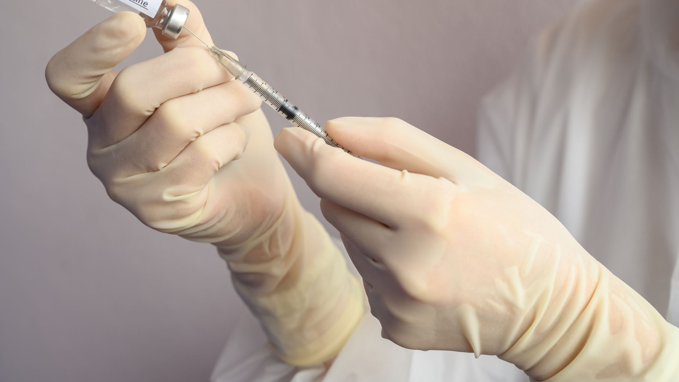
Cont.
Education level is a predictor of vaccine acceptance where pregnant women with primary education, more than Bachelor’s or Master’s degree more likely to accept vaccination against COVID-19 than illiterate pregnant women.
On the other hand, employed pregnant women were more willingly get vaccinated against COVID-19 than pregnant women who were unemployed/housewife.
The pregnant healthcare workers had an insignificantly lower acceptance level compared to the non-healthcare workers/non-medical person.
Husband’s education also a predictor of acceptance of COVID-19 vaccination among pregnant women which shows more acceptance for educated husbands.

Slide 23
Cont.
Confidence in COVID-19 vaccines and fewer concerns about the safety and side effects of COVID-19 vaccines are predictors of hesitancy of COVID-19 vaccination. Similar factors, such as confidence in the safety and effectiveness of COVID-19 vaccines, confidence in the information received about vaccination against COVID-19, confidence in childhood vaccines, and influenza vaccination in the previous year, are associated with a higher rate of intention of pregnant women to deny a COVID-19 vaccine.
Accordingly, previous studies suggested that evidence-based education could change women’s behavior, which is likely to decrease COVID-19 vaccine hesitancy and, therefore, minimize the effect of the COVID-19 pandemic.
In general, high levels of information and knowledge about COVID-19 vaccines reduce fear and have a significant effect on a pregnant woman’s decision to get vaccinated against COVID-19.
This may suggest that health workers have an important role in patients’ education on vaccine safety and importance.

Slide 24
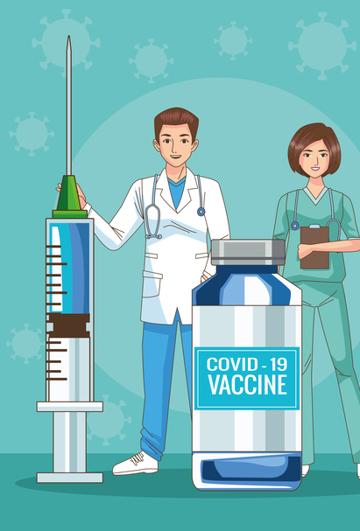
Cont.
We also found that the source of education can heavily influence a person’s willingness to accept a vaccine during pregnancy, whereas the delivery method of vaccine education had a lesser impact on a person’s willingness to accept vaccination during pregnancy.
The sources of education with the greatest influence on vaccine acceptance during pregnancy were institutional backed sources, followed by verbal education from family members. Institutional sources included: verbal education from trusted health care providers and written information from academic clinical facilities.
Considering both the historical context of vaccine hesitancy and results from the literature search, we propose that health care providers consider our suggested framework developed to deliver vaccine information to pregnant persons based on their current feelings towards vaccination.

Slide 25
Limitation of the review
This paper has several limitations. Given the nature of narrative reviews, the articles included in our study were not systematically reviewed. Moreover, articles in the English language were only included which may have prevented us from accessing literature in other native languages across South Asia.
In addition, conference proceedings and other databases such as Scopus were not included in our search, which limited our final results.
Our review only included cross-sectional studies that were survey-based while other studies including ones that analyze threads on social media platforms may have provided more insights since the use of such platforms increased during the pandemic.
Also, qualitative studies may have given more in-depth descriptions of individual experiences.
Collectively, these different factors could potentially add bias, and varying views may reflect different findings suggesting the diversity of opinions and conclusions.

Slide 26
conclusion
In summary, it can be said that most of the studies considered in this review has shown that the hesitancy and acceptance of COVID-19 vaccine among the pregnant women depends on their own knowledge about vaccine as well as their partners also.
It was concluded that the knowledge of pregnant women after being given an education program about COVID-19 vaccination improved their willingness to participate in the COVID-19 vaccination and decreased their hesitancy.
Efforts need to be made to increase the knowledge of pregnant women through health education on COVID-19 vaccination by health workers so that the coverage of COVID-19 vaccination in pregnant women can increase, which in turn will affect the morbidity and mortality rates of pregnant women due to COVID-19 infection.
From this review, it can be also suggested that further investigation is also required to understand different socio economic and other issues to better understand the factors of hesitancy of COVID-19 vaccine among pregnant women in Worldwide.

Slide 27
references
Hinman AR. The eradication of polio: have we succeeded? Vaccine. 2017;35(42):5519‐5521. [PubMed] [Google Scholar]
Durrheim DN, Crowcroft NS, Strebel PM. Measles—the epidemiology of elimination. Vaccine. 2014;32(51):6880‐6883. [PubMed] [Google Scholar]
Goncu Ayhan S, Oluklu D, Atalay A, Menekse Beser D, Tanacan A, Moraloglu Tekin O, et al. COVID-19 vaccine acceptance in pregnant women. Int J Gynaecol Obstet. (2021) 154:291–6. doi: 10.1002/ijgo.13713
Michailidou, D.; Stavridou, A.; Panagouli, E.D.; Sergentanis, T.N.; Psaltopoulou, T.; Bacopoulou, F.; Baltag, V.; Greydanus, D.E.; Mastorakos, G.; Chrousos, G.P.; et al. The impact of COVID-19 during pregnancy on maternal and neonatal outcomes: A systematic review. EMBnet. J. 2021, 26, e969. https://doi.org/10.14806/EJ.26.1.969.
Kumar V, Patil Y, Jain R, Bhanushali N, Gaonkar K, Ciby J. COVID-19 vaccination acceptance and adherence among pregnant and lactating high-risk group individuals of Maharashtra State, India. J Edu Health Promot 2023;12:36.
Dhakal R, Shapkota S, Shrestha P, Adhikari P, Nepal S (2023) Pregnant women’s awareness, perception, and acceptability of COVID-19 vaccine attending antenatal clinics in Bharatpur, Nepal. PLoS ONE 18(3): e0278694. https://doi.org/10.1371/journal.pone.0278694
World Health Organization. Coronavirus disease (COVID-19). 2020 [cited 2023 Apr 5]. Available from: https://www.who.int/health-topics/coronavirus#tab=tab_1
Tormen M, Taliento C, Salvioli S, Piccolotti I, Scutiero G, Cappadona R, et al. Effectiveness and safety of COVID-19 vaccine in pregnant women: a systematic review with meta-analysis.
Centers for Disease Control and Prevention. CDC Covid data tracker. 2022 [cited 2023 Apr 5]. Available from: https://covid.cdc.gov/covid-data-tracker/#vaccinations_vacc-total-admin-rate-total
Yoon, H.; Choi, B.Y.; Seong, W.J.; Cho, G.J.; Na, S.; Jung, Y.M.; Jo, J.H.; Ko, H.S.; Park, J.S. COVID-19 Vaccine Acceptance during Pregnancy and Influencing Factors in South Korea. J. Clin. Med. 2022, 11, 5733. https://doi.org/10.3390/jcm11195733
The effect of COVID-19 vaccine tele-educational program on vaccine hesitancy and receiving the vaccine among women planning for pregnancy, pregnant or breast-feeding mothers Aaliyah Momani, Shaher H. Hamaideh, Arwa B. Masadeh, Fadwa Alhalaiqa, Fadi N. Bani Mostafa, Haneen Isam Weld Ali, Rami Masa’Deh. https://doi.org/10.1371/journal.pone.0282627
Stock S.J., et al., SARS-CoV-2 infection and COVID-19 vaccination rates in pregnant women in Scotland. Nature medicine, 2022: p. 1–9.
Samannodi M., COVID-19 Vaccine Acceptability Among Women Who are Pregnant or Planning for Pregnancy in Saudi Arabia: A Cross-Sectional Study. Patient Preference and Adherence, 2021. Volume 15: p. 2609–2618. https://doi.org/10.2147/PPA.S338932 PMID: 34866902
Mohan S., et al., COVID-19 vaccine hesitancy in perinatal women: A cross sectional survey. Journal of Perinatal Medicine, 2021. 49(6): p. 678–685. https://doi.org/10.1515/jpm-2021-0069 PMID: 33905622
Iacobucci G., Covid-19 and pregnancy: vaccine hesitancy and how to overcome it. 2021, British Medical Journal Publishing Group.
Tao L., et al., Acceptance of a COVID-19 vaccine and associated factors among pregnant women in China: a multi-center cross-sectional study based on health belief model. 2021. 17(8): p. 2378–2388.
Sutton D., et al., COVID-19 vaccine acceptance among pregnant, breastfeeding, and nonpregnant reproductive-aged women. American journal of obstetrics & gynecology MFM, 2021. 3(5): p. 100403.
Sallam M., COVID-19 vaccine hesitancy worldwide: a concise systematic review of vaccine acceptance rates. Vaccines, 2021. 9(2): p. 160. https://doi.org/10.3390/vaccines9020160 PMID: 33669441 23.
Syan S.K., et al., COVID-19 Vaccine Perceptions and Differences by Sex, Age, and Education in 1,367 Community Adults in Ontario. Frontiers in public health, 2021. 9. https://doi.org/10.3389/fpubh.2021. 719665 PMID: 34631647
Abanoub Riad * , Anna Jouzová , Batuhan Üstün , Eliška Lagová , Lukáš Hruban , Petr Jank ˚u , Andrea Pokorná , Jitka Klugarová, Michal Košˇcík and Miloslav Klugar ,* . COVID-19 Vaccine Acceptance of Pregnant and Lactating Women (PLW) in Czechia: An Analytical Cross-Sectional Study.
Ahmed S, Jafri H, Rashid Y, Yi H, Dong D, Zhu J, et al. Autonomous decision-making for antenatal screening in Pakistan: views held by women, men and health professionals in a low-middle income country. Eur J Hum Genet. 2019;27(6):848–856.
Lewis S, Lee A, Simkhada P. The role of husbands in maternal health and safe childbirth in rural Nepal: a qualitative study. BMC Pregnancy Childbirth. 2015;15:162.
Rahman AE, Perkins J, Islam S, Siddique AB, Moinuddin M, Anwar MR, et al. Knowledge and involvement of husbands in maternal and newborn health in rural Bangladesh. BMC Pregnancy Childbirth. 2018;18(1):247
Saeed M. Omar1 Osama S. Osman1 Rehana Khalil2 Osama Al-Wutayd2* Ishag Adam3, COVID-19 vaccine acceptance among pregnant women: a hospital-based cross-sectional study in Sudan,
Shane Khan1, Karen Sohan2, Zada CM Mohammed3, Vishal Bachan4. COVID-19 Vaccine Uptake, Acceptance, and Reasons for Vaccine Hesitancy: A Cross-Sectional Study Among Pregnant Women in Trinidad, West Indies.
Ranya A Ghamri , Sahar S Othman1 , Mudhawi H Alhiniah2 , Rakan H Alelyani2 , Atheer M Badawi2 , Asma A Alshahrani, Acceptance of COVID-19 Vaccine and Associated Factors Among Pregnant Women in Saudi Arabia, Asma A Alshahrani
Monica Rikard-Bell1,2 , James Elhindi2 , Justin Lam3 , Sean Seeho3,4 , Kirsten Black2,5 , Sarah Melov2,6, Greg Jenkins1 , Justin McNab2,7, Kerrie Wiley8 and Dharmintra Pasupathy. COVID-19 vaccine acceptance among pregnant women and the reasons for hesitancy: A multi-centre cross-sectional survey
Tamirat Getachew ,* , Bikila Balis , Addis Eyeberu , Adera Debella , Shambel Nigussie , Sisay Habte , Bajrond Eshetu , Habtamu Bekele , Addisu Alemu , Yadeta Dessie . COVID-19 vaccine acceptance among pregnant women attending antenatal care in public hospitals in eastern Ethiopia: A multi-center facility-based cross-sectional study.

Slide 28
Cont.
29. Kalok A, Razak Dali W, Sharip S, Abdullah B, Kamarudin M, Dasrilsyah RA, Abdul Rahman R and Kamisan Atan I (2023) Maternal COVID-19 vaccine acceptance among Malaysian pregnant women: A multicenter cross-sectional study. Front. Public Health 11:1092724. doi: 10.3389/fpubh.2023.1092724
30. CDC. COVID-19 Vaccines While Pregnant or Breastfeeding. 2022 [cited 2022 15/04]; Available from: https://www.cdc.gov/coronavirus/2019ncov/vaccines/recommendations/pregnancy.html.
31. Al-Mulla R., et al., COVID-19 Vaccine Hesitancy in a Representative Education Sector Population in Qatar. 2021. 9(6): p. 665.
32. Lazarus J.V., et al., Hesitant or not? The association of age, gender, and education with potential acceptance of a COVID-19 vaccine: a country-level analysis. 2020. 25(10): p. 799–807. https://doi.org/10. 1080/10810730.2020.1868630 PMID: 33719881
33. Rawal S., et al., COVID-19 Vaccination among Pregnant People in the US: A Systematic Review. 2022: p. 100616.
34. Blakeway H., et al., COVID-19 vaccination during pregnancy: coverage and safety. American Journal of Obstetrics and Gynecology, 2022. 226(2): p. 236. e1–236. e14. https://doi.org/10.1016/j.ajog.2021.08. 007 PMID: 34389291
35. Rutten L.J.F., et al. Evidence-based strategies for clinical organizations to address COVID-19 vaccine hesitancy. in Mayo Clinic Proceedings. 2021. Elsevier.
36. Alfatease A., et al., The Impact of Social Media on the Acceptance of the COVID-19 Vaccine: A Cross-Sectional Study from Saudi Arabia. Patient preference and adherence, 2021. 15: p. 2673–2681. https://doi.org/10.2147/PPA.S342535 PMID: 34876809 42.
37. Zaid A.A., et al., Knowledge and awareness of community toward COVID-19 in Jordan: a cross-sec-tional study. 2020. 11(7): p. 135–142.
38. Maternal immunization. ACOG committee opinion No. 741. American College of Obstetricians and Gynecologists. Obstet Gynecol 2018;131:e214–7.
39. ACOG and SMFM Recommend COVID-19 Vaccination for Pregnant Individuals (2021, July 30), American College of Obstetricians and Gynecologists News Releases, https://www.acog.org/news/news-releases/2021/07/acog-smfmrecommend-covid-19-vaccination-for-pregnant-individuals [Retrieved June 9, 2022].
40. Centers for Disease Control and Prevention. (2021, November 9), Pregnancy and vaccination, Centers for Disease Control and Prevention, https://www. cdc.gov/vaccines/pregnancy/index.html [Retrieved March 20, 2022].
41. Conde-Agudelo A, Romero R. SARS-CoV-2 infection during pregnancy and risk of preeclampsia: a systematic review and meta-analysis. Am J Obstet Gynecol 2022;226(1). https://doi.org/10.1016/j.ajog.2021.07.009. 68–89.e3.
42. Stock SJ, Carruthers J, Calvert C, Denny C, Donaghy J, Goulding A, et al. SARSCoV-2 infection and COVID-19 vaccination rates in pregnant women in Scotland. Nat. Med. 2022;28(3):504–12. 10.1038/s41591-021-01666-2.
43. Metz TD, Clifton RG, Hughes BL, Sandoval GJ, Grobman WA, Saade GR, et al. Association of SARS-CoV-2 infection with serious maternal morbidity and mortality from obstetric complications. JAMA 2022;327(8):748–59. https:// doi.org/10.1001/jama.2022.1190.
44. Centers for Disease Control and Prevention. CDC Covid data tracker. 2022 [cited 2023 Apr 5]. Available from: https://covid.cdc.gov/covid-data-tracker/#vaccinations_vacc-total-admin-rate-total
45. hoi R, Nagappan A, Kopyto D, Wexler A. Pregnant at the start of the pandemic: a content analysis of COVID-19-related posts on online pregnancy discussion boards. BMC Pregnancy Childbirth. 2022; 22(1): 493.
46.Momani A, Hamaideh SH, Masadeh AB, Alhalaiqa F, Bani Mostafa FN, Weld Ali HI, et al. (2023) The effect of COVID-19 vaccine teleeducational program on vaccine hesitancy and receiving the vaccine among women planning for pregnancy, pregnant or breast-feeding mothers. PLoS ONE 18(3): e0282627. https://doi.org/ 10.1371/journal.pone.0282627
47. Carbone, L.; Di Girolamo, R.; Mappa, I.; Saccone, G.; Raffone, A.; Di Mascio, D.; De Vivo, V.; D’Antonio, F.; Guida, M.; Rizzo, G.; et al. Worldwide beliefs among pregnant women on SARS-CoV-2 vaccine: A systematic review. Eur. J. Obstet. Gynecol. Reprod. Biol. 2022, 268, 144–164. https://doi.org/10.1016/J.EJOGRB.2021.12.003.
48. Nikpour, M.; Sepidarkish, M.; Omidvar, S.; Firouzbakht, M. Global prevalence of acceptance of COVID-19 vaccines and associated factors in pregnant women: A systematic review and meta-analysis. Expert Rev. Vaccines 2022, 21, 843–851. https://doi.org/10.1080/14760584.2022.2053677.
49.Levy, A.T.; Singh, S.; Riley, L.E.; Prabhu, M. Acceptance of COVID-19 vaccination in pregnancy: A survey study. Am. J. Obstet. Gynecol. Mfm 2021, 3, 100399. https://doi.org/10.1016/J.AJOGMF.2021.100399.

