Slide 1
PRESENTATION ON
Perception And Misconceptions Regarding Covid-19 In Bangladesh:
A Narrative Review
Presented by:
S. M. TAHSIN RAHAMAN
Student ID: 1913515
Course: HSC 575 (Thesis)
SCHOOL OF PHARMACY AND PUBLIC HEALTH, INDEPENDENT UNIVERSITY BANGLADESH (IUB)

Slide 2
PRESENTATION OUTLINE
OBJECTIVE
RESULTS
CONCLUSION
BACKGROUND
METHODOLOGY
DISCUSSION

Slide 3
BACKGROUND OF THE NARRATIVE REVIEW
The COVID-19 pandemic has swept across the globe and created enormous interference in human history in this decade
Causing hundreds of thousands of deaths, shutting down economies, disrupting the education system, closing borders and wreaking havoc on an unprecedented scale
Confirmed Cases
2M+ 679M+
9.8K 20M+
Active Cases
Thus, it became essential to understand how people perceive COVID-19, what are the myths and rumors about the virus and how the people of Bangladesh respond to coronavirus
Source: worldometer, 26.2.2023

Slide 4
OBJECTIVE OF THE NARRATIVE REVIEW
Understand the perception and misconceptions regarding COVID-19 in the Bangladeshi community

Slide 5
METHODOLOGY: SEARCH STRATEGY AND SELECTION OF PAPERS
Serial No. | Search Strategy Following Multiple Keywords
1 | COVID-19 + Bangladesh + Rural + Perception + Beliefs
2 | COVID-19 + Bangladesh + Urban + Perception + Knowledge
3 | COVID-19 + Bangladesh + Rural + Knowledge and Practices
4 | COVID-19 + Bangladesh + Urban + Knowledge and Practices
5 | COVID-19 + Bangladesh + Rural + Misinformation
6 | COVID-19 + Bangladesh + Urban + Misinformation
7 | COVID-19 + Bangladesh + Rural + Fake news
8 | COVID-19 + Bangladesh + Urban + Fake news
9 | COVID-19 + Bangladesh + Rural + Rumors
10 | COVID-19 + Bangladesh + Urban + Rumors
THEMES
Study Context of the selected papers
Methodology of the selected papers
Major findings of the selected papers
Strength and limitations of the selected papers
Conclusion and recommendation of the selected papers
Multiple keywords
Thematic analysis
Coverage
Year of publications 2020 and 2021
Titles and Abstract
11 papers were finally selected from the 35 articles after go through the title and abstract of those articles
5

Slide 6
RESULTS: DATA EXTRACTION FROM THE REVIEWED ARTICLES
Coverage
Data Analysis
Study Context
Major Findings
Strength & Limitations
Conclusion & Recommendation
Methodology
Title
Year of publications
Authors
Journal name
Study location
Target population
Study design
Sampling
Statistical analysis
Perception
Misconception
Knowledge, Attitude & Practice
Rumor
Strength
Limitations
Conclusion
Recommendation
6

Slide 7
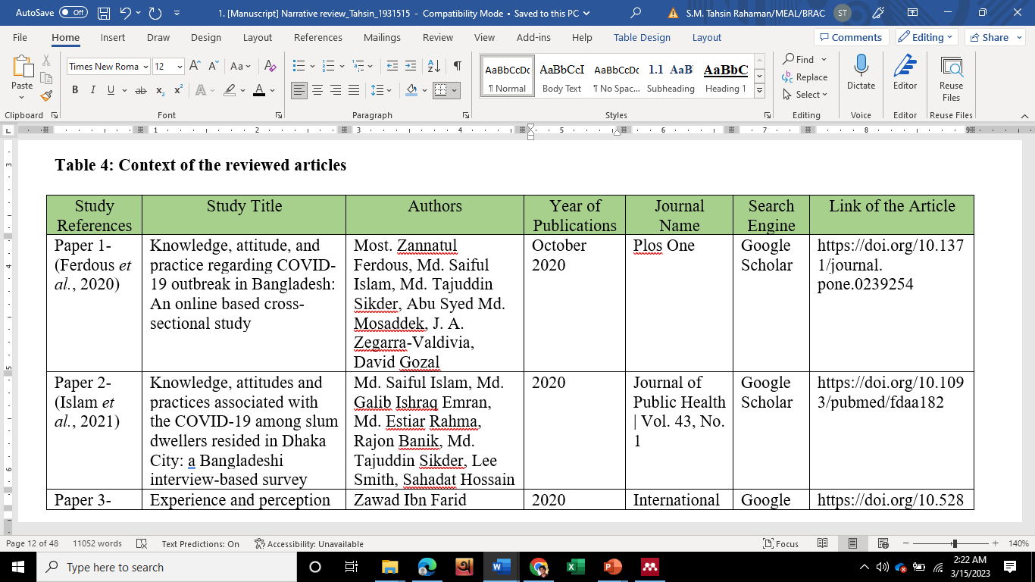
RESULTS: STUDY CONTEXT OF THE REVIEWED ARTICLES
5 articles were published in 2020, and 6 were published in 2021; Google scholar and PubMed was the search engine
The publishers were Plos One, SAGE, International Journal of Public Health Science, Journal of Public Health etc.
57%
8%
1. Indicator definition is comprehensive enough to measure attribution
2. Reported data represents the indicator
4 indicators out of 7 found consistent across all reporting layers. Less than 1% under-reporting was found for 2 indicators and less than 1% over-reporting was found for 1 indicator at source to BM level.

Slide 8
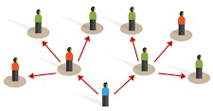
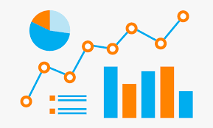
RESULTS: METHODOLOGY OF THE REVIEWED ARTICLES
Study Design: 7 quantitative (cross-sectional), 2 qualitative and 2 mixed-method study
Study Location: Rural and/or urban Bangladesh
Study Population: Youth, elderly people, internet users, slum dwellers and adults (18+)
Sampling: Convenient sampling technique (multi-stage, snowball)
Statistical Analysis: Descriptive analysis, chi-square, multivariate regression
Ethical Approval: Formal ethical approval was taken, and no conflict of interest declared for almost all the articles
57%
8%
1. Indicator definition is comprehensive enough to measure attribution
2. Reported data represents the indicator
4 indicators out of 7 found consistent across all reporting layers. Less than 1% under-reporting was found for 2 indicators and less than 1% over-reporting was found for 1 indicator at source to BM level.

Slide 9
RESULTS: MAJOR FINDINGS FROM THE REVIEWED ARTICLES
Perception is the primary form of cognitive contact with the world around us
Knowledge, attitude and practice establish a harmony of interactive factors characterized by enthusiasm and unique interdependence
A misconception is an incorrect opinion due to a flawed understanding which arises from myths, tales, stereotypes, superstitions, fallacies etc.
Major Findings
Rumor is unverified information that may or may not be true

Slide 10
RESULTS: PERCEPTION FROM THE REVIEWED ARTICLES
COVID-19 is not a fatal disease
COVID-19 cannot infect the young people
Perception
COVID-19 is a rumor, and this is a rich people disease perceived by the working-class
All the hospital has facilities for COVID-19 test in Bangladesh
10

Slide 11
RESULTS: MISCONCEPTION FROM THE REVIEWED ARTICLES
Coronavirus will not survive above 30-degree Celsius temperature
Wearing any kind of masks can prevent the viral infection
Misconception
This is a part of virus war (conspiracy theory)
COVID-19 is a bacterial disease and can spread through pets
11

Slide 12
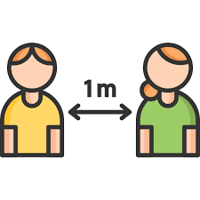
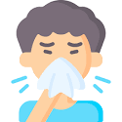
RESULTS: KNOWLEDGE, ATTITUDE AND PRACTICES FROM THE REVIEWED ARTICLES
The sources of COVID-19 knowledge are reportedly social media, television, neighbors and friends
Knowledge, Attitude & Practice
Sociodemographic factors like place of residence, educational status, and HH size have a significant association with the KAP
12

Slide 13
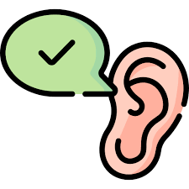
RESULTS: RUMORS FROM THE REVIEWED ARTICLES
TRANSMISSION
Religious rumors stated COVID-19 is a punishment of God and Muslims will not be infected
PREVENTION
Drinking 3 cups of tea daily could avoid the virus infection
TREATMENT
Gargling with hot water, salt and vinegar could disinfect the virus from the throat
Only elderly people will be infected and died
Farm chicken, Tilapia and Pangasius could spread the virus
Thankuni leaves can prevent the virus
Intake of garlic can also prevent the virus
4 indicators out of 7 found consistent across all reporting layers. Less than 1% under-reporting was found for 2 indicators and less than 1% over-reporting was found for 1 indicator at source to BM level.

Slide 14
RESULTS: STRENGTHS AND LIMITATIONS OF THE REVIEWED ARTICLES
STRENGTHS
> Only 2 articles mentioned their strengths in the paper
> Contemporary and evolving issues were addressed in the articles
> Most of the articles showed the sociodemographic association with KAP
> All the studies were able to addressed the research questions
LIMITATIONS
> 5 articles mentioned their limitations in the paper
> Almost all the studies followed a cross-sectional study design which cannot establish the causal inferences
> Sampling and response biases exist, as most of the mode of data collection was online google form (self administrative) and telephone interview
57%
1. Indicator definition is comprehensive enough to measure attribution

Slide 15
RESULTS: CONCLUSION AND RECOMMENDATION OF THE REVIEWED ARTICLES
57%
8%
CONCLUSION
All the articles ended with a justified conclusion based on the study’s objective.
RECOMMENDATIONS
All the articles provided recommendations to the relevant stakeholders, at least one, in some cases 6 to 8 recommendations were found
Recommendations focused on an awareness campaign, mass media campaign, digital literacy, deploying law enforcement etc.
1. Indicator definition is comprehensive enough to measure attribution
2. Reported data represents the indicator

Slide 16
DISCUSSION: CRITICAL APPRAISE OF THE REVIEWED ARTICLES
The study questions were relevant for all the reviewed articles (11 out of 11)
All the studies (11 out of 11) extract new findings
Aiming the study objectives, the research questions were set and relevant to the results for all the reviewed articles (11 out of 11)
Almost all the study (10 out of 11) designs were appropriate for the research questions
Almost all the study (10 out of 11) methods able to address either sampling bias and/or response bias
Almost all the articles (10 out of 11) linked their arguments with pertinent other publications and justified their discussions

Slide 17
DISCUSSION: CRITICAL APPRAISE OF THE REVIEWED ARTICLES
None of the articles (11 out of 11) mentioned the stated hypotheses
The statistical analysis was made correctly for all the quantitative study (9 out of 11)
All the articles (11 out of 11) ended up with a justified conclusion in terms of its objective
Most of the articles (7 out of 11) declared having no conflict of interest, rest of the articles mention nothing about conflict of interest
Almost all the study (10 out of 11) performed the original protocol in terms of the research questions

Slide 18
CONCLUSION
This narrative review compiled the perception, misconceptions and rumors regarding COVID-19 as well as captured the knowledge, attitude and practice among Bangladeshi rural and urban people
This narrative would help to plan and execute appropriate interventions to respond to such a pandemic or infectious diseases like COVID-19
This can also help the government strategically to make policies to combat such pandemics or endemic
This narrative review opens the door for further research, a systematic review could be done on similar concerns in the near future

Slide 19
SUGGESTIONS AND FEEDBACK ARE MUCH APPRECIATED

