Slide 1
A Retrospective Approach to Determine the Household Factors Associated with the Breastfeeding Practice in Bangladesh: Evidence from BDHS 2017-2018
Akash Ahmed
Student Id: 2031381

Slide 2
Introduction
Breastfeeding is a unique source of nutrition that plays an important role in the growth, development, and survival of infants¹
Breastfeeding is promoted internationally as the preferred method of feeding infants up to 6 months and continuing up to 2-3 years with the addition of weaning food ²
Unfortunately, the breastfeeding initiation and duration rate was quite low in both developed and developing countries and particularly in Bangladesh³
Giashuddin, M. S., & Kabir, M. (2004). Duration of breast-feeding in Bangladesh. Indian Journal of Medical Research, 119, 267-272.
Giashuddin, M. S., & Kabir, M. (2003). Breastfeeding duration in Bangladesh and factors associated with it. Indian Journal of Community Medicine, 28, 34-38.
Galler, J. R., Harrison, R. H., Ramsey, F., Chawla, S., & Taylor, J. (2006) Postpartum feeding attitudes, maternal depression, and breastfeeding in Barbados. Journal of infant Behaviour and Development, 29, 189-203.

Slide 3
Introduction
Breast-feeding is important for several reasons
  A great nutrition source
  Provide immunity up to a certain level
Feeding a baby at 12 months was common in low- and lower-middle-income families, but uncommon elsewhere.⁵
Many distal-level variables, including maternal age and educational attainment, the number of children, and family income, showed strong correlations with the continuation of breastfeeding for 12 months or longer.⁵
To encourage the practice of breastfeeding, it is important to identify the various factors that influence women's feeding decisions and continuation.
4. UNICEF ─ nutrition. Available at: https://www. unicef.org/nutrition/index_100585.html.
5. Victora, C. G., Bahl, R., Barros, A. J. D., França, G. V. A., Horton, S., Krasevec, J., Murch, S., Sankar, M. J., & Walker, N. (2016). Breastfeeding 1 Breastfeeding in the 21st century : epidemiology , mechanisms , and lifelong eff ect. The Lancet, 387(10017), 475–490. https://doi.org/10.1016/S0140-6736(15)01024-76. Galler, J. R., Harrison, R. H., Ramsey, F., Chawla, S., & Taylor, J. (2006) Postpartum feeding attitudes, maternal depression, and breastfeeding in Barbados. Journal of infant Behaviour and Development, 29, 189-203.

Slide 4
Objective of the Study
General Objectives:
Enumerate the frequency of breastfeeding practice among Bangladeshi Women.
Explore the household characteristic of women who practice breastfeeding.
Specific Objectives:
Evaluate the impact of household characteristics on breastfeeding practice
To find out potential determinants for breastfeeding practice continuation in Bangladesh

Slide 5
Methodology
Open source data from Bangladesh Demographic Health Survey 2017-2018 is used for this study. Women who have children aged up to 36 are considered as research subject.
Inclusion Criteria: Mother’s having at least one child aged less than 36 months living with them and currently non-pregnant were included in this study. The sample size used in this study is 3057
Dependent Variable: Women having at least one child aged more than six months who practiced breastfeeding (duration of breastfeeding more than 1 month) but currently stopped was the dependent variable for this study.
Independent variables: A set of categorical explanatory variables is selected to fit the regression model. The selected variables are- Place of Residence, Division, Parity, Wealth Index, Age, Mother’s Education, Partner’s Education, Working Status, Number of Household Members, Sex of Child, Mode of Delivery, Total Children Ever Born, Age of Mother at First Birth, BMI of Mother
Descriptive statistics are used to describe the characteristics of the respondents. Bivariate analysis is used to see the percentage of breast-feeding practice across selected individual household and community-level factors. Data is analyzed by STATA software.

Slide 6
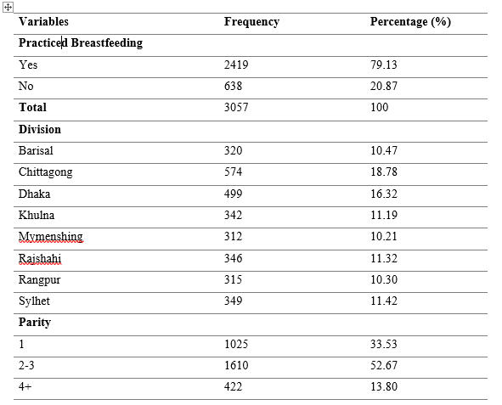
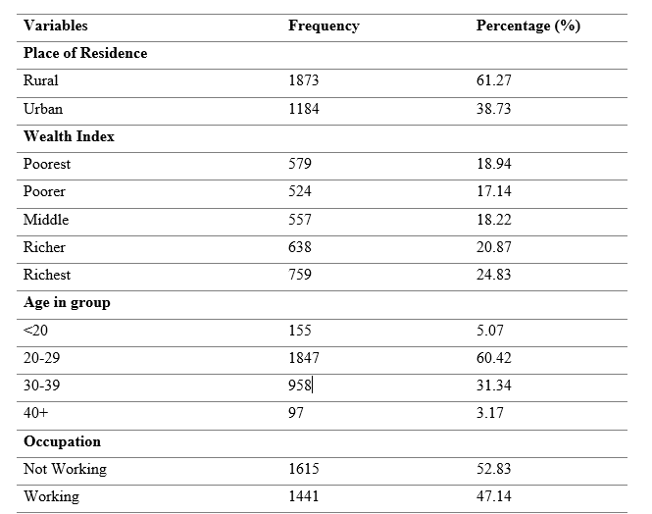
Results: Frequency Distribution

Slide 7
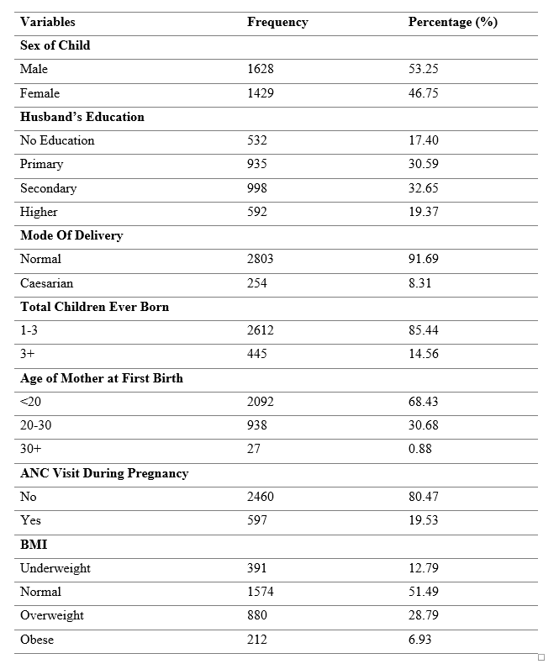
Results: Frequency Distribution

Slide 8
Results
Variables | Odds Ratio | P- value
Place of Residence (Ref: Rural)
Urban | 2.25 | 0.027
Wealth Index (Ref: Poorest)
Poorer | 1.84 | 0.128
Middle | .98 | 0.981
Richer | .18 | 0.009
Richest | .08 | 0.003
Age in group (Ref: 40+)
<20 | 21.76 | 0.026
20-29 | 9.15 | 0.066
30-39 | 2.34 | 0.457
Occupation (Ref: Not Working)
Working | .58 | 0.092
Results of multi-level logistic regression analysis of community-level characteristics
If all the covariates remain constant-
the odds of breastfeeding practice for a woman living in urban area is 125% higher than the woman living in rural area
the odds of breastfeeding practice for a woman from richer family is 82% lower than for a woman from poorest family and a woman from richest family has 92% lower odds of breastfeeding practice than a woman from poorest family

Slide 9
Results
Variables | Odds Ratio | P-value
BMI (Ref: Underweight)
Normal | .52 | 0.090
Overweight | .17 | 0.002
Obese | .14 | 0.050
Number of Household Members (Ref: <3)
4-5 | .28 | 0.005
5+ | .33 | 0.009
Parity (Ref: 1)
2-3 | 2.65 | 0.020
4+ | .032 | 0.982
Results of multi-level logistic regression analysis of community-level characteristics
If all the covariates remain constant-
a woman being overweight has 83% lower odds of breastfeeding practice than a woman being and the odds of breastfeeding practice for a woman being obese is 86% lower than for a woman being underweight
women who have 4-5 and more than 5 household members bears 72% & 67% respectively lower odds of breastfeeding practice compared to a woman who has less than 3 household members

Slide 10
Results
Variables | Odds Ratio | P-value
Education (Ref: No Education)
Primary | 1.13 | 0.810
Secondary | .70 | 0.565
Religion (Ref: Others)
Islam | 1.29 | 0.677
Mode Of Delivery (Ref: Normal)
Caesarian | 5.39 | 0.075
Age of Mother at First Birth (Ref: 30+)
<20 | .48 | 0.818
Results of multi-level logistic regression analysis of community-level characteristics
However, in this logistic regression analysis, among all the selected variables, nine variables were not found to be significant for breastfeeding practice as p-value is more than 0.05 for all of these variables.
These variables are, division of mother, occupation of mother, education of mother, mother’s religion, the sex of child, husband’s education, mode of delivery, total children ever born and age of mother at first birth.

Slide 11
Discussion
In this study it is found that 79.13% women having children aged up to 36 months practice breastfeeding. Indeed, the breastfeeding percentage is increasing as it was only 42% in 2004 and 64% in 2011⁷
Breast-feeding practice in Bangladesh is found to be higher than other low-income country like India (46.40%) and Nepal (53%)⁸
Breast-feeding women in urban area is found at higher than rural area (OR 2.25). A previous study found breast feeding women in urban area at a higher percentage of 61% from BDHS 2014 data. ⁹
7. NIPORT et al. Bangladesh Demographic and Health Survey, 2014. National Institute of Population Research and Training (NIPORT) Mitra and Associates & Macro International 2016.
8. Patel, A., Badhoniya, N., Khadse, S., Senarath, U., Agho, K. E., Dibley, M. J., & South Asia Infant Feeding Research Netwoork (2010). Infant and young child feeding indicators and determinants of poor feeding practices in India: secondary data analysis of National Family Health Survey 2005-06. Food and nutrition bulletin, 31(2), 314–333. https://doi.org/10.1177/156482651003100221
9. Rahman, Md. A., Khan, Md. N., Akter, S., Rahman, A., Alam, Md. M., Khan, Md. A., & Rahman, Md. M. (2020). Determinants of exclusive breastfeeding practice in Bangladesh: Evidence from nationally representative survey data. PLOS ONE, 15(7), e0236080. https://doi.org/10.1371/journal.pone.0236080

Slide 12
Discussion
Mother’s education has both positive and negative impact on breast-feeding practice according to this study. It is found that mother’s having higher education practice more breast-feeding than any other education group. However
Women’s education enrollment and participation in the labor force (mostly educated women) have increased manifolds in Bangladesh even much faster than the growth of male participation in the labor force¹⁰
Along with enrolment in education and involvement in labor force, women also have to deal with several factors such as increased work pressure, travel time, and availability of breastfeeding facility in the institution and workplace. As a result, all these factors negatively affect mothers’ behaviours towards practising breast-feeding¹¹
10. Tanakam T, Takahashi K, Otsuka K. Increasing female education, stagnating female labor force participation, and gains from marriage: The case of rural Bangladesh. National Graduate Institute for Policy Studies, 2020.
11. Afrose L, Banu B, Ahmed KR, Khanom K. Factors associated with knowledge about breastfeeding among female garment workers in Dhaka city. 1. 2012; 3(249):255.

Slide 13
Limitation of the study
This study is carried out with four years back data and limited number of independent variables

Slide 14
Conclusion
This study is able to explore some really important findings and around 79.13% children aged up to 36 months are being breast-fed.
Residence in urban area, wealth index richer and richest, having secondary education and increase in age of mothers after 24 years decrease the breast-feeding practice.
Though this study is carried out with four years back data and limited number of independent variables, it can be a baseline study for further investigation and policy implementation.
Greater community awareness program, breast-feeding corner at job place should be introduced to increase the breast-feeding practice.

Slide 15
Thank you

