Slide 1


Slide 2
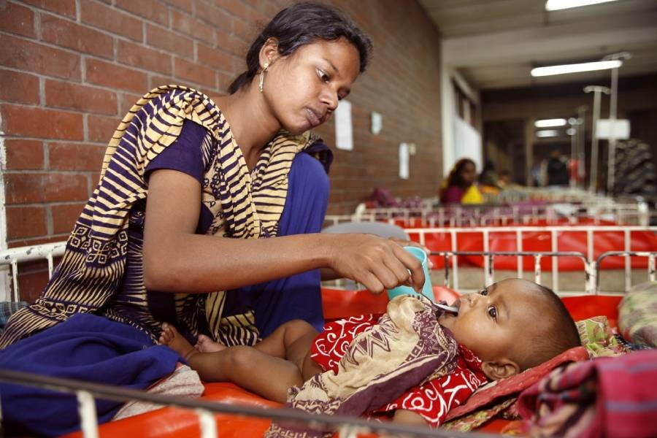
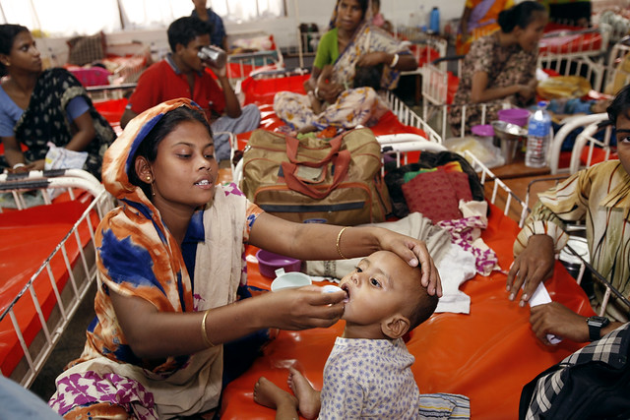
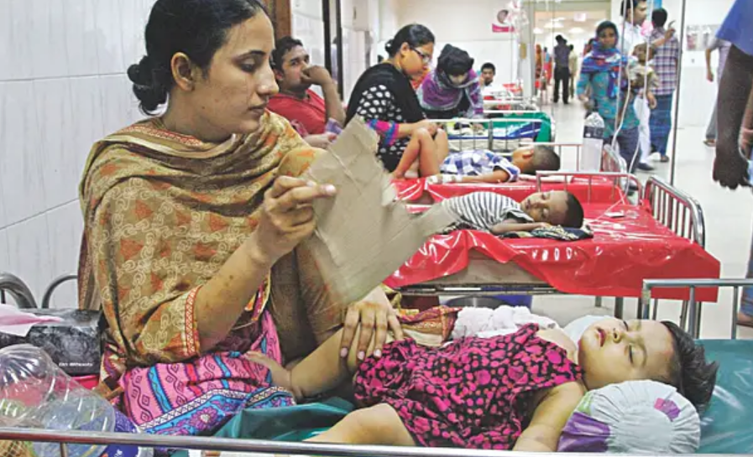
….Presentation on….
A NARRATIVE REVIEW ON CHILDHOOD DIARRHOEA IN BANGLADESH
----Presenter----
PABITRO KUMAR BISWAS
Student ID: 2022986 (Batch: 22)
----Supervisor----
DR. NAFISA HUQ
Assistant Professor, Department of Public Health
School of Pharmacy and Public Health (SPPH)
INDEPENDENT UNIVERSITY, BANGLADESH (IUB)

Slide 3



1
Abstract
Literature Review
Introduction
Discussion
Conclusion
Reference
List of Departments
PRESENTATION OUTLINE

Slide 4


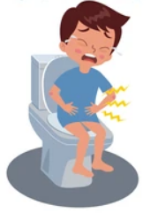
2
INTRODUCTION
-- OUR CHILDREN, OUR FUTURE
-- DIARRHOEA ENDANGERING CHILDREN LIVES
-- FIGHT AGAINST DIARROHEA

Slide 5

3
ABSTRACT
-- Root causes-why and how children are being affected by diarrhoeal diseases have been identified by studying most recently published article.
The causes are→
* Unsafe drinking water
* Sanitation & Hygiene
* Annual floods
* Economic conditions
* Lack of Health education
-- It has been identified that death rate due to diarrhoea was high in present but it has been reduced significantly
-- How different initiatives of Government and NGOs help to combat childhood diarrhoea has been identified
-- Significance of using ORS and Zinc tablet for treatment of diarrhoeal diseases has also been explored

Slide 6

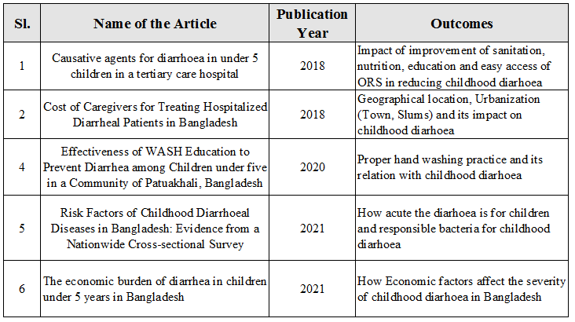
4
LITERATURE REVIEW

Slide 7
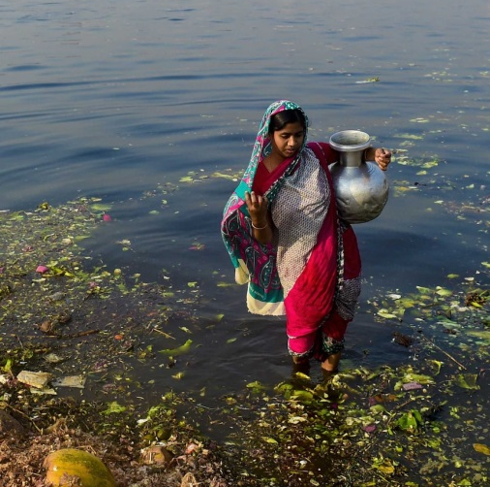
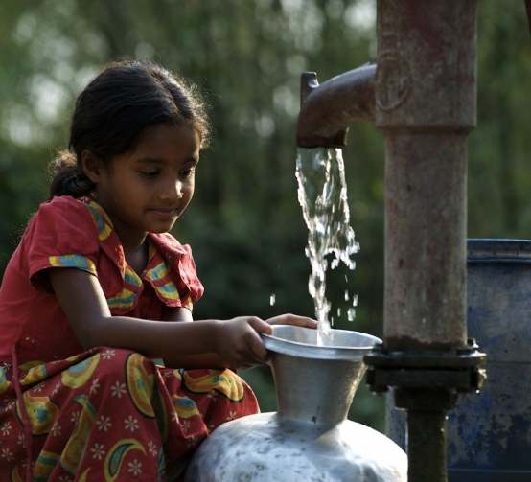
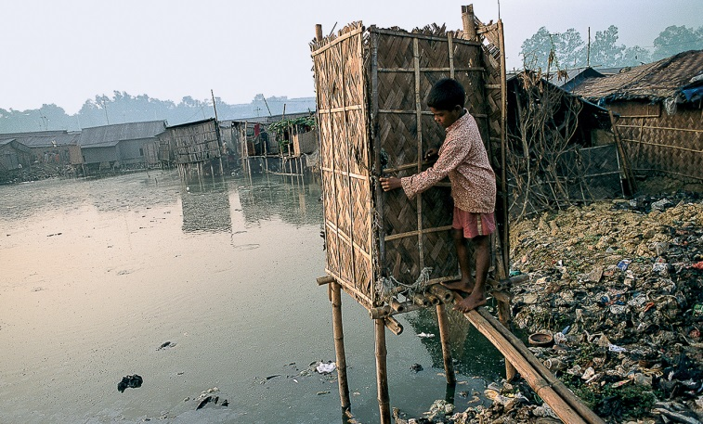
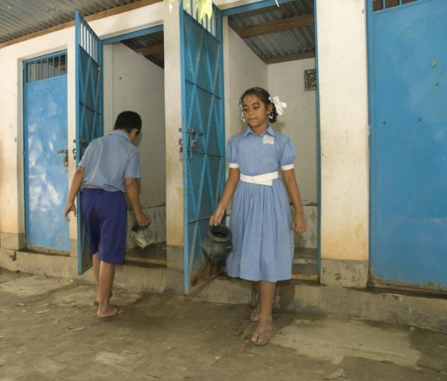
5
DISCUSSION
-- In order to combat Childhood diarrhoea and to reduce death rate due to diarrhoea different initiative has been taken by Government and NGOs
-- It has been possible to make awareness among people regarding safe drinking water, sanitation and hygiene which are playing significant role to combat childhood diarrhoea.

Slide 8
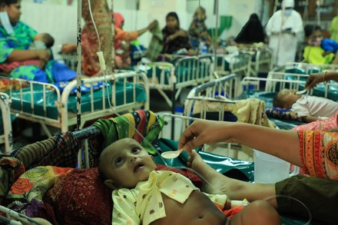

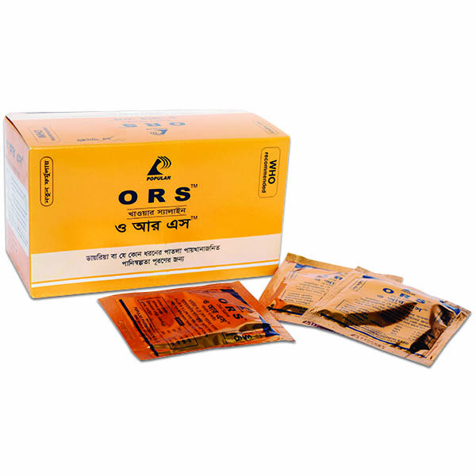
6
DISCUSSION (Cont..)
-- Bangladesh has made exceptional progress in reducing life threatening diarrhoea. Separate diarrhoea wards has been established in hospitals to ensure proper treatment.
-- Now death rate due to diarrhoeal diseases has been reduced significantly
-- Zinc and Oral Rehydration Solution (ORS) has a significant impact on reducing diarrhea in children in Bangladesh

Slide 9
7
CONCLUSION
-- Bangladesh has set an example for low and middle-income countries in the reduction of under-five child deaths due to diarrhoea. The key factors contributing to this reduction in diarrhoea related under-five mortality are improvement of nutritional status and achieving high coverage of ORS and zinc for the management of diarrhoeal episodes had the largest effects, although vitamin A also contributed along with smaller effects from most of the other interventions.
-- Improvements in water sources and sanitation have contributed to approximately 10% reduction of diarrhoea related deaths
-- Access to improved sanitation and hand washing with soap has improved from 41% to 61%
Effective collaboration with the private sector, NGO and social marketing efforts, and overall socio-economic progress has significant role to combat childhood diarrhoea

Slide 10

8
REFERENCE
An Evidence of Socio-Demographic Effects on Child’s Diarrhoea in Bangladesh, Md. Rafiqul Islam , Md. Kamal Hossain , Md. Nuruzzaman Khan , Md. Raihan Ali, Department of Population Science and Human Resource Development, University of Rajshahi, Bangladesh]
Cost of Caregivers for Treating Hospitalized Diarrheal Patients in Bangladesh Abdur Razzaque Sarker, Marufa Sultana, Nausad Ali, Raisul Akram, Khorshed Alam, Jahangir A.M. Khan and Alec Morton
Causative agents for diarrhoea in under 5 children in a tertiary care hospital MK Pervin1, ST Jhora, S Paul, A Naher, D Sarkar, 2018
The economic burden of diarrhea in children under 5 years in Bangladesh Md. Zahid Hasana, Gazi Golam Mehdia, Gatien De Brouckerb, Sayem Ahmedc,d,e, Md. Wazed Alia, Jorge Martin Del Campob, Dagna Constenlab,f, Bryan Patenaudeb,g, Md. Jasim Uddina a International Centre for Diarrhoeal Disease

Slide 11
9
REFERENCE (Cont…)
5. A cross sectional study on prevalence of diarrhoeal disease and nutritional status among children under 5-years of age in Kushtia, Bangladesh. Afroza Khatun1, Sk. Shahinur Rahman*,1, Hafizur Rahman1, Sabir Hossain2 1Dept. of Applied Nutrition and Food Technology, Islamic University, Kushtia, Bangladesh Dept. of Biochemistry and Molecular Biology, Jahangirnogor University, Savar, Dhaka, Bangladesh
6. The Effect of Handwashing at Recommended Times with Water Alone and With Soap on Child Diarrhea in Rural Bangladesh: An Observational StudyRisk Factors of Childhood Diarrhoeal Diseases in Bangladesh: Evidence from a Nationwide Cross-sectional Survey Siddiqi, N.A.MD., Muyeed, A. (2021).
7. A cross sectional study on prevalence of diarrhoeal disease and nutritional status among children under 5-years of age in Kushtia, Bangladesh. Afroza Khatun1, Sk. Shahinur Rahman*,1, Hafizur Rahman1, Sabir Hossain2 1Dept. of Applied Nutrition and Food Technology, Islamic University, Kushtia, Bangladesh Dept. of Biochemistry and Molecular Biology, Jahangirnogor University, Savar, Dhaka, Bangladesh

Slide 12

10
1
Website Links
https://www.who.int/news-room/fact-sheets/detail/diarrhoeal disease#:~:text=Diarrhoea%20is%20defined%20as%20the,is%20normal%20for%20the%20individual).
https://www.borgenmagazine.com/defeating-diarrhea-in bangladesh/#:~:text=From%202003%20to%202017%2C%20mortality,3%20per%20every%20million%20people.]
https://borgenproject.org/bangladesh-winning-the-war-against-diarrhea/
https://www.defeatdd.org/blog/turning-point-how-ors-zinc-and-wash-transformed-bangladesh-community
https://www.cochrane.org/CD004265/INFECTN_does-encouraging-people-wash-their-hands-stop-them-having-diarrhoea

Slide 13

11
QUESTION
&
ANSWER SESSION

Slide 14
….. END…..

