Slide 1
Antibiotic resistance: A possible threat to achieving sustainable development goals, A systematic review
Presented by Supervised by
Name - Nusrat Jahan Dr. Kamran Ul Baset
ID – 2023007 MBBS, MPH, Ph.D.
Associate Professor
Department of Public Health
Independent University,Bangladesh

Slide 2
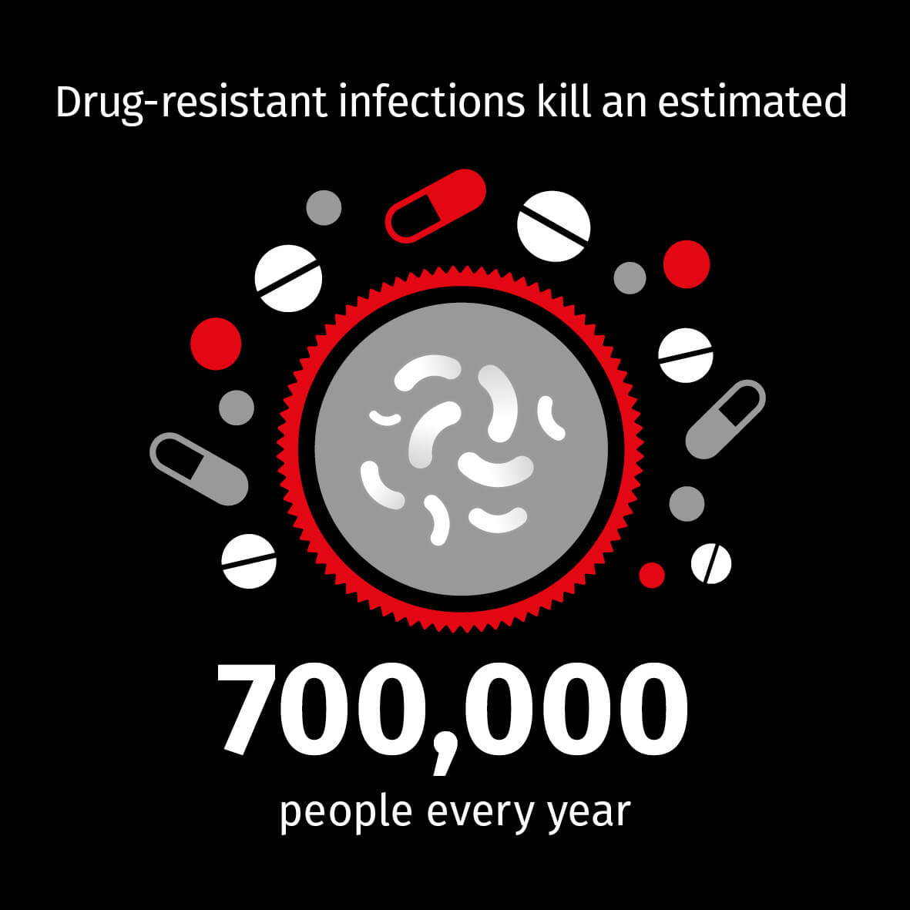

Slide 3
Introduction
Antibiotic resistance is a condition when harmful microorganisms acquire resistance to antibiotics that are used to treat them.
Dependence on antibiotics has been taken for granted by people all over the world since the introduction of antibiotics in the mid-nineteenth century, but the rising trend of antibiotic resistance threatens to take it away.
Antibiotic resistance is on the rise across the world as a result of widespread overuse and abuse of antibiotics.

Slide 4
Rationality
Many more Research Paper could have been taken in consideration. It would have introduced new Variables, Parameters, Indicators and Solutions.
As human physiology varies based on Regions, Climate, Food Intake and many factors, more accurate review could have been done if those were taken to consideration.

Slide 5
Research Question
What are the possible threat of antibiotic to achieving sustainable development goals?
?
?
?

Slide 6
Research Objective
General objective: To search the possible threats of antibiotic from every aspects and to come to a conclusion to determine the ways to eradicate it.
Specific objective: To determine the possible difficulties to reach the goal.

Slide 7
Search strategy
Data source –EBSCO, Springer Link, ACM, Google Scholars and IEEE in where those libraries are very well known and famous and also distinguished for open-source research platforms.
Duration – 2005 to 2019 (year)

Slide 8
Eligibility criteria (Included)
1. Age
2. Nature of Study
3. Study Field

Slide 9
Eligibility criteria (Excluded)
1. Studies conducted on diagnosed cases of developmental delay
2. Studies focusing on autism spectrum disorder (ASD) and other behavioral disorders
3. Studies on developmental delay among children aged more than five years.
4. Interventional studies on developmental delay.
5. Studies on developmental delay published before 2005
6. Article published in languages other than English

Slide 10
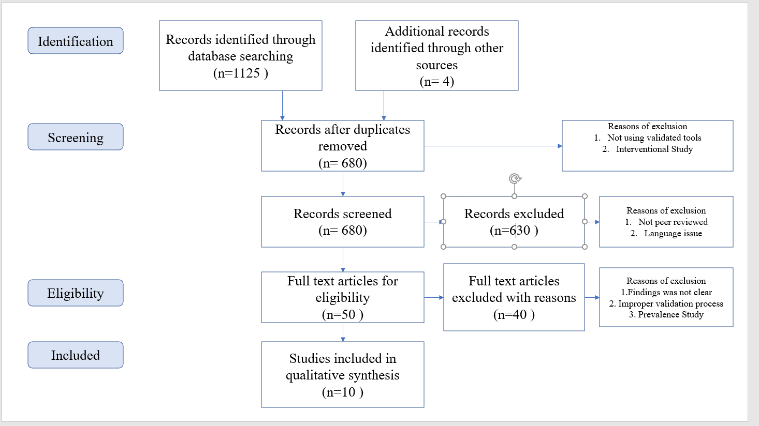
Prisma model

Slide 11
Results
Result
Study Place
Target Population
Study Design
Sampling
Confounding Factor
Type of Statistical Analysis
Notable Statistical Findings
Major Success of the Antibiotic
Limitation of Antibiotic

Slide 12
Results
Tendency of patients to be prescribed with antibiotics enables overuse and widespread use of antibiotic.
Adverse effect emerges due to inappropriate and unnecessary antibiotic dosage causing infection and re-taking of antibiotic.
Literacy among mass people is imperative to control antibiotic abuse.
Focus should be given on suitability rather than embarrassing new antibiotic.
Antibiotic sell purchase should be strictly controlled to prevent unprescribed and misuse of antibiotic.

Slide 13
Discussion
Global Response
Increasing Awareness Through Educational Campaigns
Implementation of Surveillance Systems
Technology and Antibiotic Resistance
Balancing Preservation and Research
Sustainable Development Goals as a Solution

Slide 14
Conclusion
We must learn to target infections more precisely and to reduce the indiscriminate use of antimicrobials and other activities that hasten the establishment of emerging resistance mechanisms. Investigating the microbiological world around us for probable causes of antibiotic resistance and spread might aid in the development of early warning and preventative methods to ensure antibacterial effectiveness.

Slide 15
Thank you!!

