Slide 2
A Narrative Review on Mental Health Disorders of the Elder People during COVID 19 Pandemic
Name: Humayra Tarannum Rahman
ID: 2022987
Batch: 22nd

Slide 3
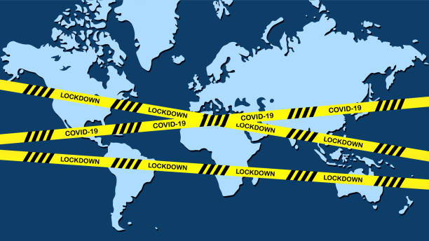
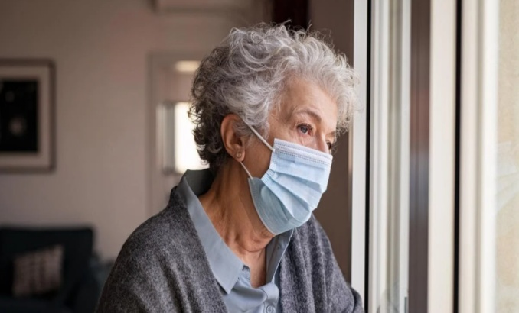
Introduction
First recorded in Wuhan, China [1]
Declared as global pandemic by World Health
Organization on 11th of March, 2020. [2]
Lockdown Strategy was taken by most of the countries around the world
Mental Health of the elderly people affected
severely during this pandemic [3]

Slide 4
Research Question
What is the Mental Health condition of the elderly people during COVID 19?

Slide 5
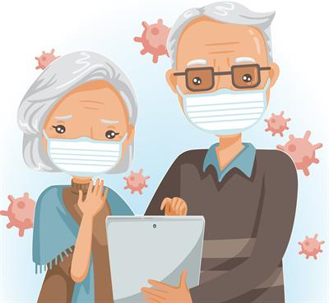
Objective
Aim is to summarize the mental health condition of elder people during COVID 19 lockdown

Slide 6
Materials and Methods
Searched through Google Scholar databases and some electronic databases like PubMed, PLOS ONE, frontiers in Psychiatry, THE LANCET
Investigated related research articles
Followed Preferred Reporting Items for Systematic Reviews and Meta-Analysis (PRISMA) guideline
Study timeline September 2021 to January 2022
Collected data's were qualitatively analyzed for this study and used graphs were constructed by Microsoft Office Excel 2016

Slide 7
Materials and Methods
Criteria's for including a journal in this study-
▪ The journal should be published during the COVID 19 pandemic
▪ Elder adults should be aged 60 and above
▪ Journals should be based on primary data.
▪ Published in peer reviewed journals
▪ The language of the journals must be in English

Slide 8
Materials and Methods
Records Identified
(n= 25)
Records Excluded for not meeting criteria (n= 12)
Records Screened (n= 13)

Slide 9
Materials and Methods
Characteristics of the included studies | Numbers | Percentage
Online Survey | 6 | 50%
Questionnaire Filled up by the Participants in paper | 2 | 17%
Telephone Survey | 2 | 17%
Both Computer and Face to face Based Survey | 1 | 8%
Face to Face Interview | 1 | 8%

Slide 11
Results
Study in Nepal
Used seven items of the COVID-19 fear scale.
Showed that the fear of Covid 19 increased with the age.

Slide 12
Results From China
Psychological dimensions | Score range | Scores (Mean ± Standard Deviation) | Correlation with Age (P-Value)
Depression | 0-3 | 0.27 ± 0.48 | 0.096
Neurasthenia | 0-3 | 0.28 ± 0.45 | 0.070
Fear | 0-3 | 0.99 ± 0.59 | 0.451
Anxiety | 0-3 | 0.18 ± 0.35 | 0.197
Hypochondria | 0-3 | 0.24 ± 0.46 | 0.266
Psychological status of Chinese elderly and correlation of factors with age

Slide 13
Results From Bangladesh
Increase in depressive symptoms, compared to research done using the same type of population, in 2019
01
91%
03
71%
Participants with prior history of medical illness had 91% higher odds of having depressive symptoms during pandemic
02
71% participants felt concerned about Covid-19
3.2%

Slide 14
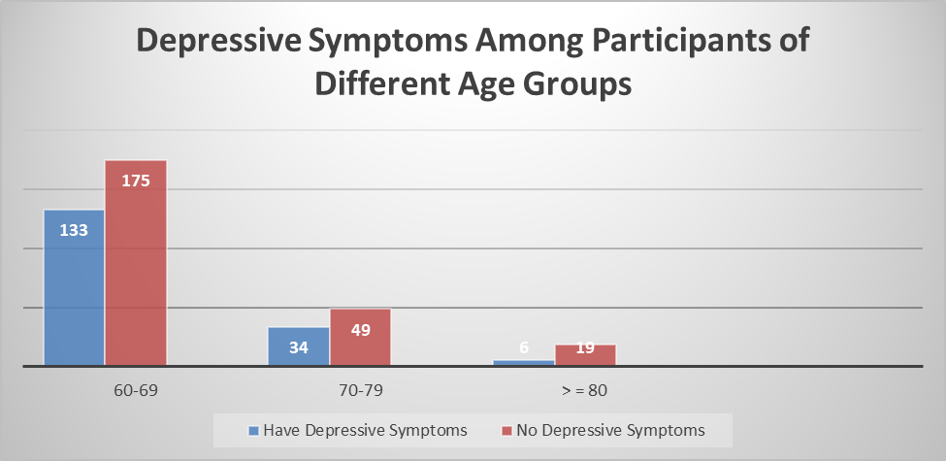
Results in Rohingya Community

Slide 15
Results From Ireland
01
02
03
40%
57%
70%
Mental Health Worse or Much Worse due to Cocooning
Loneliness, at least some of the time during cocooning
Low mood, at least some of the time
Notes:
https://pixabay.com/en/workplace-team-business-meeting-1245776/

Slide 16
Results From Hong Kong
Loneliness (In Different Scales and Types) | Pre Covid-Mean | Peri Covid Mean | Paired Mean Difference | P-value
DJG Loneliness total | 1.6 | 2.9 | 1.3 | <0.001
Social loneliness | 0.8 | 1.7 | 0.9 | <0.001
Emotional loneliness | 0.7 | 1.2 | 0.5 | <0.001
GAD-7 | 2.5 | 3 | 0.5 | 0.011
PHQ-9 | 4.4 | 4.9 | 0.19 | 0.359
Comparison of outcomes pre- and during the COVID-19 outbreak.

Slide 17
Study in Scotland
01
Reported the chances of feeling stressed, anxious or negativity by the elder people compared to younger ones during Covid 19
Mostly Good Outcomes, However…
02
Association of loneliness with aging during lockdown was found.
03
25% participants mentioned loneliness

Slide 18
Results From Poland
Loneliness Parameters | Anxiety | Depression | Irritability
Intimate others | r = 0.42 p < 0.001 | r = 0.44 p < 0.001 | r = 0.43 p < 0.001
Social others | r = 0.29 p < 0.001 | r = 0.40 p < 0.001 | r = 0.37 p < 0.001
Belonging and affiliation | r = 0.30 p < 0.001 | r = 0.34 p < 0.001 | r = 0.32 p < 0.001
Correlation between Loneliness with anxiety, depression, and irritability

Slide 19
Study In England
Mental Conditions | P-value
Depression | <0.0001
Anxiety | <0.0001
Loneliness | <0.0001
Associations of impaired ADL with mental health and wellbeing during the COVID-19 pandemic

Slide 20
Qualitative Literature Analysis: Switzerland
Resentment
Ambivalent Feelings
Feelings of Elderly People against Covid 19 pandemic and relative public health measures

Slide 21
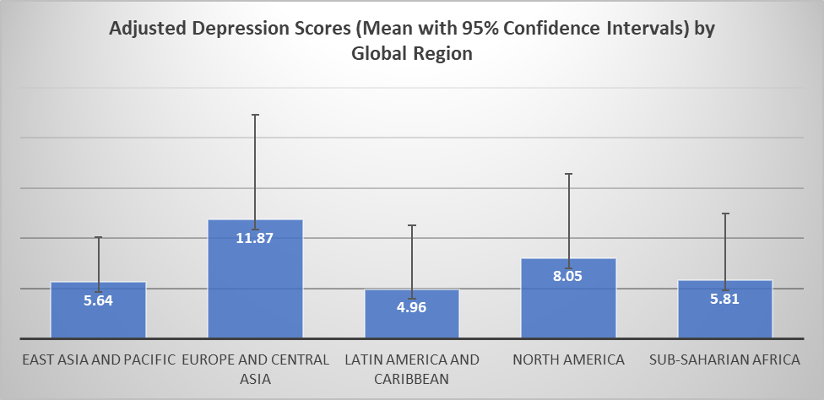
Analysis in Different Regions: Results from 33 Countries

Slide 22
Limitations
A limited number of studies found for this particular study
The nature of the study was qualitative and narrative
No causal associations were established as only cross-sectional studies were included
As online based study was done mostly selection bias was seen in the study
Gender situation could
not be considered
Socio economic status could not be considered

Slide 23
Recommendations
Most of the studies considered in this review has shown impact of Covid 19 pandemic on mental health of elder people. Although their extents are of different level and different nature, all these articles suggested public health measures to maintain their proper mental health condition.
Further investigation is also required to understand different socio economic and other issues to better understand the impact of such pandemic and save our elders from their detrimental effects
Notes:
https://pixabay.com/en/agree-english-consent-contract-1728448/

Slide 24
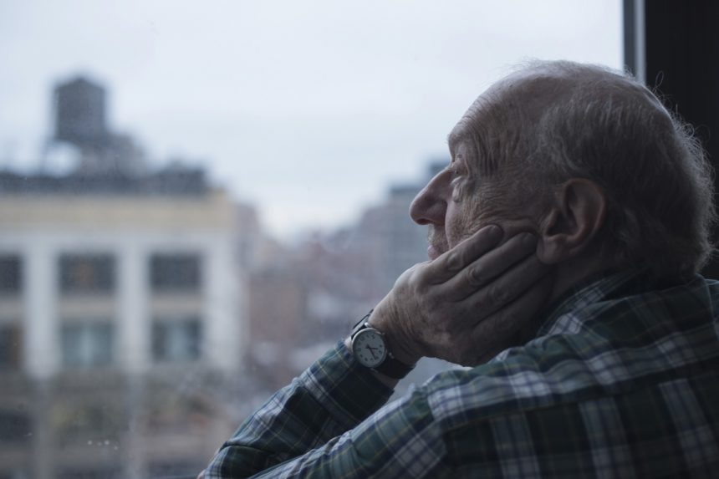
Conclusion
Showed a negative impact on the mental health of Elderly people
Depression, anxiety and loneliness are found to be typical conditions which are associated with COVID 19 pandemic

Slide 25
References
Zhou R, Chen H, Zhu L, Chen Y, Chen B, Li Y, Chen Z, Zhu H, Wang H. Mental health status of the elderly Chinese population during COVID-19: An online cross-sectional study. Frontiers in psychiatry. 2021;12.
WHO Website
Tyler CM, McKee GB, Alzueta E, Perrin PB, Kingsley K, Baker FC, Arango-Lasprilla JC. A study of older adults’ mental health across 33 countries during the COVID-19 pandemic. International journal of environmental research and public health. 2021 Jan;18(10):5090.

Slide 26
Thank You

