Slide 1
Thesis Defense
Submitted by:
Dr. Asif Md. Farhad Noor
Student ID:2010577
Independent University of Bangladesh
Department of Public health
School of Pharmacy and Public health
Course: Master of Public Health
Supervisor:
Dr. Md. Kamran ul Baset
Associate Professor
Department of Public Health,
School of Pharmacy and Public Health
Independent University of Bangladesh.

Slide 2
Socio demographic conditions & common health issues of workers of tobacco factory

Slide 3
Table of contents
Summary -04
Introduction-05
Literature Review & Research question-06
Objectives-07
Methodology-08-09
Data collection & Managements-10
Results-11-18
Discussions-19
Limitations-20
Conclusions-21
Recommendations-22

Slide 4
Summary
Tobacco is one of the major cash crops being cultivated in Bangladesh for a few decades. The degree of tobacco development remains considerably tall in countryside of Bangladesh, which is the 12th biggest tobacco maker within the world. This advance of human society outpaces our natural advancement, and this brings startling wellbeing issues.
This paper examined the health status, socio demography and the awareness level about workplace related hazards in the tobacco industry workers in Bangladesh by looking at the realities winning in a chosen tobacco production line outskirt of Dhaka.
A cross-sectional descriptive study was conducted among the factory employees. An overview was carried out. Pathological tests like blood tests and lipid profiles along other imaging tests were implemented during this study. All pertinent information were collected by face-to-face interview with a semi organized questionary in conjunction with clinical examinations. All the members were overwhelmingly male with a lower to middle class financial level.
This study has divulged few imperative discoveries which can assist partners and policymakers to make strides the quality of life of workers and to take require preventive measures to improvement of working conditions in tobacco production line workers.

Slide 5
Introduction
Tobacco is one of the major cash crops being cultivated in Bangladesh for a few decades. The degree of tobacco development remains considerably tall in countryside of Bangladesh, which is the 12th biggest tobacco grower within the world. This advance of human society outpaces our natural advancement, and this brings startling wellbeing issues.
Tobacco cultivating has been introduced since mid-sixties of the final century in this nation into the areas where nourishment crops were developed. Its generation extended broadly after liberation war of 1971 at Teesta sediment in Rangpur area. Tobacco is developed in agrarian arrive, but really it isn't an agricultural crop.
The biggest tobacco cultivating ranges in country are Rangpur, Lalmonirhat, Kushtia, and Chittagong hill tracts. Tobacco cultivating has been introduced since mid-sixties of the final century in this nation into the areas where nourishment crops were developed.
Tobacco production has been extended altogether within the nation. Agreeing to BBS statistics, tobacco cultivating zones and its generation has risen by 76% and 134% individually amid the period from 2007-08 to 2014-15.
In addition, at Tongi numerous tobacco factory workers live in packed and undesirable habitants where fundamental administrations and utilities are either truant or terribly lacking. Most of the workers houses are semi - strong made of bamboo, wooden sheets, or plastic or even built with Tin. Simply a couple of are living in well-constructed houses. Many of them cannot utilize clean restrooms, as a rule utilize open or hanging toilet and channels for their toileting. So, it makes health risks a few times all through the year or in persistent shape, since of natural contamination. None of the employees own a house, everyone lives in rented houses. Concurring to Bangladesh Organized of Labor Considers there are around 10.4 million laborers are locked in this industry in which numerous women and children are too included in cigarettes and bidi generation. Benefits from the deal of tobacco items are not equally disseminated among those included within the work. Much of the financial pick up from tobacco remains within the hands of a capable few like area leaders, worker union leaders, whereas a tremendous number of specialists stay frantically.
This paper examined the socio-demographic , health status and the awareness level of the tobacco industry workers in Bangladesh by looking at the realities winning in a chosen tobacco production line outskirt of Dhaka.

Slide 6
Literature review and Research question
Bangladesh is the foremost overly populated nation of the world. An expansive proportion of the people is living underneath the poverty line, with an in advantageous living condition and health status
Occupational health should aim at the promotion and maintenance of the highest degree of physical, mental and social well-being of workers in all occupations; the prevention amongst workers of departures from health caused by their working conditions; the protection of workers in their employment from risks resulting from factors adverse to health; the placing and maintenance of the worker in an occupational environment adapted to his physiological and psychological capabilities, and to summarize, the adaptation of work to man and of each man to his job.
Very few studies on health hazards and quality of life of the workers in tobacco industries have so far been conducted in Bangladesh. So, the present study could be taken as an attempt to investigate the effect of tobacco on the health status and quality of life of tobacco industries workers. Since the 1990s, tobacco companies have increased the development and marketing of products which they claim have the potential to reduce the risk of disease and death compared with conventional tobacco products. Any scientific evaluation must start with the recognition that these products are diverse in nature, intent, and apparent claims. The different products include modifications of more traditional products: all, however, contain tobacco and deliver nicotine and tobacco toxins.
Little information is available about the contents or emissions of most of these products, and what is available comes primarily from the companies that make and sell the products. Although new tobacco products have the theoretical potential to reduce the risk of disease in people who are unable to abstain from tobacco completely, the risks and overall public health harm could be increased, depending upon how the products are used. The sheer diversity of product offerings makes it even more urgent to introduce regulation to protect health-conscious smokers from being misled by this new generation of unevaluated and unapproved products. Without strong regulatory oversight aimed at protecting health, people will continue to be hostages of the promises of tobacco product developers and marketers.
Research question
What are the common health issues of tobacco factory workers?

Slide 7
Objectives
General Objective
To Find out the overall health condition of a tobacco factory workers.
1
Specific objectives To identify the common health problems of tobacco factory workers.
To determine the socio-demographic condition of tobacco factory workers
To assess the perception of occupational hazards.
2

Slide 8
Methodology-01
Study design: This study used a descriptive cross-sectional design.
Study Area: Morkun, Tongi is a major township in Gazipur, Bangladesh.
Study Period: Six months are taken to complete the study, 1st July -31st December 2021.
Target Population: The factory staffs a total head counts were 645, where 545 were workers and 100 were management employees. Only abnormal blood test reports during a yearly health checkup were taken under consideration for this study.
Sample size: Sample size was 120 when the study was performed.
Inclusion criteria:
Out of 645(total employees) only 120 were included after an annual health checkup whose blood tests and other follow tests report found abnormality and provided relevant follow up tests reports to medical center.
Who were present physically during the blood sample collection procedure while this study was conducting and this count both workers (110) and from management team members (10).
Only Permanent employees were added.
Exclusion criteria:
Employees whose tests reports found normal and follow up reports did not confirm any diagnosis and who were absent while specimen collection process, were not included in this study.
Who did not complete information form and other data were not found were excluded.
Healthy and third-party contractual staffs were not kept in this study.
Data source: All the data were collected from factory medical center information software system, factory’s human resource information system which were available of company website, and all are primary data.
Data collection tools: For collections of data this study we have used medical center data base, which is composed of semi structured questionaries, human resources information of factory, lab test reports and annual surveys.
Data collection process :All identified 120 employees through health screening project filled out a semi-structured questionaries form where the sociodemographic aspects were collected for instance habits, lifestyles, and pathological history. The instruments were validated by expert judgment. During this survey, an annual blood test was carried out and all employee’s participation was compulsory, for each of the participants a sample of venous blood was extracted without anticoagulant solution and under fasting conditions after taken all biosafety measurements. All the blood samples were obtained by professionals and experts. These serological samples processed in a private clinic laboratory with high reliability and quality. This lab was standard level 4 category (as per DGHS guideline).
Data Management: All data were collected in a standard process by maintaining an optimum level of quality. Data confidentiality is maintained throughout the study period. All information is housed in a secure recording cabinet. A single password-protected computer is utilized for computerized records. Only the main investigator has access to documented factory medical center’s information.
Ethical clearance: As all were primary data, a written consent from the employees and a letter of authorization from the factory authority were obtained.
Conflict of interest: There is no conflict of interests

Slide 9
Methodology-02
Data Analysis Plan
To analysis of data Microsoft office 2020 (excel), SPSS version 28.00 is used. This study has yielded out the variable’s frequency and percentage and found the distributions of normal and abnormal biochemical tests reports, ages, education level, monthly income, marital status, common health problems i.e., chronic diseases and knowledge on occupational hazards among the factory workers.
Entries of data in Microsoft excel sheets were done by separating into sets of individual sheets for each day to avoid duplication and confusion. This appeared to the help of investigators to cross-check for precision and correction if required. Accurateness was accomplished by conducting entry of the information twice by the primary investigator, and after that comparing for any dissimilarities in data entries.
If any inconsistency was found, sets were rechecked and entered once again by the staff for that set. After completion of all information section, all the sheets were consolidated into a Microsoft Excel file. Once the information was compiled in Microsoft Excel, it was organized within the SPSS version 28 and all variables were entered. SPSS (IBM Statistical Package for Social Science) utilized to produce the tables from the data. Microsoft excel is used to reproduce charts from data. Different characteristics and diagnosis of the respondents were analyzed with quantitative methods. Where applicable mean, standard deviation (SD), and proportions were utilized.
All the continuous variables such as age, job experiences were displayed as frequency and categorical data as percentages. This frequency and percentage were utilized as well to depict categorical factors such as age, work experiences, education, marital status, monthly income, and number of chronic diseases, biochemical tests, perception of occupational hazards, smoking habits, reasons for working in tobacco factory etc. The age groups were categorized into three clusters and the education status of members was categorized into three sub classes. Monthly income was grouped in to four categories., where biochemical test results was sectioned into two groups. Perception of knowledge about work related health hazards were plied in two groups. No gender-based comparison was made on age, education levels and disease diagnostic purposes.
Different characteristics and conclusion of the respondents were analyzed with quantitative strategies. Where applicable mean, standard deviation (SD), and proportions were utilized.
All the continuous variables such as age, job experiences were displayed as frequency and categorical data as percentages.
This frequency and percentage were utilized as well to depict categorical factors such as age, work experiences, education, marital status, monthly income, and number of chronic diseases, biochemical tests, perception of occupational hazards, smoking habits, reasons for working in tobacco factory etc. The age groups were categorized into three clusters and the education status of members was categorized into three sub classes. No gender-based comparison was made on age, education levels. Monthly income was grouped in to four categories., where biochemical test results was sectioned into two groups. Perception of knowledge about work related health hazards were plied in two groups.

Slide 10
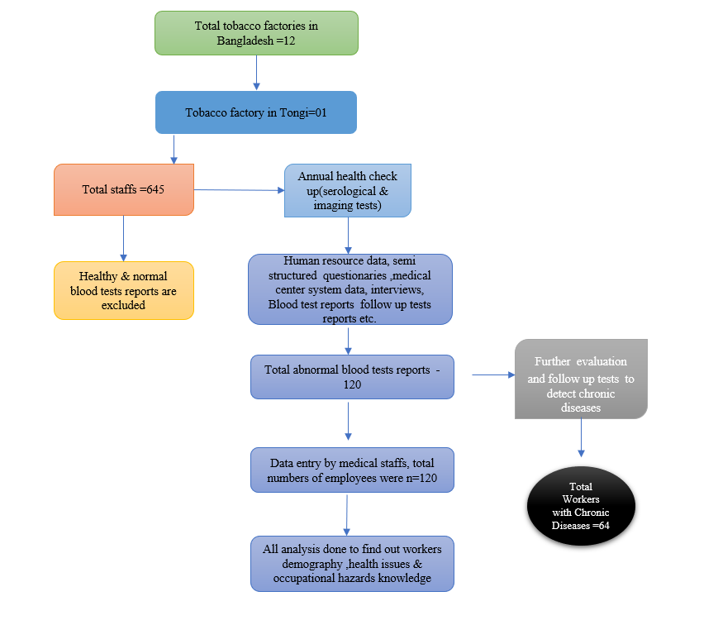
Data Collection & Management

Slide 11
Results-1(Socio-demographic conditions)

Slide 12
Results-2(Socio-demographic conditions)

Slide 13
Results-3(Socio-demographic conditions)

Slide 14
Results-4 (Perception on occupational hazards)

Slide 15
Results-5(Common health problems)

Slide 16
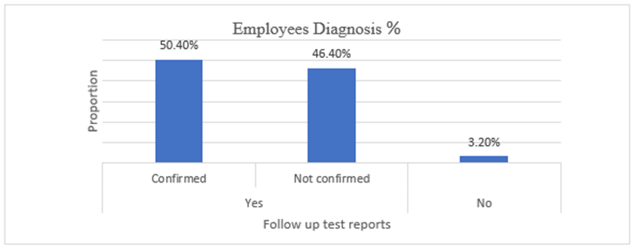
Results-6 (Common health problems)
By mass screening project we have found only 18.64% (120) employees were having abnormal blood biochemical tests reports and rest 81.40% were found with normal tests reports. Out of these 120 staff’s abnormal tests reports 64 employees (50.40%) were diagnosed with chronic diseases and other 46.40% were found normal

Slide 17
Graph showed that from the annual medical test reports out of 120 respondents 64 were diagnosed with chronic diseases. 50% found only with diabetes, 23.44% hypertension with diabetes and 9.38% found with hypertension with cardiovascular diseases. 46.40% found with out any chronic

Slide 18
Results-7 (Common health problems)

Slide 19
Discussions
From above statistical analysis it is revealed that many of the workers’ wages are not that much to live a decent life. A few don’t have any education to understand various awareness sessions and signages properly. Large numbers of employees are diagnosed with chronic diseases many of them were not aware of. Frequently they were reinfected and visited to medical center. A good quantity of production workers was not well known about work related dangers and didn’t take preventive gears or measure about it. These are important issues and required to be addressed.
is observed that small percentages of workers were illiterate and as it were a less portion of them having secondary level education. Most of the staffs were educated to primary level. It was moreover found in this study that although the tobacco factory workers were doing such sorts of perilous work their socio-economic condition is not so well; major portion of them lived in semi-solid and tin shed house and the income picked up from this work is scarcely sufficient to maintain them or is insufficient to meet the foremost essential of require and to maintain a bigger family with large expenses (most extreme workers month to month pay lies underneath 15,000Tk).
Health risks at the working environment, such as warm, clamor, tidy, perilous chemicals, hazardous machines and mental push, cause work related diseases and can exasperate other wellbeing issues. Conditions of work, occupation, and the position within the work environment chain of command too influence wellbeing. Individuals working beneath stretch or with tricky work conditions are likely to smoke more, exercise less and have an unhealthy diet.

Slide 20
Limitations
No fund was available for this research, less response from employees throughout the survey, not all data were accessible specially of those annual blood tests reports came out with normal results. Possessing an on-site clinic may be a time-efficient method to analyze and treat medical conditions, because it addresses different barriers to healthcare such as transportation costs, access, and accessibility. In any case, the most shortcoming of the study about is the information collected was secondary. The clinic lacked records of crucial statistics of the respondents, such as body mass index (BMI), blood pressure, blood sugar levels, and past medical history, that might have made a difference with advance examination of disease predominance. Collecting essential information will allow control over more data that can provide more understanding on the issues confronted by workers. It is critical to note that the comes about are for as it were one tobacco factory and may not be pertinent to other manufacturing plants. There was no control group to compare results with this study.

Slide 21
Conclusion
The tobacco manufacturing plant workers took support outstandingly promptly but must stand up to some issues from the proprietor of the tobacco production line. The issues of natural contamination are most strongly within the encompassing ranges of tobacco businesses. Tobacco production line workers are living in an unhygienic environment in their working place, and they are enduring from diverse constant infections and many other sorts of contaminations all throughout the year. Tireless inward breath of tobacco dusts makes various illnesses. Inert smoking moreover makes lungs infections of tobacco workers. Danger of lung cancer, heart illnesses, bronchitis, pneumonia, and respiratory sickness of the factory workers are extending day by day. Other than, various tobacco specialists live in stuffed and disastrous environment where essential services and utilities are either truant or appallingly insufficient. Most of the workers houses and cabins are made of tin, bamboo, or bricks.
We must be compelled to create awareness among the workers regarding causes of how they are being affected and how might they be able to overcome the issues. As the larger part of the workers were uneducated and unable to get secondary education, venture in education for their children and activities for equality for women would help the destitute to rise from their despicable conditions in tobacco-related business, “Tobacco Control Law” ought to be modified to cover other sorts of tobacco items and to extend their costs. It is fundamental to guarantee the accessibility of health care centers and appropriate sanitation facilities by the businesses, it is similarly vital that a parcel of the benefits gained from the deal of tobacco items ought to equitably disseminate among those included within the work education to bring approximately an enduring effect on the general health condition of the tobacco workers.
Fortunately, in this factory after seeing the results it clear that at here health issues among the workers are not that high. Factory medical center is dealing with common infectious diseases and chronic illnesses on regular basis. Probation of good health care, regular monitoring health data, early detection and intervention through medical center and by an efficient medical team able to keep the workers healthy. Continuous monitoring of working environment and risks by environment & safety department of this tobacco factory. This is helping to prevent work related accidents, injurers to employees. Factory management team always cares about wellbeing of its staffs. It could be a role model for other industry.

Slide 22
Recommendations
Increase training, learning sessions for the workers to increase awareness
Improvise monthly occupational hazards related sessions with area leader to decrease hazards within the premises
Improvise health and hygiene education from factory medical center to reduce the rate of common skin and respiratory communicable diseases.
Take extra cares on employees with chronic diseases specially for diabetics
Take necessary steps to improve workers working conditions.
Take needful steps to improve workers household conditions.
Increase the salary who are below 15000BDT/ month to improve their socio-economic situations.
Detecting and managing work-related health problems at an early stage; and
Educating and involving welfare union leaders in the protection of factory personnel’s health.
Implementation of yearly survey on factory medical center data to find out common health issues of workers and sort out the gaps to mitigate

