Slide 1
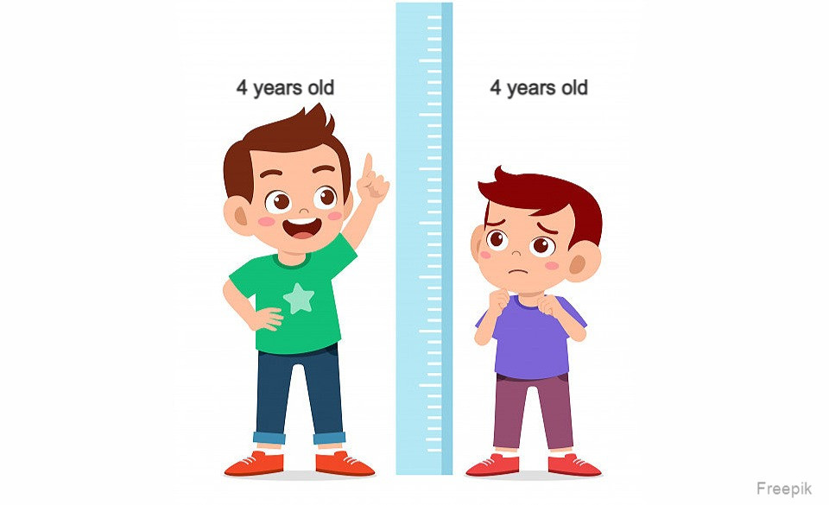

Slide 2
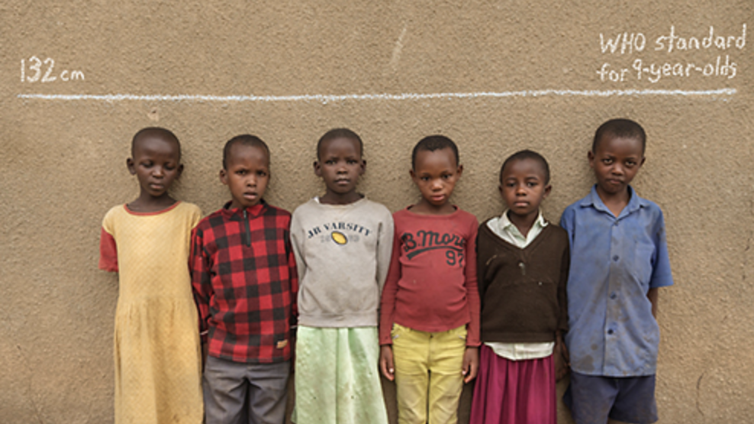

Slide 3
DETERMINANTS OF STUNTING AMONG UNDER FIVE CHILDREN IN BANGLADESH: A CROSS SECTIONAL STUDY
PRESENTED BY
MD. ABDUL MUTALIB
STUDENT ID: 2023012

Slide 4
INTRODUCTION
Low height for age is stunting.
It is one of the indicator of malnutrition.
Global stunting prevalence is 22% (UNICEF)
3.1 million or 45% death each year due to stunting (1).
31% children of Bangladesh are stunted (BDHS 2017-18)
It is declined from 51%-31% during 2004-2017 ( BDHS 2017-18)

Slide 5
METHODOLOGY
Data is used from the BDHS 2017-18.
The outcome variable of interest , Stunting is a binary variable.
There are 12 different independent variables are considered in this study.
Logistic regression was carried out to identify the determinants of stunting.
Analysis were performed using statistical software SPSS version 22.

Slide 6
RESULT
Figure 3.1.1 : Pie Chart for Prevalence of Stunting

Slide 7
RESULT
Figure : Bar Chart for Frequency Distribution of Education of Mother

Slide 8
RESULT
Figure 3.1.3: Pie Chart of Sex of Child

Slide 9
RESULT
Figure : Types of Place of Residence

Slide 10
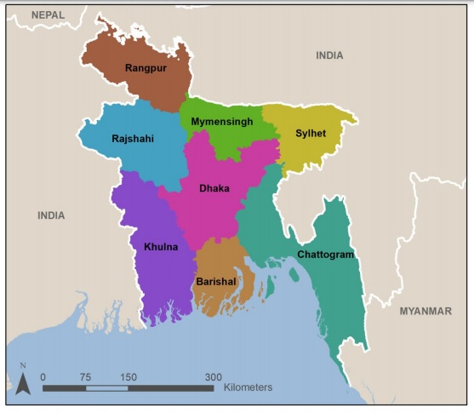
RESULT
11.4%
11.9%
10.3%
14.8%
14.2%
10.5%
10.5%
16.2%

Slide 11
RESULT
Variables | $$Frequency$$ | Percentage (%)
Age of Mother Below 25 25-34 Above 35 | 4240 3034 628 | 53.7 38.4 7.9
Wealth Index Poorest Poorer Middle Richer Richest | 1767 1597 1430 1565 1543 | 22.4 20.2 18.1 19.8 19.5
Religion Muslim Others | 7226 676 | 91.4 8.6
Delivery by Caesarean Section No Yes | 3260 1619 | 66.8 33.2

Slide 12
RESULT
Variables | $$Frequency$$ | Percentage (%)
Mothers Working Status No Yes | 4519 3380 | 57.2 42.8
Sex of Household Head Male Female | 6920 982 | 87.6 12.4
Gave Child Fortified Baby Food No Yes | 3807 203 | 94.9 5.1
Breastfeeding No Yes | 109 4884 | 2.2 97.8

Slide 13
RESULT
Table: Distribution of stunting by potential factors ( Chi square test)
Variables | Stunting |  | P Value
 | No (%) | Yes (%)
Age of Mother
Below 25 | 68.5 | 31.5 | 0.762
25-34 | 68.9 | 31.1
Above 35 | 67.4 | 32.6
Education of Mother
No Education | 55.1 | 44.9 | 0.000
Primary | 60.6 | 39.5
Secondary | 69.8 | 30.2
Higher | 84.7 | 15.3

Slide 14
RESULT CONT….
Variables | Stunting |  | P Value
 | No (%) | Yes (%)
Sex of Child
Male | 68.5 | 31.5 | 0.846
Female | 68.7 | 31.3
Types of place of residence
Urban | 73.3 | 26.7 | 0.000
Rural | 66.1 | 33.9
Division
Barisal | 68.6 | 31.4 | 0.000
Chittagong | 68.1 | 31.9
Dhaka | 74.8 | 25.2
Khulna | 74.8 | 25.2
Mymensingh | 64.7 | 35.3
Rajshahi | 70.7 | 29.3
Rangpur | 70.4 | 29.6
Sylhet | 58.7 | 41.3

Slide 15
RESULT CONT….
Variables | Stunting |  | P Value
 | No (%) | Yes (%)
Wealth Index
Poorest | 59.2 | 40.8 | 0.000
Poorer | 61.2 | 38.8
Middle | 69.2 | 30.8
Richer | 72.3 | 27.7
Richest | 82.6 | 17.4
Religion
Muslim | 68.5 | 31.5 | 0.729
Others | 69.2 | 30.8
Delivery by Caesarean Section
No | 64.5 | 35.5 | 0.000
Yes | 77.0 | 23.0

Slide 16
RESULT CONT….
Variables | Stunting |  | P Value
 | No (%) | Yes (%)
Mothers Working Status
No | 70.8 | 29.2 | 0.000
Yes | 65.6 | 34.4
Sex of Household Head
Male | 68.2 | 31.8 | 0.084
Female | 71.0 | 29.0
Gave Child Fortified Baby Food
No | 70.1 | 29.9 | 0.003
Yes | 79.8 | 20.2
Breastfeeding
No | 75.8 | 24.2 | 0.097
Yes | 67.7 | 32.3

Slide 17
RESULT CONT….
Factors | Stunting
 | Adjusted OR | 95% CI for OR |  | p value
 |  | Lower | Upper
Age of Mother
Below 25 | Ref
25-34 | 0.917 | 0.736 | 1.141 | 0.436
Above 35 | 1.209 | 0.799 | 1.830 | 0.369
Education of Mother
No Education | Ref
Primary | 1.097 | 0.738 | 1.631 | 0.648
Secondary | 0.910 | 0.609 | 1.360 | 0.647
Higher | 0.778 | 0.482 | 1.256 | 0.304

Slide 18
RESULT CONT….
Factors | Stunting
 | Adjusted OR | 95% CI for OR |  | p value
 |  | Lower | Upper
Sex of Child
Male | Ref
Female | 0.872 | 0.715 | 1.062 | 0.173
Types of Place of Residence
Rural | Ref
Urban | 0.909 | 0.718 | 1.151 | 0.427

Slide 19
RESULT CONT….
Factors | Stunting
 | Adjusted OR | 95% CI for OR |  | p value
 |  | Lower | Upper
Division
Barisal | Ref
Chittagong | 1.087 | 0.736 | 1.604 | 0.675
Dhaka | 0.942 | 0.618 | 1.435 | 0.780
Khulna | 1.228 | 0.789 | 1.913 | 0.363
Mymensingh | 1.745 | 1.174 | 2.594 | 0.006
Rajshahi | 1.006 | 0.646 | 1.567 | 0.979
Rangpur | 1.311 | 0.865 | 1.985 | 0.202
Sylhet | 1.430 | 0.959 | 2.133 | 0.079

Slide 20
RESULT CONT….
Factors | Stunting
 | Adjusted OR | 95% CI for OR |  | p value
 |  | Lower | Upper
Wealth Index
Poorest | Ref
Poorer | 0.918 | 0.687 | 1.226 | 0.560
Middle | 0.833 | 0.612 | 1.135 | 0.248
Richer | 0.639 | 0.457 | 0.892 | 0.008
Richest | 0.470 | 0.314 | 0.703 | 0.000
Religion
Muslim | Ref
Others | 1.008 | 0.684 | 1.487 | 0.967
Delivery by Caesarean Section
No | Ref
Yes | 0.753 | 0.593 | 0.956 | 0.020

Slide 21
RESULT CONT….
Factors | Stunting
 | Adjusted OR | 95% Confidence Interval |  |  | p value
 |  | Lower | Upper
Mothers Working Status
No | Ref
Yes | 0.992 | 0.798 | 1.232 | 0.939
Sex of Household Head
Male | Ref
Female | 1.268 | 0.939 | 1.714 | 0.121
Gave Child Fortified Baby Food
No | Ref
Yes | 1.048 | 0.640 | 1.716 | 0.852
Breastfeeding
No | Ref
Yes | 1.496 | 0.697 | 3.213 | 0.301

Slide 22
RECOMMENDATION
Special consideration should be given to the lower income population.
Program should be run to the poor population.
Myemensingh division should be given special consideration.
Initiative should be taken to reduce stunting among normal delivery babies.

Slide 23
CONCLUSION
Bangladesh still has a high rate of child malnutrition. The factors that primarily influence the prevalence of stunting in children under-five years in Bangladesh are socioeconomic factors, particularly household wealth index, geographical position like division and the child delivery through caesarean section. To minimize the prevalence of stunting in children under the age of five, multi-sector and integrated initiatives are required to boost household income and knowledge to cesarean delivery.

Slide 24
References
Chowdhury TR, Chakrabarty S, Rakib M, Afrin S, Saltmarsh S, Winn S. Factors
associated with stunting and wasting in children under 2 years in Bangladesh. Heliyon
[Internet]. 2020;6(9):e04849. Available from:
https://doi.org/10.1016/j.heliyon.2020.e04849
2. Unicef, WHO W. Levels and trends in child malnutrition: key findings of the 2019
Edition of the Joint Child Malnutrition Estimates. Geneva: World Health Organization.
2020.
BDHS. Bangladesh Demographic and Health Survey. Dhaka, Bangladesh and Calverton,
Maryland, USA: National Institute of Population Research and Training, Mitra and
Associates, and Macro International: 2007
https://dhsprogram.com/publications/publication-FR344-DHS-Final-Reports.cfm

Slide 25
THANK YOU

