Slide 2
A REVIEW OF REGIONAL VARIATIONS OF CONTRACEPTIVE USE IN BANGLADESH
--Presented By--
Rima Rani Bardhan
Student ID: 2022994
Master of Public Health (MPH) Independent University, Bangladesh(IUB)
--Supervised By--
DR. SHABAREEN TISHA Senior Lecturer
Department of Public Health Independent University, Bangladesh(IUB)

Slide 3
PRESENTATION CONTENT
Background
Aim Of the Project
Result
Discussion
Conclusion & Recommendation

Slide 4
BACKGROUND
Fertility control is one of the main issues for the last five or six decades for global leader.
Bangladesh is ahead from global fertility rate (In Bangladesh 2.01child per women where globally 2.4 01child per women following 2019 data).
Total fertility rate can be controlled by increasing contraceptive prevalence rate.
Contraceptive prevalence Rate in Bangladesh was 62.4% at 2014, globally it was 64.%.
1

Slide 5
Continue……
There was a huge regional variation in CPR both global & Bangladesh context.
In least develop country it was 40%, in Africa it was 33%, In Oceania it was 59% & in Northern America it was 75%.
In Bangladesh there was also a regional variation, in Rangpur Division it was 73.9% where in Sylhet division it was 54.3%.
Education, socio-economic condition, religion, residence, exposure to media, women occupation, poverty etc are the significant factors for CPR.
2

Slide 6
AIM OF THE PROJECT
Though Bangladesh is improving a lot in CPR but not all the districts of Bangladesh did same improvement.
Review the Contraceptive use trend among rural & urban areas women of reproductive age of Bangladesh.
To find out different socio-economic and demographic factors for Contraceptive prevalence Rate.
3

Slide 7
Continue……
To find out district wise situation of contraceptive use trend among reproductive age women.
This project is initiated to identify the factors which are responsible for “Regional Variations of Contraceptive Prevalence of Bangladesh”.
4

Slide 8
RESULTS
Contraceptive use among currently married women in Bangladesh, 1975–2014 (BDHS 2014).
Source - Fauzia Akhter Huda, Yolande Robertson, Sabiha Chowdhuri, Bidhan Krishna Sarker, Laura Reichenbach & Ratana Somrongthong “Contraceptive practices among married women of reproductive age in Bangladesh: a review of the evidence.” BMC (Part of Springer Nature), 2017.
5

Slide 9
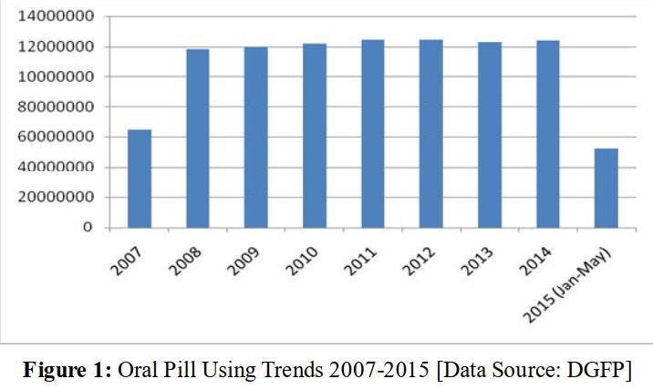
Continue…..
Oral Pill Using Trends 2007-2014
Source - Akkur Chandra Das “Contraceptive Using Trends in Bangladesh.” INTERNATIONAL JOURNAL OF BUSINESS, SOCIAL AND SCIENTIFIC RESEARCH,2015.
6

Slide 10
Continue…..
IUD, IMPLANT & TUBECTOMY Using Trends 2007-2014
Source - Akkur Chandra Das “Contraceptive Using Trends in Bangladesh.” INTERNATIONAL JOURNAL OF BUSINESS, SOCIAL AND SCIENTIFIC RESEARCH,2015.
7

Slide 11
Continue…..
Contraceptive using trend among urban & rural area in Bangladesh.
Source - Md. Kamrul Islam,Md. Rabiul Haque ,Prianka Sultana Hema “Regional variations of contraceptive use in Bangladesh: A disaggregate analysis by place of residence.” PLOS ONE, 2020.
8

Slide 12
Continue…..
Contraceptive using trend among different division of Bangladesh along with urban & rural trend.
Source - Md. Kamrul Islam,Md. Rabiul Haque ,Prianka Sultana Hema “Regional variations of contraceptive use in Bangladesh: A disaggregate analysis by place of residence.” PLOS ONE, 2020.
9

Slide 13
Continue…..
Contraceptive using trend comparison with sample education label.
Source - Md. Kamrul Islam,Md. Rabiul Haque ,Prianka Sultana Hema “Regional variations of contraceptive use in Bangladesh: A disaggregate analysis by place of residence.” PLOS ONE, 2020.
10

Slide 14
Continue…..
Contraceptive using trend comparison with son preference.
Source - Mohammad NazmulHoq, “Influence of the preference for sons on contraceptive use in Bangladesh: A multivariate analysis.” HELIYON, 2020.
11

Slide 15
Though Bangladesh is Muslim-majority country (Almost 90% Muslim people) characterized by higher poverty, a lower literacy rate but did a tremendous job in contraceptive prevalence rate (CPR) from 8.0% in 1975 to 62.4% in 2014.
Women in rural area had lower contraceptive use trend compare with urban areas women.
Husband education level play a vital rule in CPR among women.
DISCUSSION
12

Slide 16
Usually, women with higher education label had more contraceptive use rate than their less educated counterpart.
Rural areas women were enjoying less autonomy than urban areas women.
Son preference was one of the reasons to use less contraceptive in rural area in Bangladesh.
Women from Rangpur Division were highest position at CPR in Bangladesh.
Continue…..
13

Slide 17
CONCLUSION & RECOMMENDATION
To increase education label of women in both Rural & Urban area.
Need to increase social awareness about CPR.
Should take initiative to ensure family planning materials in available in rural area.
Need to create more income source for women to make them self-dependable.
14

Slide 18
Continue……
Should take initiative to increase family planning worker visit in rural area of Bangladesh.
Need to conduct more qualitative research to explore why CPR is different in different residence.
15

