Slide 1
Supervisor:
Dr. Kamran ul Baset (PhD) Associate Professor
Department of Public Health
School of Pharmacy & Public Health
Independent University Bangladesh
Presented By:
K.M.RAKIBUL HASAN
IUB ID: 2031385
Session: Summer 2020
Batch: 23

Slide 2
Research Title
Prevalence of low back pain and associated risk factors among professional private car drivers in Dhaka city

Slide 3
Introduction
Back pain is the third most common health problem reported by individuals, after headaches and tiredness. The prevalence of LBP among private car drivers found too high in different studies such as a study in Taiwan found 57% & another in Bangladesh found 78%.

Slide 4
Justification
The justification of the selective study is following, which are described one after another as per there necessity. Low back pain is the most common orthopedic problem worldwide.

Slide 5
Justification Cont…
The prevalence rate of LBP among professional car drivers reported too high in Bangladesh & globally also, on various study, and creates a negative impact on the health and economics.
It is important to determine prevalence and risk factors for low back pain among car drivers and disseminate this findings of this study to take necessary steps to minimize low back pain and reduce the costs and injuries
Finally suggesting Rehabilitation of patients with LBP which is very important to lessen the disability and will promote quality of life.

Slide 6
Research Question
What is the prevalence of low back pain and associated risk factors among professional private car drivers in Dhaka city?

Slide 7
Objectives of the study
General Objective:
To find out the prevalence of low back pain and associated risk factors among professional car drivers in Dhaka city
Specific Objectives:
To determine the magnitude of low back pain,
To find out risk factors associated with low back pain

Slide 8
Methodology
Study Design: Cross-sectional study
Study Area: Different places of Dhaka city.
Study Population: professional car drivers
Data Source: secondary source from Quest Bangladesh
Study Period: Six months, from January 2018 to June2018.
Sample size: Estimated was 378

Slide 9
Methodology Cont…
Sampling Procedure: Convenience
Inclusion criteria: Age 18 or >18, More than one year driving experience
Exclusion criteria: The subject who were not willing to participate & medically unstable
Data collection instrument: Structured questionnaire
Data collection procedure: Face to face interview

Slide 10
Result
In this study 130 car drivers in Dhaka city were taken as a sample to explore the prevalence of LBP among the car drivers in Dhaka city.
The mean age of the participants were 36.34 years. The minimum age were 22 years and maximum 55 years.

Slide 11
Result cont…
From this study it was found that among the participants, 64.6% (N=84) car drivers in Dhaka city are suffered from LBP as seen in figure.

Slide 12
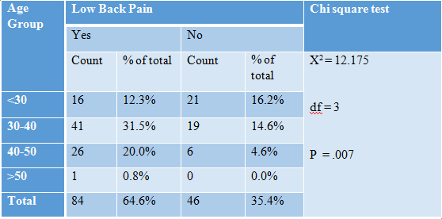
Result cont…
Association between LBP with age

Slide 13
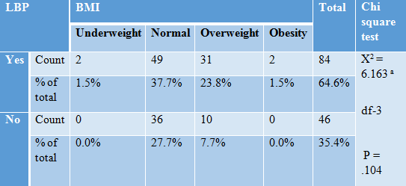
Result cont…
Association between LBP & BMI

Slide 14
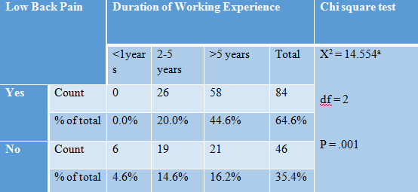
Result cont…
Association between LBP & Working Experience

Slide 15
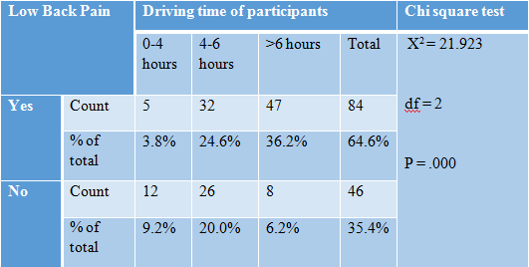
Result cont…
Association between LBP & driving time of participants

Slide 16
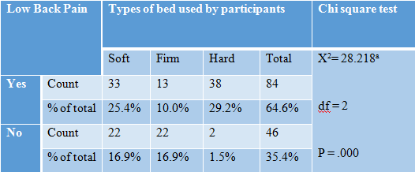
Result cont…
Association between LBP & types of bed used by participants

Slide 17
Discussion
The result showed that the prevalence rate was 64.6%. This finding is very close to the 78% rate reported for taxi driver in Dhaka city, Bangladesh in 2010 and 51% reported for taxi drivers of Taiwan had a significantly higher prevalence of LBP (P < 0.001)

Slide 18
Discussion cont…
This study the mean age of participants was 36.30 years (P=0.007) and Prevalence of LBP was highest at age 30-40 years (N=60) and age are not statistically significant with LBP of car drivers. However, a study Slovenia found that, age had positive effect on the occurrence of LBP among professional drivers.

Slide 19
Discussion cont…
Working time are highly statistically significant with LBP (P = .001) of car drivers. A study in Dhaka city also found that the car drivers that driving more than 7 hours/day increase the risk by about 4 times.
LBP is also statistically significant with working years, type of bed used & working experience of participant.

Slide 20
Conculation
This study was carried out among private car drivers & prevalence was high. Significant associations were between LBP and driving time of participants, working years, age & type of bed used.

Slide 21
Recommendation:
Based on the study findings, the following recommendations are given:
Government and non-Government organizations need to plan awareness programs about LBP & monitoring of Law.
Continued and regular study in this area should play an essential part in improving quality of life of the car drivers.
Recommendations for other researcher as follows:
Increasing the number of the participants and conduct the research in different places.
Including both subjective and objective to find out the objective.

Slide 22
Recommendation
Counseling
Lifestyle modification
Education about posture
Modification of sitting habit
Making rest house at certain distance in highway.
Continuously driving not more than six hours

