Slide 1
Perception, attitude and practice about COVID 19 and Its Vaccine among the low-income urban people in Bangladesh: A qualitative study
Md. Aminul Islam
Student ID: 1931517
School of Pharmacy and Public Health
Independent University, Bangladesh (IUB)

Slide 2
Background
The world is passing a difficult time for COVID 19 pandemic. To prevent this pandemic different countries took different measurement such as lockdown, social distance, waring facemask, frequently hand wash with soap and water and restricted their domestic and international travel.
Coronavirus is a member of a large virus group. It is the cause of common cold, cough and more serious illness or disease. This new virus was subsequently named the “COVID-19”.
The first outbreak of COVID 19 was exposed in Wuhan city of China, in December 2019. In Bangladesh, the first corona patient has detected on 8 March 2020. And WHO declared the coronavirus disease is a global pandemic On March 11, 2020

Slide 3
Many countries already developed drugs and vaccine for treating and preventing the COVID 19 disease. And the Bangladesh mass vaccination has started on 7 Feb 2021.
It is very important for the government and policy makers to know the perception, attitude and practice of the low-income people about COVID 19 and its vaccine to address all challenges to control outbreak and vaccine distribution.
In Bangladesh, qualitative research among low income people’s perception on COVID 19 and its vaccines is limited.

Slide 4
Objectives of the study
Main Objective
The aim of this study is to explore the perception, attitude and practice about COVID 19 and its vaccine among the low-income urban people’s in Bangladesh.
Specific objectives
To explore the existing knowledge and believe about COVID-19
To identify the practice against COVID 19
To explore the treatment seeking behaviour during COVID 19

Slide 5
Methodology of the study

Slide 6
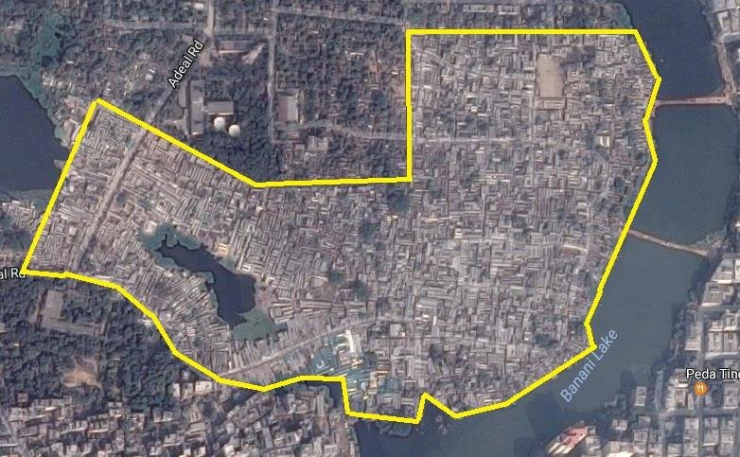
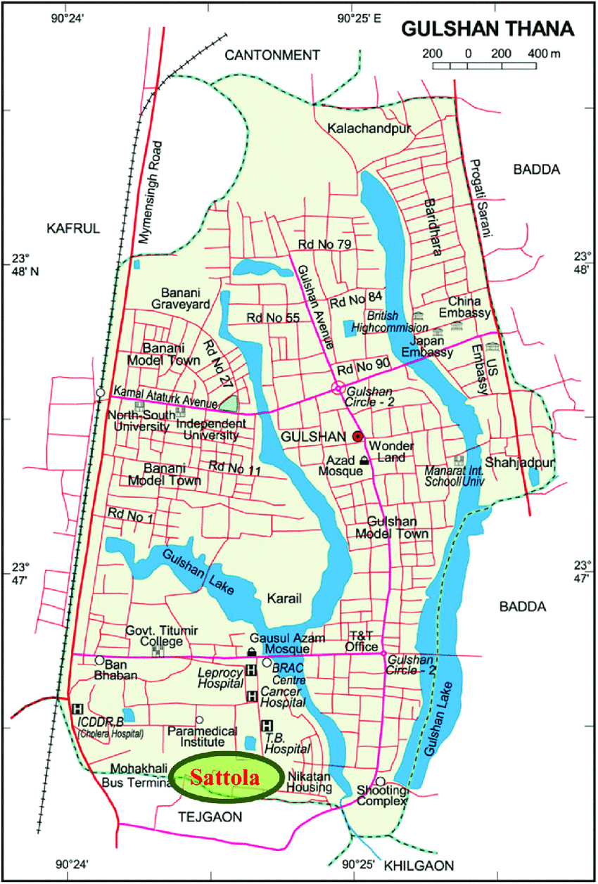
Study Side
Two Urban slum in Bangladesh
Karail Slum
Sattola Slum
Korail slum
Sattola slum

Slide 7
Study participant
Peoples who were involved in low-income generating activities, such as;
Rickshaw puller
Housemaid
job lost during COVID 19 (house wife)
Hawker
Day labor
Tea stall owner

Slide 8
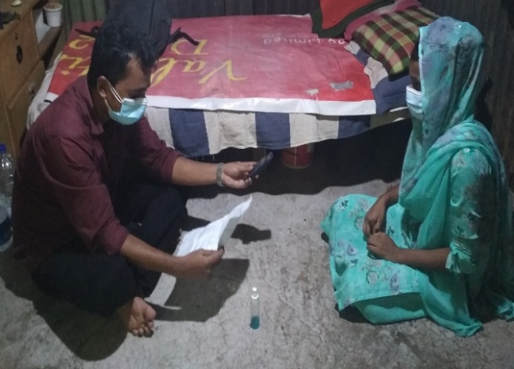
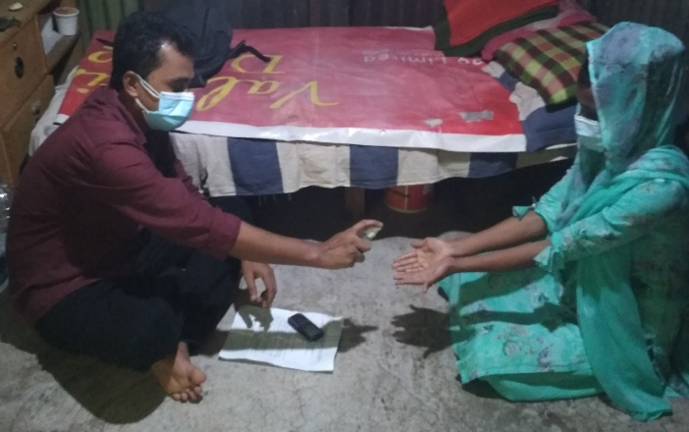
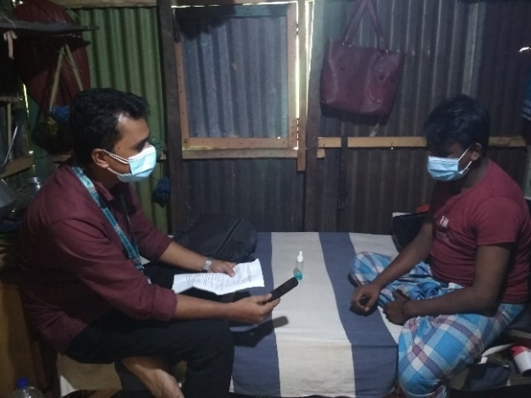
Data collection methods
In-depth interview
Observation (Tea stall, Street of slum & Daily market place)

Slide 9
Sampling and sampling technique
I used purposive sampling strategy to select study participants, considering their occupation and leaving in the slum.
Name of data collection tools | Total number
In-depth interview | 18
Observation | 10

Slide 10
Data collection procedure
Guideline development
Communicate with community leader
Select the participants & fixed a suitable time for interview
Receiving writing consent from participant
Identify new issues for further investigation
Summarization after immediate data collection
Conduct interview

Slide 11
Data Management
labeling all materials (recorded data, consent forms, observation note, and impression notes)
Back up of all data (recorded data and transcription) in the laptop and google drive

Slide 12
Data Analysis
Thematic data analysis strategies was performed for analyzing the data. I analyzed the data by the following steps:
Transcription
Refine codes
Re read text
Themes Identified
Thematic analysis/Interpretation
Read and code
Data display and reduction
Prepared a report

Slide 13
Result of the study

Slide 14
Participants Characteristics

Slide 17
Perception about corona virus
COVID 19 is a whooping cough, coldness, fever, headache. and it is way of wearing masks, washing hands
Coronavirus is nothing, when people get old then they get infected with various diseases and they die naturally.
Coronavirus is a political game.
Coronavirus is not for the poor, it's for the rich.
“I don’t understand that the coronavirus is present now or it is a political game. if the government is politicizing this issue then it is a problem. …politics means, a few days ago a minister (narendra modi) of India visited our country, the government did a lot of trouble for this minister with the huzur. Now hearing that the government will give lockdown again. So, what is this?” [IDI-03, Rickshaw puller, Male, Age:29].

Slide 18
Reason of COVID 19
Rich people embezzlement the rights of the poor, Allah has given COVID 19 disease to them.
People lost their vote casting right, and they got hurt, so Allah has given coronavirus.
Lack of good food after hard working
Passing lazy time and staying in air-conditioned room.
It is the punishment to the infidels for torturing the Muslims.
Fear of coronavirus.
“Suppose, someone got the COVID 19 but I didn't see him, touch him, and didn't go close to him but I am scared. Because of this fear, even if I stay away, I will be infected by the COVID 19” [IDI-05, Housemaid, Female, Age;40].
“I think the reason of many people die in the America and India is the God punishment. Allah has given punishment to the Hindus and the Jews because they are torturing the Muslim” [IDI-12, Hawker, Male, Age;24].

Slide 19
Spread of coronavirus
Through Sneezing, coughing of the infected person, uncleanliness, money, different products from market
Don’t believe that there is a disease called coronavirus
“I heard that coronavirus spreads through touch from one person to another. It can transmit at the time of talking of one person. But I don’t know how it spreads from talking & touching. Even I don’t understand. If you have the virus and I am touched by you then the germ can spread. I don’t know how it happens actually. Virus also gives birth. But I don’t believe that corona will spread from handshake” [IDI-10, Rickshaw puller, Male, Age;30].

Slide 20
Sign & symptom of COVID 19 patient
Coughing, diarrhoea, fever, vomiting, severe headache, throat ache & pain in the different parts of the body
Diabetics & high blood pressure are the symptoms of COVID 19 disease.
“Now new variant of coronavirus has been identified…. If high blood pressure, diabetics is seen, then it will be understood that he got corona virus. I have heard this TV news & from the local people” [IDI-11, Rickshaw puller, Male, Age;38].

Slide 21
Risk in COVID 19
Not at risk of COVID 19
They are poor people,
They earn by hard labour
Blessing of prophet SM & their parents always they have.
Few of them go out of their house for work, even they got sick.
‘’Neither of the two members of my family is not at risk by coronavirus. Because we are poor people, we are living by hardship… Allah’s mercy has upon us & prayers of my parents always. Allah will protect us” [IDI-17, Day labour, Male, Age;47]

Slide 22
Strategy for avoiding COVID 19
Need cleanliness, should avoid infected person, wear mask at the time of going outside.
Hand & face should be washed properly before eating food.
Nutrition should be increased in the body through eating fish, meat, vegetable, various fruits.
The faith on Allah & prophet, disease will not come
‘’We need to eat the good food (fish, meat, vegetables) to stay away from coronavirus. Consequently, calcium will increase in the body & body will be healthy. Then the disease will not come” [IDI-07, Housewife (she lost her job during COVID 19), Female, Age;20]

Slide 23
Perception about wearing mask and maintaining social distance
Wearing mask and maintaining social distance are nothing if the GOD gives disease
Mask is necessary to avoid bad smell and dust.
Social distance is not mandatory
Observational findings
Observe full of people without wearing mask & maintaining social distance in the tea stall, street and local daily market.
Those who wear mask, didn't wear masks properly. Putted the mask under their chin ‍and keep their noses out even after wearing masks.

Slide 24
“Wearing mask is good because dust don’t enter into nose…Only for this reason wearing mask is good. If God gives disease, then no one will be able to save if it is in the mother's womb….I wear mask so that dust, bad smell can’t enter into nose… The passengers don’t want to get in the rickshaw if I don’t wear mask. That’s why I wear mask but not for corona. I don’t believe that corona will not be got if we maintain three feet distance. …If Allah gives us the disease then the disease will happen even if it is 100 feet away. So, I think that there is no need of maintaining social distance, it’s better to remain together” [IDI-01, Rickshaw puller, Male, Age;30].

Slide 25
Treatment seeking behaviour during COVID-19 period
The local drug shopkeeper were closed
Fear of police they couldn’t go and admit severely sick patient in the hospital.
Lack of transport in the road to bring the emergency patient to hospital
Doctors didn’t give treatment to the patients without corona test
Doctors misbehaved with the patients
Unavailability of adequate doctors in the hospital
“My father’s had cancer during corona. But we couldn’t take him to the hospital in fear of corona… After communicating with hospital, doctor said that firstly corona test should be done, then treatment will be provided. We are poor people, so we couldn’t do the corona test for the lack of money. So, my father’s condition was deteriorating day by day. Then the nearby people said that my father got corona. But actually, my father didn’t get corona. Then he died after few days” [IDI-03, Rickshaw puller, Male, Age;29].

Slide 26
Economic factor
Loss of income during COVID 19 Period
Scopes of income source have been declined
Lack of passenger in the rickshaw
Scope of daily labour has decrease
Small business have been shut down
Salary has been decreased of the low paid service holders
job lost
“We don’t earn now like before. We earned by rickshaw pulling. Now how can we earn if the people don’t come outside… In this corona time I have sent my family in the village, now staying in the mess for saving house rent… Sold the five goats of my village house to run the family. Now this is the condition that, have to sell the cow which I have” [IDI-03, Rickshaw puller, Male, Age;29].
Practice of against loss of income
Take loan from relatives
Sold domestic animals
Living in the mess by sending family to the village
Rented low cost house in the slum
Decries the cost of their daily food.

Slide 27
Perception about COVID-19 vaccine
Vaccine might be protective (It is the result of scientific research)
vaccine is the way of killing people (only aged people those who has less lifetime)
Lack of believe on vaccine (God is the owner of all disease)
“vaccine is not important to protect from coronavirus. Because only Allah is capable to protect from the disease. If Allah gives us disease, vaccine can’t save us” [IDI-17, Day labour, Male, Age;47].
“Many people are not taking corona vaccine due to their fear. Because people will die after three months if they take this vaccine…. Vaccine is only giving to our locality who are seventy years old. They have less lifetime now. They are not giving vaccine to the children and the people like our ages”. [IDI-18, Day labour, Male, Age;30]

Slide 28
Willingness to receive COVID 19 vaccination
Few are interested to take vaccine
Most are not interested to take vaccine
Believe on GOD
Think that they are healthy, Vaccine not needed.
Relatives Prohibited them to not take the vaccine
“If the COVID 19 vaccine becomes available, I will not take the vaccine. Because I haven’t seen or heard that my father, any of my uncles, grandfathers or relatives died due to coronavirus. So why will I take injection (corona vaccine) without knowing about it. …Even I am not talking about it, many people are saying that Govt. is giving vaccine to the people to decrease population of the country. Because people will die after three months if they are given the vaccine. So, I will not take this vaccine out of this fear” [IDI-16, Tea stall owner, Male, Age;28].

Slide 29
Perception about wearing mask and social distance after receiving vaccination
A few of the respondents : Don’t need to wear mask and maintain social distance
Need to wear mask or maintain social distance in spite of taking vaccine: for safety
“I think there is no need to wear mask if the vaccine is taken. Because the vaccine has been taken to be safe from the disease. Then there is not need to wear mask or maintain social distance” [IDI-06, Housewife (Business lost) Female, Age;25].

Slide 30
Conclusion
The low-income urban people have limited knowledge about COVID 19 and its vaccine.
Those who have shown positive attitude toward COVID 19 but they don’t have practice about this.
The low in-come people are still in a life-threatening situation due to their lack of awareness, belief in religion and culture, belonging in low-income status, and their cramped and unhealthy housing condition.
The unrealistic perception and preventive practice about COVID 19 will hamper to maintain the precautionary measure of COVID 19.
The misconceptions regarding COVID 19 vaccine is another matter of concern

Slide 31
Recommendation
The Government of Bangladesh should increase the awareness campaign on COVID 19 among the low-income urban people.
Ensuring the acceptance of government allowances among all these low-income people during the lockdown period. As if during lockdown they do not come close in contact with the general people for their professional.
Communication messages must be designed to be interpreted easily for people with low literacy

Slide 32
Thank You

