Slide 1
WELCOME

Slide 2
EVALUATION OF FACTORS ASSOCIATED WITH ANTENATAL CARE OF WOMEN IN RURAL AND URBAN AREAS OF BANGLADESH

Slide 3
TAHANI JASHIM
Registration no: 1911312
DR. J.M.A. HANNAN
DEAN & PROFESSOR
INDEPENDENT UNIVERSITY, BANGLADESH

Slide 4
INTRODUCTION
HYPOTHESIS
VARIABLE
DISCUSSION
OBJECTIVE
METHOD
RESULT
CONCLUSION

Slide 5
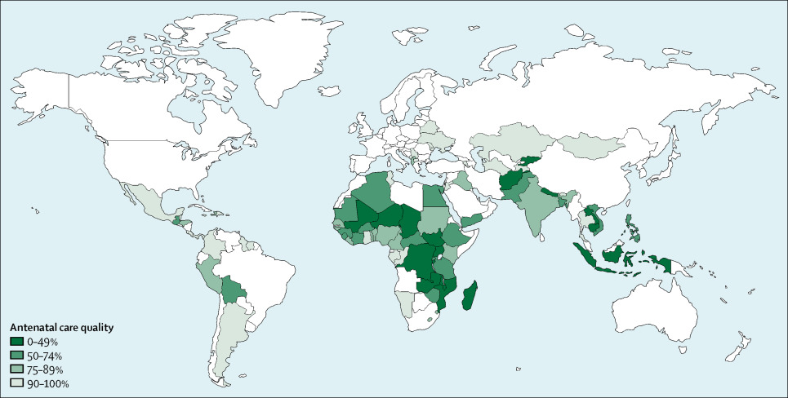
INTRODUCTION
INTRODUCTION
EQUITY IN ANTENATAL CARE QUALITY: AN ANALYSIS OF 91 NATIONAL HOUSEHOLD SURVEYS
https://www.thelancet.com/journals/langlo/article/PIIS2214-109X(18)30389-9/fulltext

Slide 6
INTRODUCTION
Antenatal care is the routine health control of presumed healthy pregnant women without symptoms (screening), in order to diagnose diseases or complicating obstetric conditions without symptoms, and to provide information about lifestyle, pregnancy and delivery.
As per the previous World Health Organization's (WHO) recommended Focused Antenatal Care (FANC) Model; under normal circumstances, a pregnant woman should have at least four ANC visits
women in the urban Philippines are 0.932 times more likely than women in the rural Philippines to make ≥4 ANC visits. On the other side, women in urban Indonesia are more likely 1.255 times than women in rural Indonesia to make ≥4 ANC visits

Slide 7
INTRODUCTION
The median age at first marriage among women age 20-49 has continued to rise slowly, increasing from 15.3 years in 2007 to 16.3 years in 2017-18. It is higher in the eastern divisions (18.1 years in Sylhet and 16.9 years in Chattogram) and lower in the western divisions (15.8 years in Khulna and 15.6 years each in Rajshahi and Rangpur). Fifty-nine percent of women age 20-24 marry before age 18 (legal age of
marriage).
The median age at first birth among women age 20-49 is 18.6 years. Forty-three percent of women gave birth before age 18.
Women in the urban Philippines are 0.932 times more likely than women in the rural Philippines to make ≥4 ANC visits. On the other side, women in urban Indonesia are more likely 1.255 times than women in rural Indonesia to make ≥4 ANC visits

Slide 8
OBJECTIVE
GENERAL OBJECTIVE:
The aim of the study is to find out the factors associated with number of antenatal visits of women, age above 18 years and below 18 years in rural and urban areas of Bangladesh
SPECIFIC OBJECTIVES:
To find out the socio demographics characteristics of women, age above 18 years and below 18 years in rural and urban areas of Bangladesh.
To compare the factors related to the number of antenatal visits of women, age above 18 years and below 18 years in rural and urban areas of Bangladesh
To determine the factors associated with antenatal care of women, age above 18 years and below 18 years in rural and urban areas of Bangladesh

Slide 9
HYPOTHESIS
Hypothesis:
The hypothesis of this study is antenatal care of women is affected by mother’s age.
Null hypothesis, H₀ = Women’s age has an association with her getting better antenatal care
Alternative Hypothesis, H_{A}= Women’s age has no association with her getting better antenatal care

Slide 10
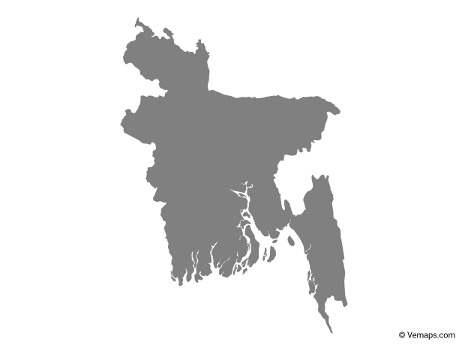
METHODOLOGY
Method:
This is a cross-sectional study.
Women aged between 15-49 years of age are the target population. A total of
20,250 households were selected for the survey (6,810 in urban areas and 13,440
in rural areas).

Slide 11
VARIABLE
Dependent:
Antenatal visit of women
Independent:
Division
Type of residence
Religion
Wealth index combined
Sex of child
Child’s Low birth weight
Antenatal visit to doctors
Respondent’s currently working status
Respondent’s education
Respondent’s husband/partners education

Slide 12
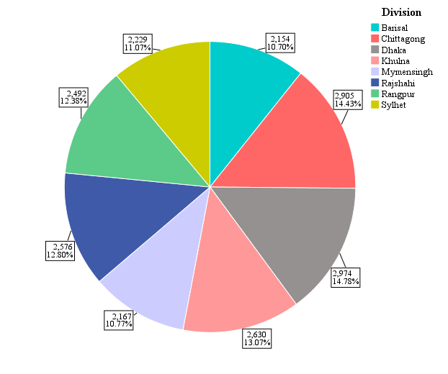
RESULT
DESCRIPTIVE ANALYSIS OF RESPONDENTS TO 8 DIVISIONS IN BANGLADESH

Slide 13
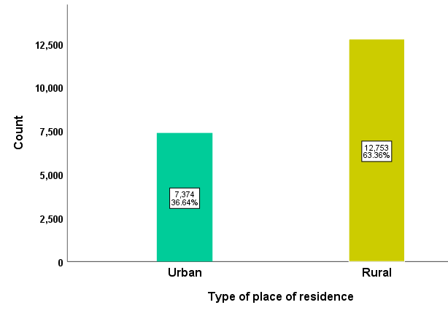
RESULT
DESCRIPTIVE ANALYSIS OF RESPONDENTS ACCORDING TO PLACE OF RESPONDENTS

Slide 14
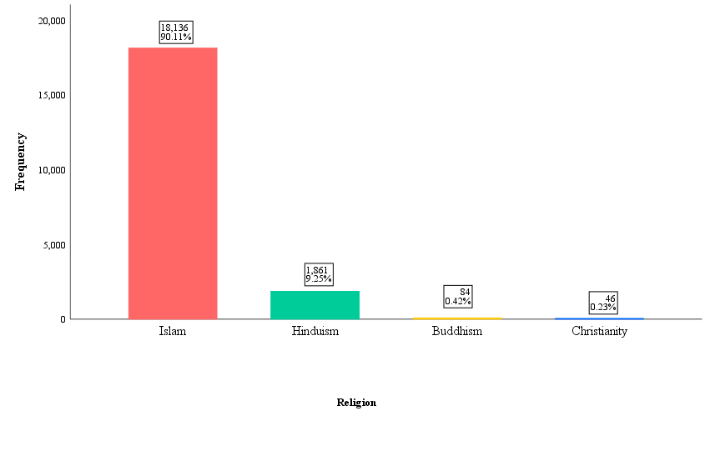
RESULT
DESCRIPTIVE ANALYSIS OF RESPONDENTS ACCORDING TO RELIGION

Slide 15
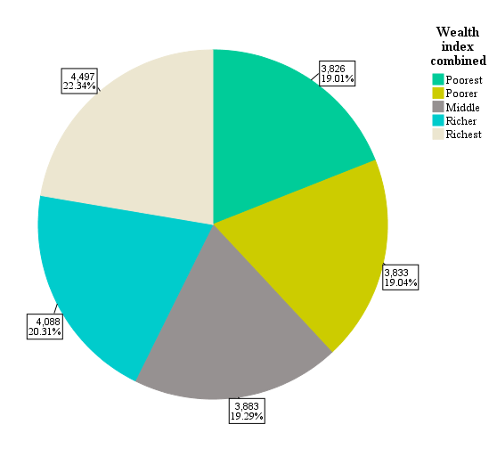
RESULT
DESCRIPTIVE ANALYSIS OF RESPONDENTS AS PER WEALTH INDEX

Slide 16
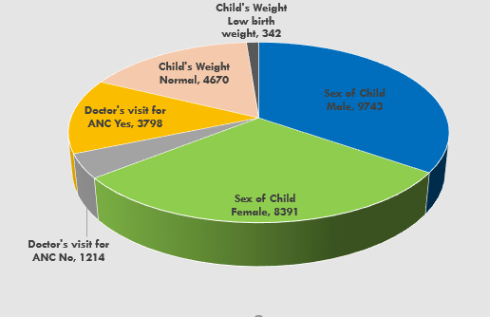
RESULT
DESCRIPTIVE STUDY OF RESPONDENT’S CHILD CHARACTERISTICS

Slide 17
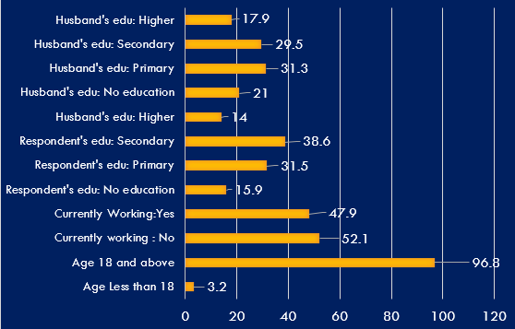
RESULT
DESCRIPTIVE STUDY OF RESPONDENT’S CHARACTERISTICS

Slide 18
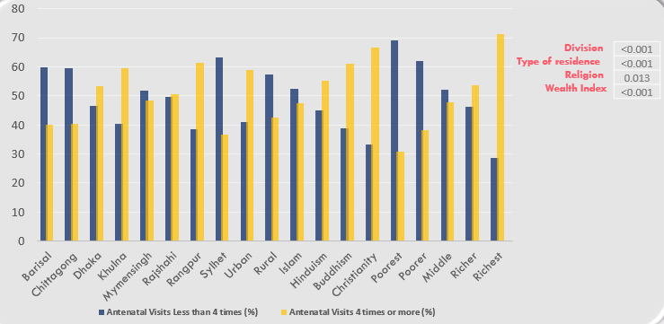
RESULT
BIVARIATE ANALYSIS BETWEEN NUMBER OF ANTENATAL VISITS AND ASSOCIATED VARIABLES OF RESPONDENT’S SOCIO-ECONOMIC CONDITION
P-value

Slide 19
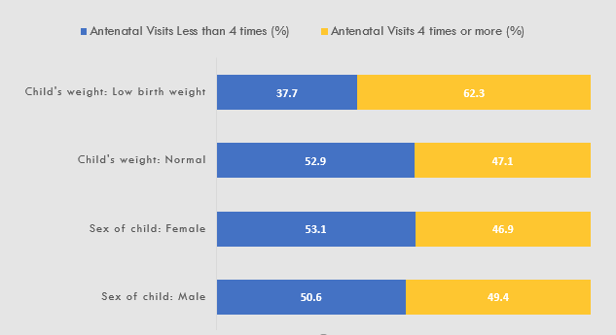
RESULT
BIVARIATE ANALYSIS BETWEEN NUMBER OF ANTENATAL VISITS AND ASSOCIATED VARIABLES OF CHILD CHARACTERISTIC
P-value
Child’s Sex
0.078
<0.001
Child’s weight

Slide 20
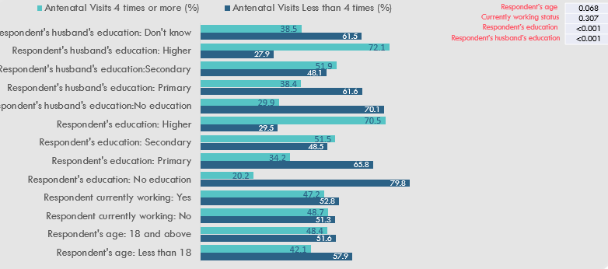
RESULT
BIVARIATE ANALYSIS BETWEEN NUMBER OF ANTENATAL VISITS AND ASSOCIATED VARIABLES OF RESPONDENT CHARACTERISTICS

Slide 21
RESULT
LOGISTIC REGRESSION OF RESPONDENT’S SOCIO-ECONOMIC CONDITION
According to division, Respondents who live in
Sylhet and Chittagong has respectively 8% and 21.3% lower odds of having 4 times or more antenatal visits than the respondent’s of Barisal division which is not significant as P value is respectively 0.058 and 0.533.
Dhaka, Khulna, Mymensingh, Rajshahi and Rangpur have respectively higher odds of having 4 times or more antenatal visit than of Barisal division, which are respectively 17.9%, 73.9%, 61.5%, 32.7% and 194.8%. But only Khulna, Mymensingh, and Rangpur as highly significant association as their P value is <0.001
According to place of residence, respondents who live in
Rural areas have 24.8% of lower odds of having 4 or more antenatal visit than the mothers living in Urban areas. Which is highly significant as P value is <0.001

Slide 22
RESULT
LOGISTIC REGRESSION OF RESPONDENT’S SOCIO-ECONOMIC CONDITION
According to wealth index, respondents who are
Richest respondents have 18.9% higher odds of taking 4 or more antenatal visit than the poorest. Respectively of Richer, Middle economic status and Poorer economic status mothers also have higher odds of taking 4 or more antenatal visit than of Poorest. Among them middle, richer, richest wealth index people are highly significant and p value is <0.001
According to religion, respondents who are
Hindu, Buddhist, and Christian mother have respectively 23.9%, 205% and 64.5% higher odds of taking 4 or more antenatal care during pregnancy than Muslim mothers. Which is significant for Buddhist as P value is 0.047 and not significant for Hindu and Christian as P values are respectively 0.07, and 0.503

Slide 23
RESULT
LOGISTIC REGRESSION OF CHILD CHARACTERISTICS
In case of female child, taking 4 or more antenatal care has 12.1% lower odds than of male child and its association is significant, p value is 0.041.
44.1% cases of low-birth-weight babies respondent’s has higher odds of taking 4 or more antenatal visit to doctors than the babies are of normal weight. Babies weight has association with better antenatal care as p value is 0.005

Slide 24
RESULT
LOGISTIC REGRESSION OF RESPONDENT’S CHARACTERISTICS
In case of age, Respondents who are aged 18 and above has 22.3% higher odds of taking 4 and more antenatal visit than who are of age less than 18. Age has significant association as p value is 0.194
In case of respondent’s current working status, Who are currently working has 16.6% higher odd of taking 4 or more antenatal visit to doctor than who are not working. It has significant association as p value is 0.026

Slide 25
RESULT
LOGISTIC REGRESSION OF RESPONDENT’S CHARACTERISTICS
Respondent’s education study shows, mother who has higher education has 190% higher odds of having 4 or more antenatal visit than who has no education also ration is higher also from who has primary education. Respondents’ education has significant association but secondary and higher education has highly significant association as P value is <0.001 for these two and for primary education, it is 0.001
In case of respondent’s husbands/partners educational level study those who has higher education has 94.6% higher odds of taking 4 or more antenatal visits for mothers during their pregnancy than who have no education or have primary education. Respondent’s husband’s primary education has no association as p value is 0.33 but who have secondary and higher education has significant association where higher education has highly significant association as p value is <0.001

Slide 26
DISCUSSION
In bivariate analysis, women from Rangpur division visits doctor more time than all other divisions and women from Sylhet division visits the least. But after fixing all other variables, multivariate analysis shows, women who are from Sylhet and Chittagong division has lower odds of visiting doctors for antenatal care among all other divisions of Bangladesh.
Women in rural areas takes lesser antenatal care than women in urban areas, and antenatal care’s association with their place of residence is highly significant. This result is same in both bivariate analysis and multivariate analysis.

Slide 27
DISCUSSION
Bivariate analysis shows Muslim women takes least antenatal care among women of all other religions where Christian women take the most, and antenatal care has significant analysis with religion. But after fixing all other variables, multivariate analysis shows, Buddhist women take the most antenatal care, visit doctors’ higher times for antenatal care but Muslim mothers has the lower odds of visiting doctors for antenatal care among all other religions.
Respondents who are richest, visits doctor fo more than four times thus takes better antenatal care than the respondents who are poorer. Wealth index’s association with number of antenatal visits is highly significant.

Slide 28
DISCUSSION
In case of female child, bivariate analysis show, respondent women get lesser antenatal care, visits doctor lesser times for antenatal care than when it is about male child. Taking more antenatal care is higher odds when it is male child and it has significant association. After fixing all the variables, multivariable analysis shows the same result.
Surprisingly birthweight data in bivariate analysis shows, women who visits doctor for more antenatal visit has low birthweight babies and who visit doctor less, has normal babies. But this has no significant association. But after fixing all other variables, multivariate analysis shows that women who visits doctor more for antenatal visit has higher odds of having low birth weight babies and it shows significant association between antenatal care and baby’s birth weight.

Slide 29
DISCUSSION
Bivariate analysis of respondent’s age shows some shocking findings. It shows women who are of age below 18, don’t visit much for antenatal care, and who are above 18, even they don’t visit doctor for antenatal care more times. Which is alarming but it doesn’t show significant association. But after fixing all other variables, multivariate analysis shows women who are 18 years and above shows higher odds of having antenatal care. Though it does not show significant association..
Respondent’s working status data study shows who are working has higher odds of taking more antenatal visit than who are not working and it has significant association. Result is same is both bivariate and multi-variate analysis

Slide 30
DISCUSSION
Bivariate analysis of respondent’s education and respondent’s husband/partners education level data shows, if respondent and respondent’s husband have higher education, respondent gets more antenatal visit. If respondent and respondent’s husband have primary or no education, respondent gets lower antenatal visit. Bivariate analysis shows highly significant association between education level and number of antenatal visit. After fixing all other variables, multivariate analysis shows some interesting findings.. Respondent’s primary education has significant association with number of antenatal visit but secondary and higher education highly significant association with it. On the other hand, respondent’s husband’s primary education has no significant association with respondent’s getting more antenatal visit to doctor, secondary education has significant association and higher education has highly significant association of respondent’s more antenatal visit

Slide 31
LIMITATION
Antenatal care is very important for both mother and baby. For this study we have chosen proxy variables according to BDHS 2017-2018 report, this way
we might missed some important variables which could give a better finding. Another limitation could be the
Missing values in respect to independents variables, we might miss some important values, some other variables.
There could be some errors in BDHS data entry as it is a national level survey, some could possibly be there.

Slide 32
CONCLUSION
In Bangladesh,
Respondent from Sylhet and Chittagong division has lower odds of taking low antenatal care
In the rural area women take less antenatal visit than who are in urban area.
Muslim respondents go for less antenatal visit than women of other religion, which is alarming.
Discrimination between male child and female child has significant effect here as for male child, women go for more antenatal visit, whereas for female child it is exactly opposite.
Women who goes for more antenatal visit, takes more antenatal care has higher odds having low birth weight child.

Slide 33
CONCLUSION
Respondent’s age shows who are above 18 years old takes more antenatal visits than who are below 18 years old.
Though people think working mother’s child don’t get better care, in this study we’ve got women who are working, they go for more antenatal visit than who are not working.
Education plays Significant role in antenatal care. If husband and women both are highly educated, then those women go for more antenatal visit, but when respondent’s husband and respondent, both have primary education, they don’t go for more antenatal visit, means, in that care respondent don’t get better antenatal care.
In conclusion, it can be said, both in rural and urban areas there are some factors having association with respondent’s antenatal visit and getting better antenatal care.

Slide 34
RECOMMENDATION
For future analysis, it is recommended to study with primary data to see more accurate result
Further analysis can be done to see if child’s birth order has association with getting antenatal care
Respondent’s husband’s economic status and his birth order in the family can also be a good analysis to check association with respondent’s antenatal visit
For further study, association between antenatal care and autism can also be checked.
If doctor’s gender preference has any association with antenatal care, can also be a good topic for further study

Slide 35
THANKS
FOR YOUR TIME

