Slide 1
Breast cancer Research in Bangladesh over the past decade-A Narrative Review
Submitted by
Heba Hoque
Matriculation ID- 1711466
Bonn, 12th March,2023

Slide 2
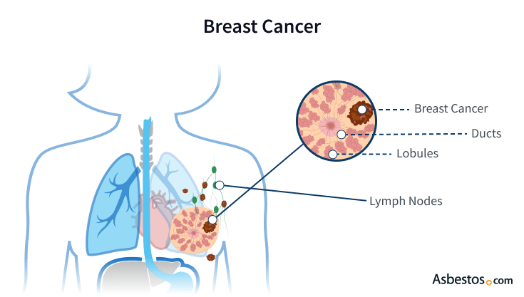
Introduction
Breast cancer remains a leading dreadful cancer of women in Bangladesh. It has become a hidden burden that accounts for 69% of the death of women.
The breast cancer burden in Bangladesh is so high that is has become a major Public health concern.

Slide 3
Background
The narrative review looks through the research from 2012-2022, which has been conducted on the following topics, to find several points. E.g.:
Where is the social barrier that leads to breast cancer one of the major Public Health concerns?
In the research carried out between 2012-2022, We looked for the socio-demographic barrier to determine the gap and the relation associated the breast cancer.

Slide 4
Screening Criteria
The screening criteria which was considered during the review are:
The only study was conducted in Bangladesh over the timeline of ten years.
The study was conducted in English and was selected for this paper.
The study looked at Knowledge, attitude, socio-demographic situation, sources of information, perception, and patient doctor situation.

Slide 5
Prevalence
In Bangladesh the rate of breast cancer occurrence is estimated to be 22.5 per 100000 females of all ages.
In the case of Bangladeshi women aged between 15-44 years, breast cancer has the highest prevalence, 19.3 per 100000, compared to any other type of cancer.
In Bangladesh, the maternal mortality survey (2010) cited that breast cancer was responsible for 21% of death of women between 15-49 years of age.

Slide 6
The cause which is leading to BC
The incident rate grows up day to day due to the unawareness of the people.
Along with a lack of confidence in medical treatment, improper screening, maltreatment, and lack of motivation to undergo institutional treatment and management.
Furthermore, because of poor socio-economic infrastructure and atmosphere, which loom large for the social stigma and instilment of fear among the patient, they keep themselves aloof from taking treatment of the patient with cancer.

Slide 7
BC mortality and socio Demographic relationship
In the last twenty years, Bangladesh has experienced an approximately five-fold increase in per capita income and a two-fold increase in literacy.
A general decline in physical activity has occurred over the past few decades due to the quick adoption of technology, heavy reliance on electronic communication, and the emergence of online activities.
In addition, the incidence of overweight and obesity among Bangladeshi women is rising due to increasing fast food consumption.
The contribution of hormones, particularly estrogens, and the formation and development of breast cancer heavily influence risk factors, which may also be the unifying denominator behind the numerous reproductive factors connected to breast cancer.

Slide 8
SL. | Name of the Study | Research year
1. | Improving Outcomes from Breast Cancer in a Low-Income Country: Lessons from Bangladesh. | 2012
2. | A Narrative Review of the Confluence of Breast Cancer and Low-wage Employment and Its Impact on Receipt of Guideline-recommended Treatment. | 2013
3. | Breast cancer in South Asia: A Bangladeshi perspective. | 2014
4. | Lack of Understanding of Cervical Cancer and Screening Is the Leading Barrier to Screening Uptake in Women at Midlife in Bangladesh: Population-Based Cross-Sectional Survey. | 2015
5. | Epidemiology of breast cancer among the female patients in Bangladesh. | 2016
6. | Authors' response to Letter to the Editor on awareness of breast cancer and barriers to breast screening uptake in Bangladesh: A population-based survey. | 2016

Slide 9
SL. | Name of the Study | Research year
7. | A major flaw in "Awareness of breast cancer and barriers to breast screening uptake in Bangladesh: A population based survey". | 2016
8. | Awareness of breast cancer and barriers to breast screening uptake in Bangladesh: A population based survey. | 2017
9. | Age distribution pattern of female breast cancer patients in Bangladesh- developing early and presenting late. | 2018
10. | Epidemiology based study on the risk factors of breast cancer research: the Bangladesh perspective. | 2018
11. | Two-Phased Strategy for Improvement of Breast Cancer Care in Bangladesh. | 2018

Slide 10
SL. | Name of the Study | Research year
12. | Knowledge, Attitude and Practice of Bangladeshi Women towards Breast Cancer: A Cross Sectional Study | 2019
13. | A hospital based survey to evaluate knowledge, awareness and perceived barriers regarding breast cancer screening among females in Bangladesh | 2020
14. | Risk Factors and Barriers of Early Breast Cancer Diagnosis and Treatment Outcome in Tertiary Level Hospitals in Bangladesh | 2021
15. | A Cross-sectional Study on Breast Cancer among the Bangladeshi Female Population. | 2022
16. | Knowledge and perception of breast cancer among women of reproductive age in Chattogram, Bangladesh: A cross‐sectional survey. | 2022
16. | Association of Distance, Region, and Insurance with Advanced Colon Cancer at Initial Diagnosis | 2022

Slide 11
Gap that has been found during review:
Data were adequate to find the cause, That breast cancer is the leading cause of death among women. However, the gap results are some factors which are given below:
KAP, Improvement of treatment facilities, Destigmatize of the doctor-patient relationship.
Most importantly, family and friend support should allow women to feel the treatment is available.
Successful awareness campaign to shape the health risk perception.

Slide 12
Conclusion
The most common perceived impediments were shyness, fear, lack of information, and lack of awareness campaigns.
This study’s findings indicate that appropriate, suitable, and socially acceptable breast cancer awareness initiatives will help raise knowledge and awareness, addressing the barriers among females in Bangladesh.

